Slide 1
A Systematic Approach to Capturing State Agency Information

Slide 2
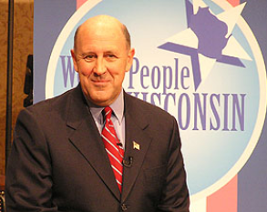
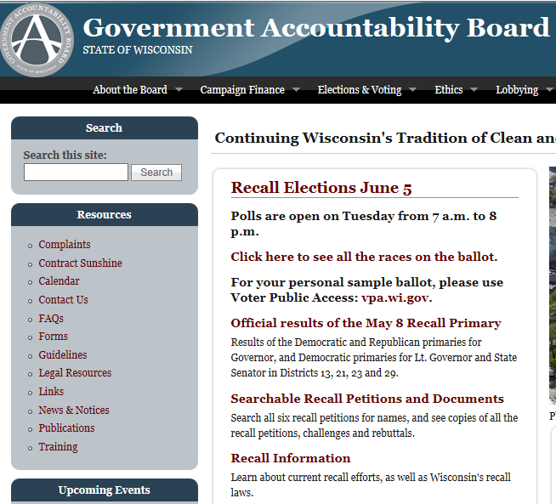
Background
WHS joined Archive-It in the fall of 2010
Began capturing state information with the capture of Governor Jim Doyle’s websites at the end of the administration
“Just in time” collecting

Slide 3
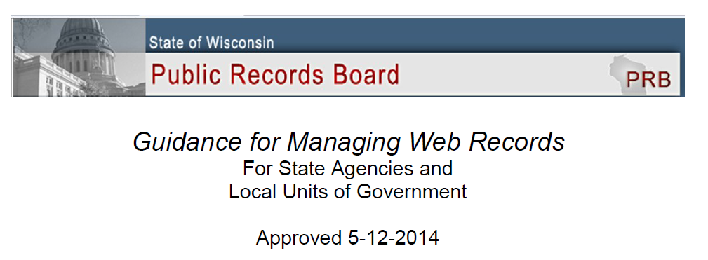
Guidance for Managing Web Records
Defines web records
Outlines roles and responsibilities for managing web content
Discusses retention and disposition of websites
Recommends “capturing web content to document compliance with state laws and regulations”

Slide 4
Phase 1 (What do we have?)
August 2013 start up
All agencies added as seeds
Metadata was added (Dublin Core)
Initial site evaluations completed
Ended September 1, 2013

Slide 5
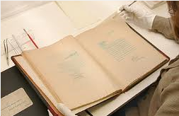
Phase 1.5 (Appraisal)
Traditional archival VS. Big bucket
appraisal appraisal

Slide 6
Big Bucket Considerations
How frequently the site appears to be updated
Information roll-off
Use of the site (publish vs. active communication)
How active is the agency
Political interest/activity of the agency
Likelihood of transfer of other materials
Relationship of items on website to collection items
Agency determination of record status items on the website
Size of crawl/percentage of budget

Slide 7
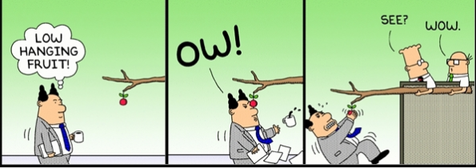
Phase 2 (Kick-off!)
March 2014 start up
Staffing Change
Developed tracking methods
Begin with low hanging fruit

Slide 8
Tracking Seed Decisions

Slide 9
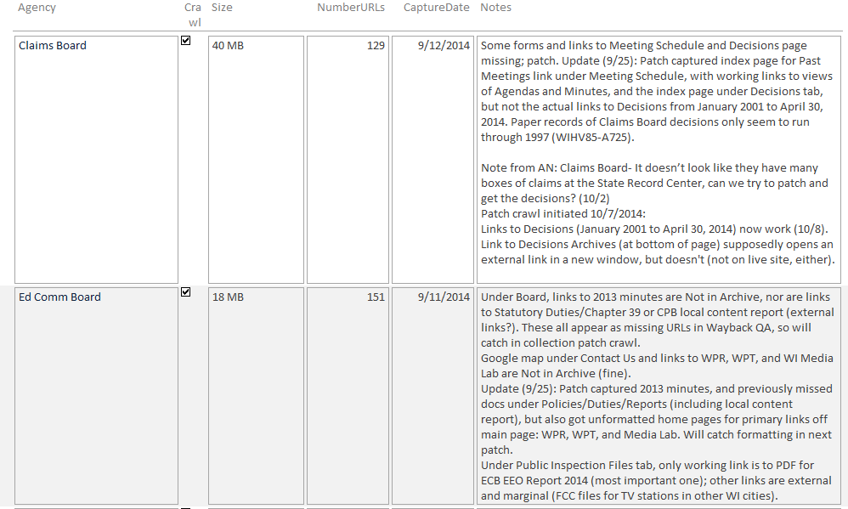
Tracking Crawl Data

Slide 10
Low Hanging Fruit
Small agencies without complex content
Sites with few links, PDFs, videos, and other formats

Slide 11
What We Ended Up With …..
Monthly crawls- 6 agencies
Quarterly crawls- 17 agencies
Semi-annual- 16 agencies
Annual - 37 agencies

Slide 12
Agency Response (thus far…..)
The fact we are crawling their websites……
Frequency of crawls……….
More communication…….

Slide 13
Next Steps
Completing the scheduled crawls
Issuing a program year-in-review
Cataloging crawls

Slide 14
Thank You! Sarah Grimm sarah.grimm@wisconsinhistory.org
Collecting, Preserving and Sharing Stories Since 1846

