Slide 1
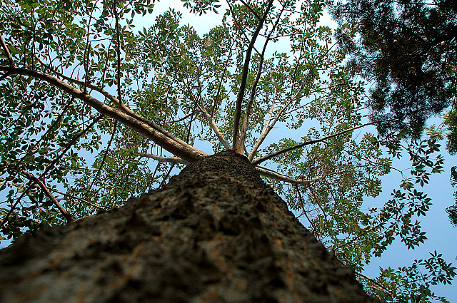
Looking Ahead
Archive-It
Partner Meeting
November 18,
2014

Slide 2
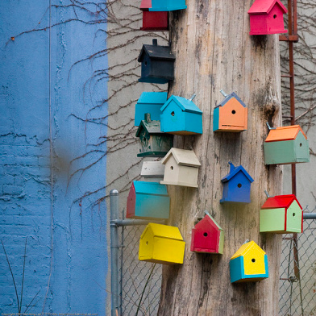
Looking Back 2014
UMBRA
Launched 5.0 phase 1
  UI
  Reports
  Google Analytics
  Backend Infrastructure
Notes:
Anything else we want to highlight?

Slide 3

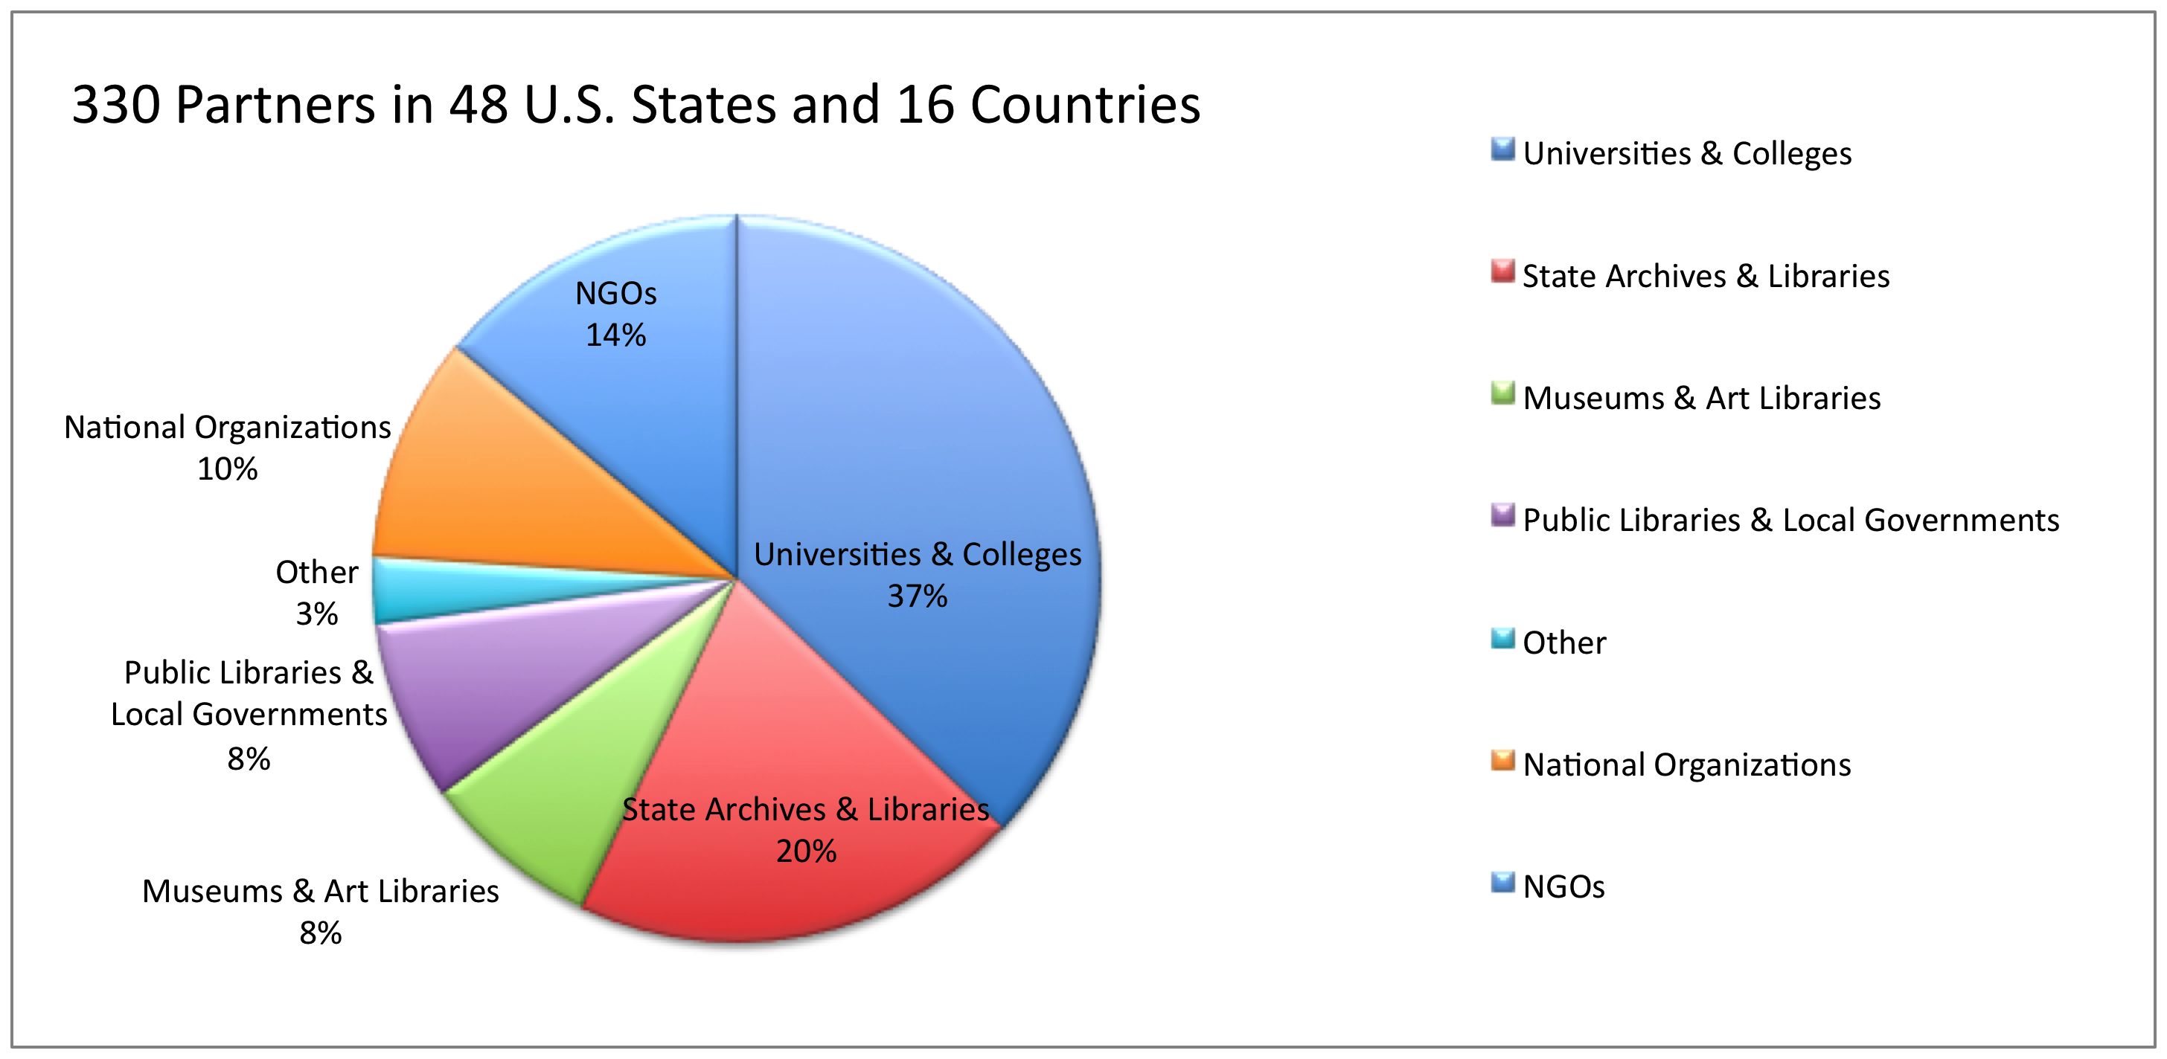
Archive-It Partners

Slide 4
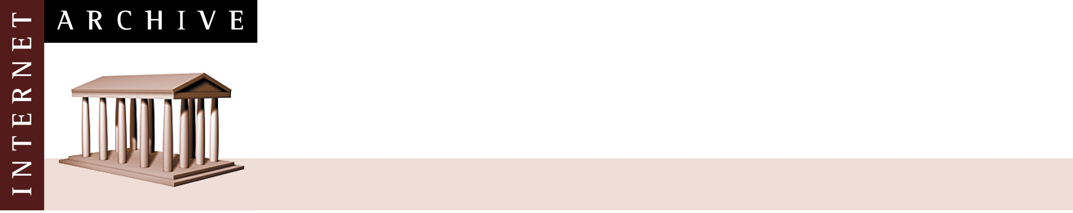
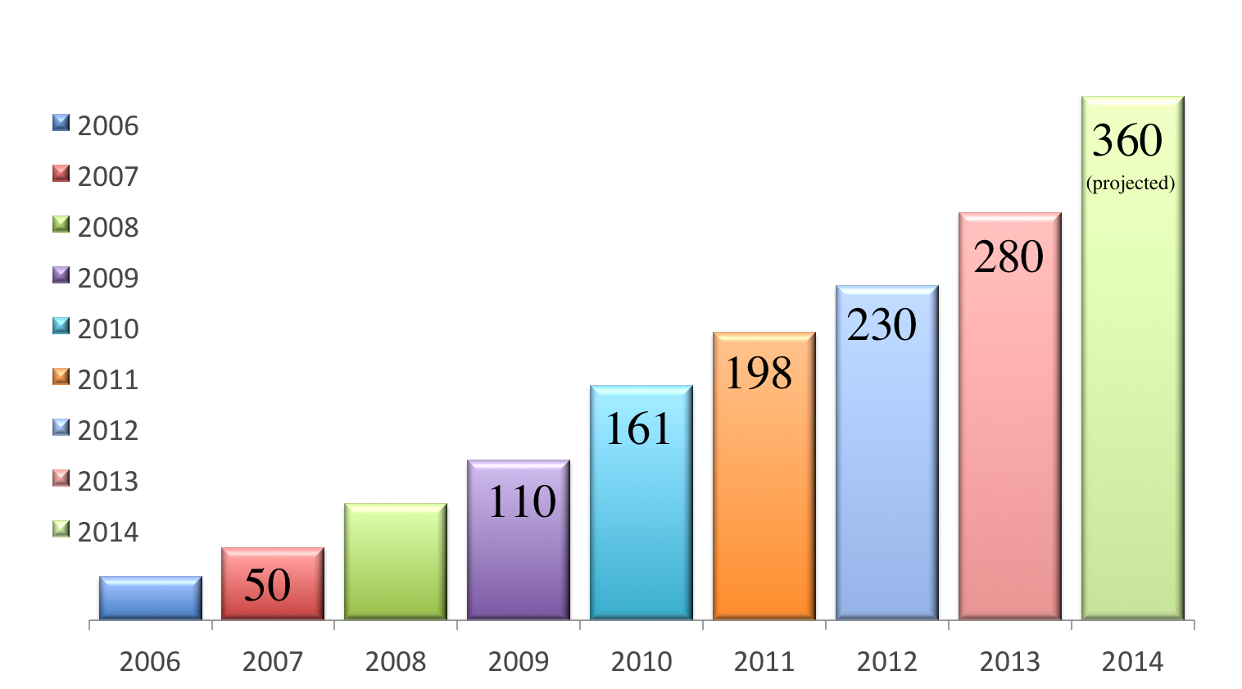
Archive-It Partners 2006 – 2014
80
30

Slide 5
User groups
Mid-Atlantic Archive-It Users Group
First group met in November at Temple University
Upcoming locations:
New York
Minneapolis/Twin Cities Colorado/Wyoming Wisconsin North Carolina Seattle Los Angeles
Southwestern
Interested in organizing a group? Email Scott: scott@archive.org
Notes:
*Use these to send requests/ideas/ to AIT team (how do we set this channel up for them and us so streamlined) google doc? Email list serve? 5.0 forum in zen desk?

Slide 6
Educational Partnerships
Graduate students use Archive-It in (primarily) Library Science classes
Programmatic Content
Spontaneous Collections
Crowd sourced, collaborative collecting on national and international events
Researcher Services
Will make available datasets derived from partner collections that can be given to patrons and researchers for large-scale analysis

Slide 7
UMBRA
Works together with Heritrix
Allows Heritrix to access sites in the same way a browser would.
a flexible way to imitate human interactions with Web sites

Slide 8

5.0 phase 1 –
User Interface
New User Interface
Cleaner layout and aesthetic
More intuitive
User friendly
Highlights important features
Streamlined work flow
Dynamic charts and visualizations to summarize and communicate key crawl, collection, and account information
Notes:
The new UI features a cleaner layout and aesthetic that is more intuitive, user friendly, better highlights important features, and streamlines the work flow for users. It also features dynamic charts and visualizations that help summarize and communicate key crawl, collection, and account information.
Ted our designer and Solomon our UI specialist. Many of you may remember Solomon who came to last years partner meeting. Your feedback on the interface and ideas for design and functionality was very very important in this development.

Slide 9
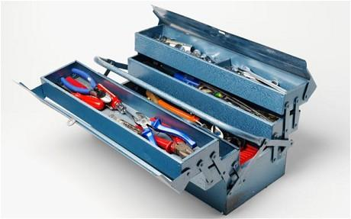
5.0 phase 1 –
Under the hood
How did we build it?
Druid: a real time data store
Django: Python framework
AngularJS: Javascript frontend
Notes:
These are the software tools that we used to develop 5.0.
Druid- Is what we use processes reports data allowing us implement the new reports interface with more visual components like graphs and charts. Druid is real time exploratory analytics system that works on large datasets stored in Hadoop. Vinay and our web application developer, James put in long hours wrestling with Druid and making sure it served our needs, so thank you to them for their work.
Django python framework that used to build the software that powers 5.0
Works hand in hand with AngularJS . This open source web application framework that builds the frontend for the Archive-It 5.0 Application.

Slide 10
5.0 phase 1
Watch the training
https://archive.webex.com/archive/ldr.php?RCID=98c869cf909e8889ed5ee829c2a037f8
Releases notes
https://webarchive.jira.com/wiki/display/ARIH/Archive-It+5.0+Phase+1+Release+Notes

Slide 11
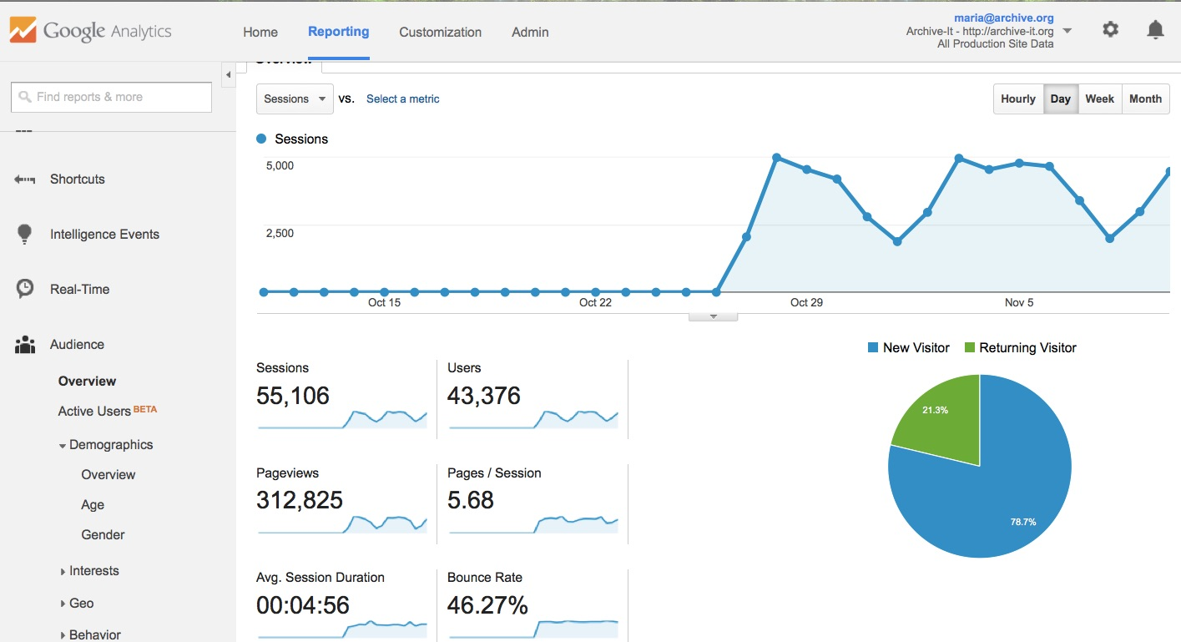
Access Statistics

Slide 12
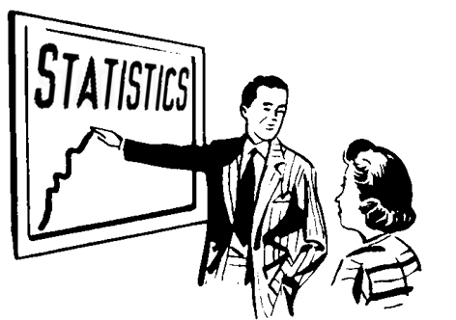
Google Analytics
Number of sessions, users, average session duration, pageviews and browser & operating systems
Traffic to all of your publicly available collections on archive-it.org
Notes:
This feature was lead by our engineer Kelsey, so thanks to Kelsey for pushing this one through!
Now going to turn it over to Lori who is going to talk about 5.0 Reports and what’s on the horizon for 5.0 coming up in 2015

Slide 13
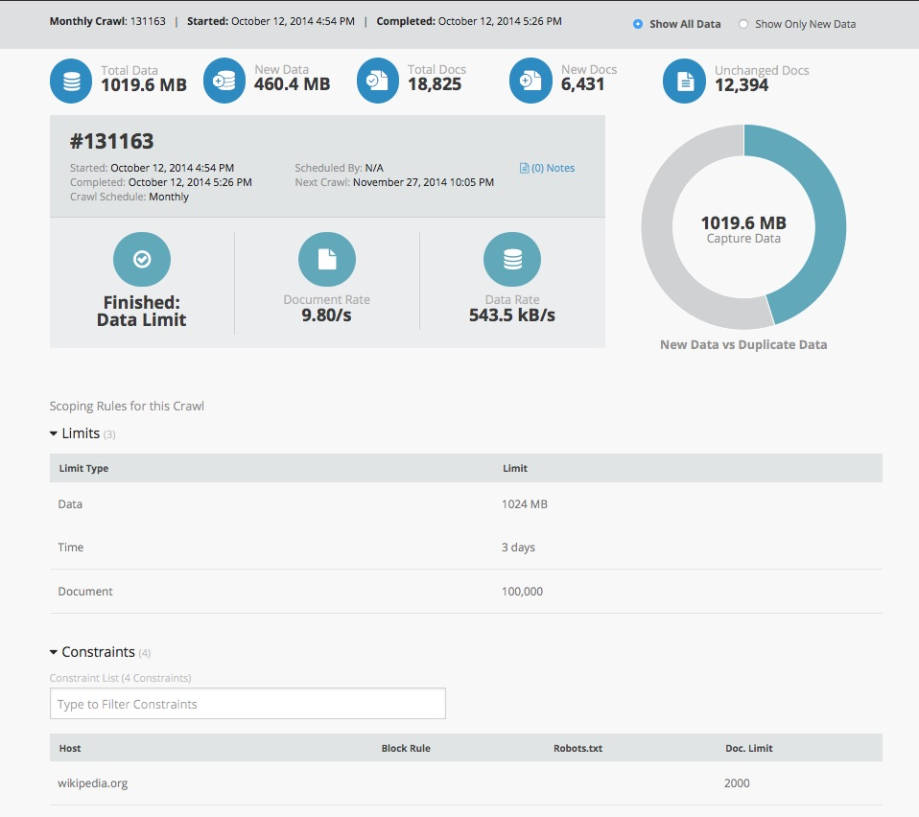
5.0 phase 1: Reports

Slide 14
Top 10 things about 5.0 reports
Quick filter and search reports
Infographics
New information: who started a crawl
New information: Scoping rules in place at the time of the crawl
Add individual notes for specific crawls, and search notes
Browse hosts by Seed
View archived URLs in Wayback directly from the report
Analyze and browse crawled documents by File Type
Compare the results of two crawls side by side
Toggle between All and New Data

Slide 15
New Data in 5.0!
Crawls started after September 9th, 2014 have new information collected & displayed in 5.0.
  Scoping Rules in place for the collection at time of crawl
  User that started or scheduled the crawl
  User that stopped a crawl (if applicable)
  Next crawl scheduled (if applicable)
When comparing crawls, the above information will not be available for crawls started before 9/9/2014, in addition you will not be able to compare the seeds crawled.

Slide 16
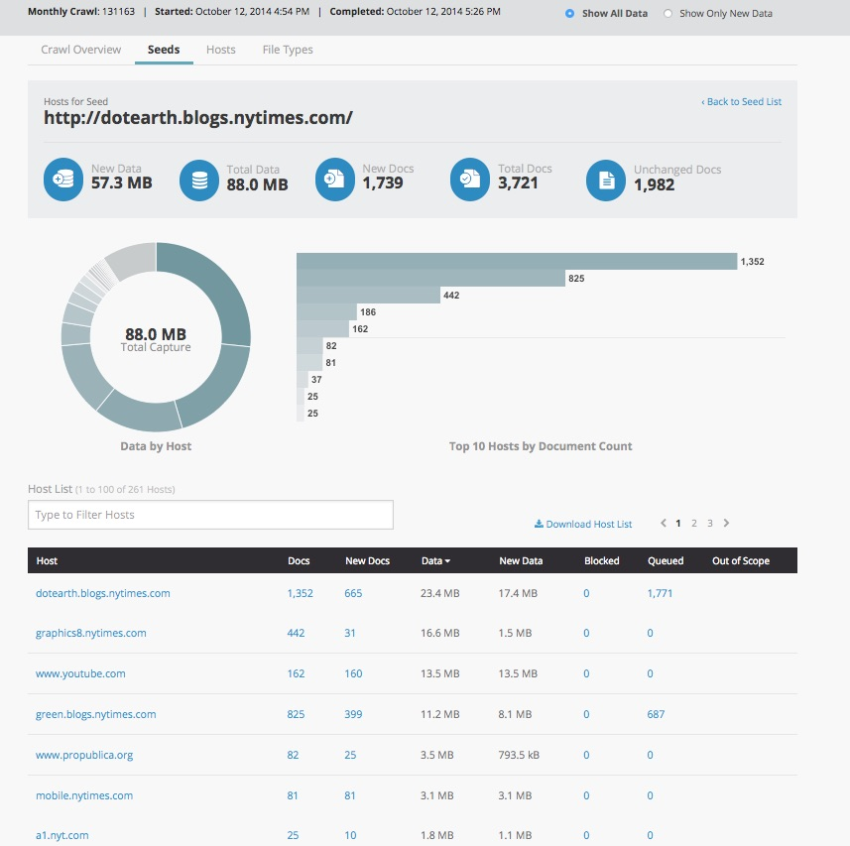
5.0 phase 1: Reports

Slide 17
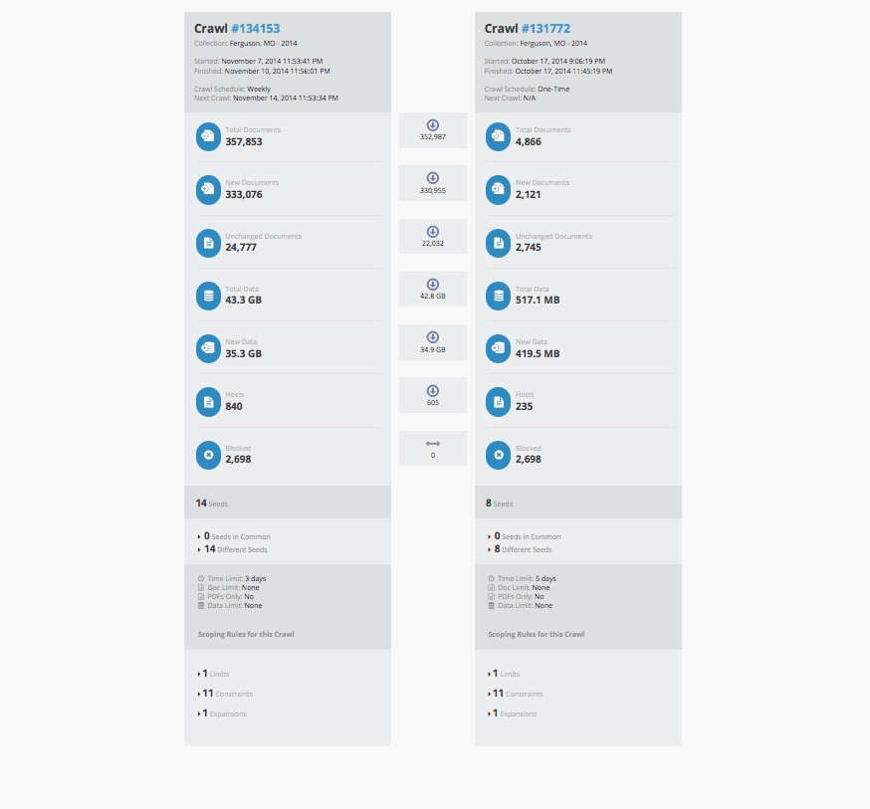

Slide 18
Looking Ahead 2015
Complete 5.0
Launch Researcher Services
Search tools
Regional User groups
Spontaneous Collections Initiative

Slide 19
5.0 winter release
Harvesting
– All crawls will have the option to to keep data as part of a collection or delete within a set period of time (tentatively 30 days).
– Embargo periods for collections and/or specific seeds (ability to pre- designate a specific length of time, ie. 3 or 6 months)
– Ability to resume crawls that have stopped or hit the time limit
– View a list of URLs being crawled in real time
Collection Management
– Improved import of metadata, including detailed error reports and confirmation of changes/additions
– Export of metadata, including ability to export metadata in a spreadsheet.
Access
- Firefox plugin

Slide 20
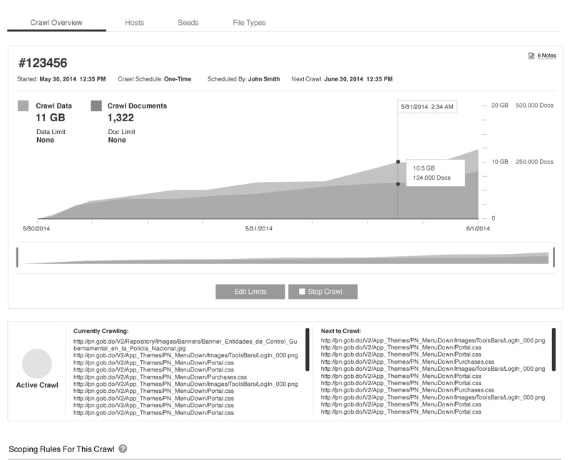
Data on Current Crawls

Slide 21
5.0 summer release
(June/July 2015)
Remaining visual and UX redesign of the web application
Web application designed to optimize experience on a variety of screen types including iOS tablets.

Slide 22
5.0 Summer release
Collection Management
– Ability to move and share seeds between collections
– Refined scoping rules, including option to apply only to specific seeds and frequencies
– Customizable user roles
– Streamlined metadata entry (ability to see previously/commonly used terms, linked data options, auto- populate metadata fields)
– Ability to rank metadata facets manually on public site
– Improved automatic extraction of metadata (especially embedded metadata from PDF files)
– View detailed seed history information, including crawl history and post crawl reports.
– Ability to archive/export specific file types such as PDFs or images

Slide 23
5.0 summer release
Access
– Enhanced integration with General Archive at www.archive.org
– Updated Wayback look and feel (banner, calendar page, etc.)
– Linking related/same pages on Wayback calendar (example: changed URL for identical site)

Slide 24

How to get involved
We want to hear from you!
Use our feature request forum: https://support.archive-it.org/categories/20126763-Archive-It-5-0-Feature-Requests
Join our user development group
Write a blog post

