Slide 1
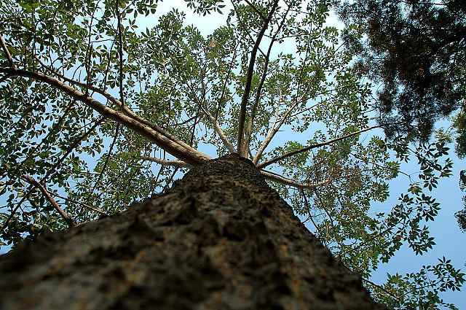
Looking Ahead
Archive-It Partner Meeting
November 12,
2013

Slide 2
Looking Ahead
2014
5.0 overhaul of UI and web application
Increased researcher tools
“Meet-ups” in mid-atlantic and mid-west regions
Birds of a Feather at regional conferences

Slide 3
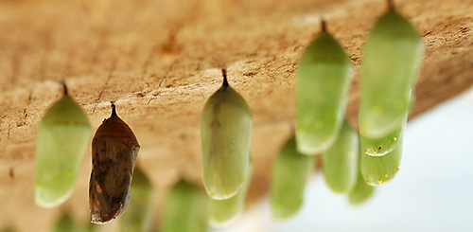
Looking Ahead Archive-It 5.0
User Interface Complete redesign of look & feel (more straightforward and streamlined)
Harvesting -Alternate capture mechanisms -Ability to schedule crawls on a calendar -Ability to browse a crawl in real time
Access -Update Wayback look and feel (Banner, Calendar page, linking related pages) -More refined access options -Continuing transition to SOLR for search functionality -Access statistics for collection use

Slide 4
Looking Ahead Archive-It 5.0
Collection Management and Scoping
Splitting, sharing and merging collections and seeds
Collecting data temporarily for test crawls
More refined scoping rules for seeds
Crawl history by seed
Integrating other metadata schema (including MARC and MODS)
Improved metadata functionality
Ability to remove 'out of scope' or unwanted content from your collection
More functionality in reports (scoping directly from the host report)
Improved QA tools

Slide 5
Looking Ahead: Social Media Archiving
Goals before end of year
Best possible capture and display using current crawling mechanism, including testing alpha features of alternate capture mechanisms with interested partners.
Goals before and leading up to 5.0
Integrate beta versions of alternate capture mechanisms into web application.

Slide 6
Looking Ahead Capture
“Ghost”
Rather than automated crawl, a browser based tool that mimics behavior of user and archives what the “Ghost” sees.
API
Communication link between software applications
Heritrix
Still a robust crawling solution able to capture most content, including JavaScript.

Slide 7
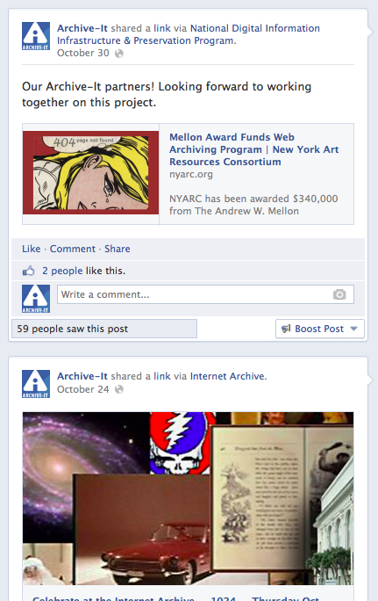
Social Media Archiving
Facebook
Today: Able to capture most data from a Facebook feed, including scroll downs using Heritrix
Alpha: Currently testing Ghost and API to enhance robustness and completeness of captures. If partners are interested they can provide AIT support team a collection # and URLs to test .
Beta: Ability to automatically capture Facebook feeds via alternate capture mechanisms through web application

Slide 8
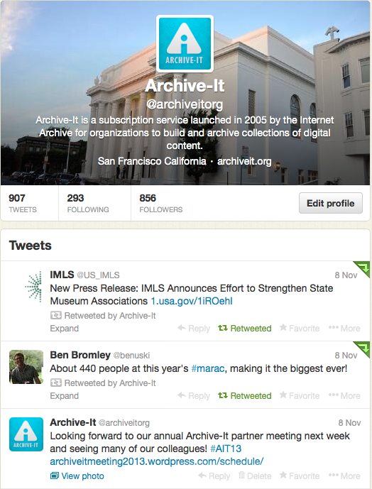
Social Media Archiving
Twitter
Today: Can capture all tweets in timeline for a specific user, and scroll down is now functional.
Alpha: API to easily archive and search Twitter feeds designated by Partners.
Beta: Ability to capture Twitter feeds via API through web application

Slide 9
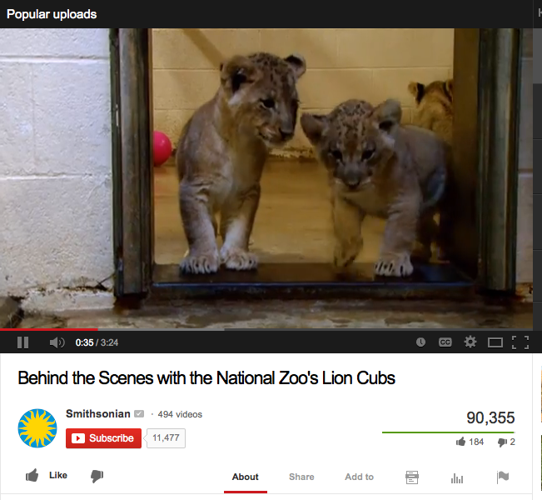
Social Media Archiving
Youtube
Today: More robust and focused capture of Youtube Channel seed URLs.
Beta: Improved playback of Youtube channels, including ability to play multiple inline videos
Investigating Playlist functionality on Youtube seeds for improved playback of multiple videos in single URL.

Slide 10
Social Media Archiving
Vimeo
Alpha: Currently developing capture mechanism for Vimeo using Ghost, determining robustness and completeness of captures. If partners are interested they can provide AIT support team a collection # and URLs to test.
-Using Ghost we can capture one video at a time
-Working on capturing entire channels
-Creating similar functionality to Youtube
Beta: By the end of the year, partners capture Vimeo content themselves via web app.

Slide 11
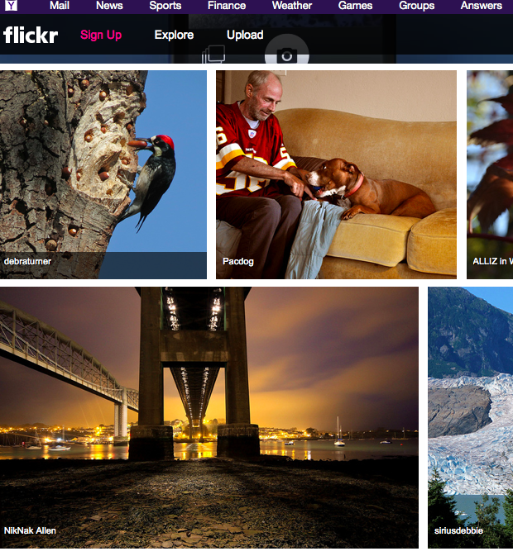
Social Media Archiving
Flickr
Today: Able to capture image files from Flickr seed URLs.
Working on capture and playback through Ghost, and making progress. It is ongoing challenge since recent redesign of site, due to complex Javascript.
Also investigating API to capture all image files, with potential custom interface to browse and search photos.

Slide 12
Social Media Archiving
On Our Radar
Instagram, Vine, Google+
Additional training and documentation

Slide 13
Types of respondents
Notes:
Goal of preparing for Archive-It 5.0
53 respondents
13 questions

Slide 14
Frequency of use

Slide 15
Actively crawled collections

Slide 16
Difficulty of web application

Slide 17
Most used features

Slide 18
Least used features

Slide 19
Brainstorming
25 Minute Brainstorming Session
Pain-points
Capture
Collection management (inc scoping)
Access (inc playback / search)

