Slide 1
Archive-It and CINCH tool: Using web harvesting to facilitate born-digital preservation
Kathleen Kenney
Archive-It Partners Meeting 2012

Slide 2
State Library of North Carolina
Collection: State government, genealogy, North Caroliniana
Support: All North Carolina libraries
Services & Materials: for those with visual/physical disabilities

Slide 3
State Library of North Carolina
Collection: State government, genealogy, North Caroliniana
Support: All North Carolina libraries
Services & Materials: for those with visual/physical disabilities
North Carolina General Statute 125
The State Library shall be the official, complete, and permanent depository for all State publications…

Slide 4
Session laws
North Carolina General Statute 125
The State Library shall be the official, complete, and permanent depository for all State publications…
Annual reports
Technical reports
Newsletters
Websites
and more …

Slide 5
Challenges
Manual collection
Website archiving
We’re not getting it all
The ingested object may not be “authentic”
We have to badger encourage contributors
A web archive is hard for users to understand
We can’t provide the continuity from digitized to digital
We have tons o’ data

Slide 6
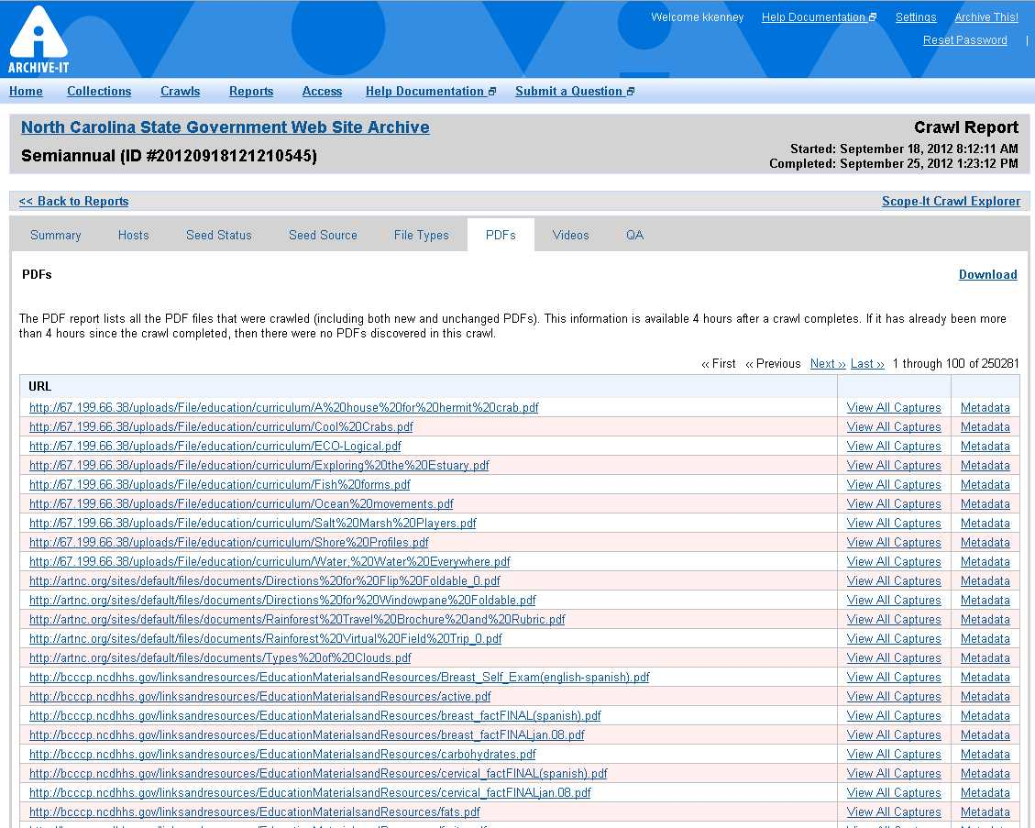

Slide 7
Our Use Case
Preservation Storage
North Carolina State Government web presence
How can we extract, use, & preserve the publications discovered by our web archiving project, in an automated and preservation-responsible way?

Slide 8
CINCH (Capture INgest CHecksum) is a tool that automates the transfer of online content to a repository, using ingest technologies appropriate for digital preservation.
More familiarly, CINCH
grabs freely available online content,
authenticates it,
extracts metadata, and
readies it for repository ingest.

Slide 9
Modular
Flexible
Easy to use
Repository-neutral
Open source
Hosted (North Carolina institutions)

Slide 10
The Web
CINCH
Checksums
De-duplication
Virus scan
Metadata extraction
Audit trail
File Types
gif, jpg, png
Microsoft Excel Powerpoint Word
mp3
pdf
txt, csv
What you get
Descriptive & administrative metadata
Audit trail
Error list

Slide 12
Stop Words
Application
Memo
Contract
Poster
FAQ
Example
Draft
Worksheet
Checklist
Chart
Instruction
Deadline
Invitation
Schedule
Flyer
Survey
Letter
Program
Rules
Procedure
Meeting
Minutes
Schedule
Comment
proposal
Agenda
Calendar
Form
Press release

Slide 13
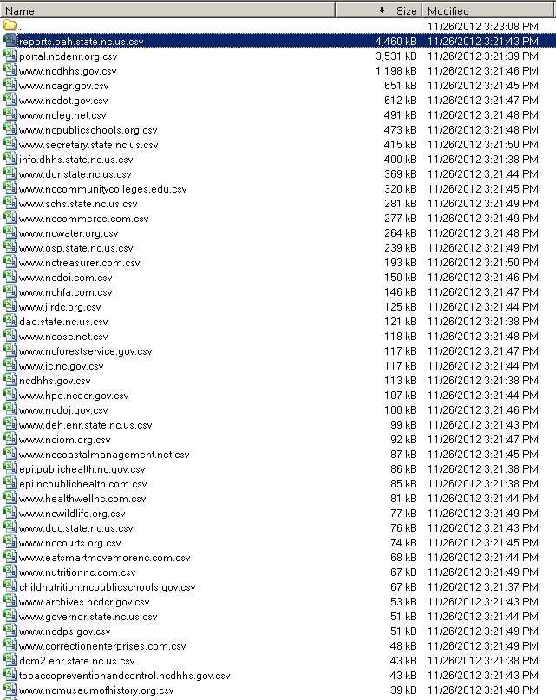
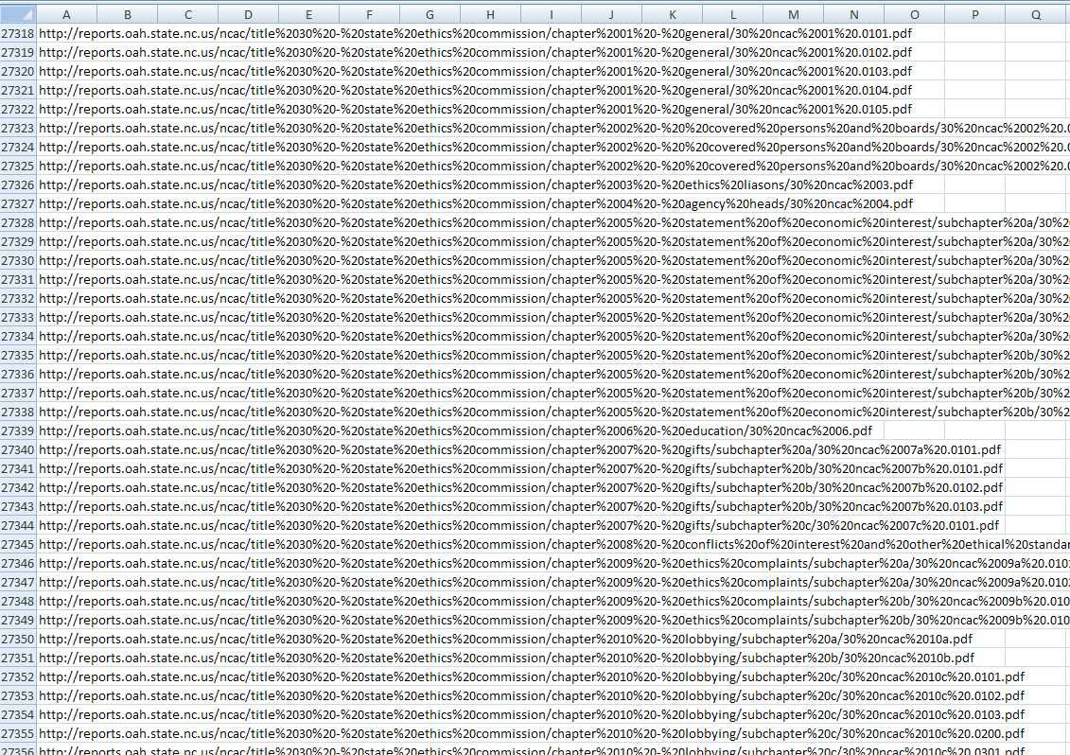

Slide 14
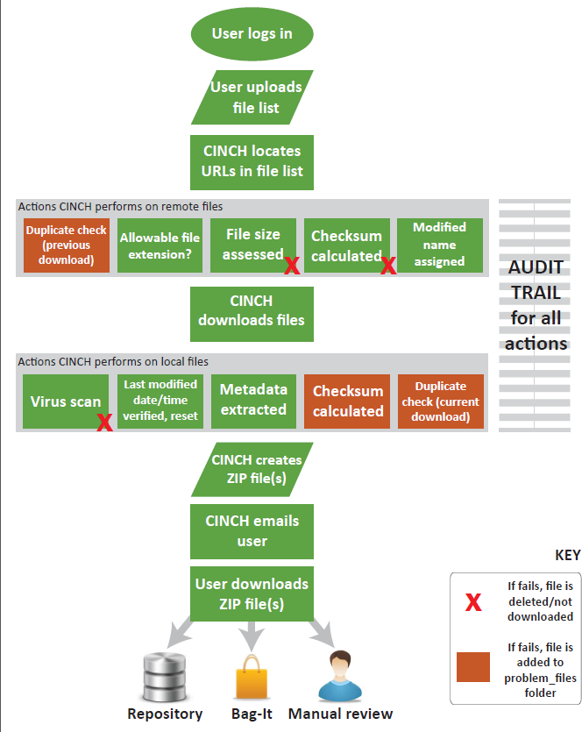
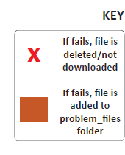

Slide 15
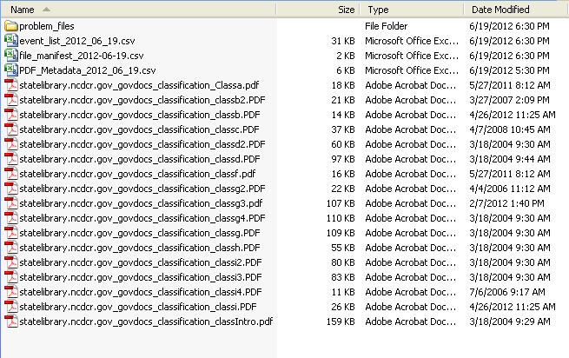
Problem files
Metadata, audit trail
Files

Slide 16
URL original file name

Slide 17
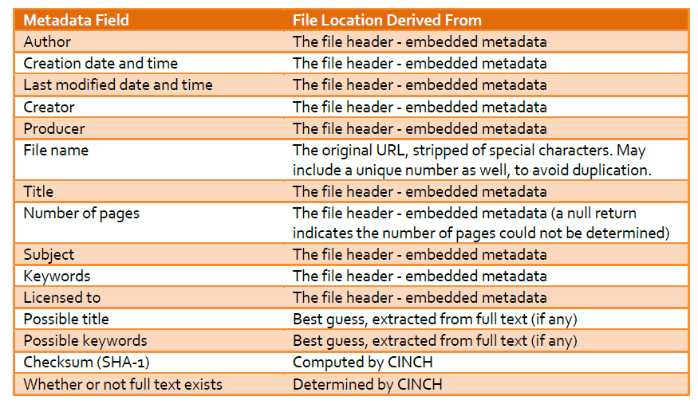

Slide 19
Where can I get it?
slnc-dimp.github.com/Cinch/
I want more information!
cinch.nclive.org

Slide 20
Feedback welcome!
digital.info@ncdcr.gov
Funding for the CINCH: Capture, INgest, & CHecksum tool made possible through an IMLS Sparks! Ignition grant.

