Slide 1
Web Archiving Life Cycle Model
Molly Bragg
molly@archive.org
Archive-It Partner Meeting
December 3, 2012
Notes:
-Welcome and such
-Today we are going to talk about the model.
-We are going to provide a summary of the model – there will be more news and details about the model available.

Slide 2
Web Archiving, A Look Back
1996: Internet Archive founded and begins archiving the web
2001: Wayback Machine launches
2002: First release of Heritrix
2003: International Internet Preservation Consortium formed with 12 participating institutions, there are now 39 members
2006: Archive-It launches as a web archiving service
2009: WARC file, the file format generated by Heritrix becomes an ISO standard.
2012: 227 Archive-It partners
Notes:
-Web archiving practices and technology have been evolving since 1996.
-the number of institutions actively archiving the web have increased over time. There are now XXXXX AIT partners, as well as a large number of other institutions archiving the web on their own or working through other service models that relay on common tools.
-more institutions have joined the IIPC – its now 39
-the tools have improved with the use of many institutions.
-technological standards have emerged
-But in all this time, there have been no best practices or common frameworks.
-This is the goal of the model we have been working on: The WALCM is an attempt to represent common workflows and create a measurable model for organizations to reference in order to create or improve their web archiving programs.

Slide 3
The Need for a Model
The growth of web archiving speaks to the need for frameworks and best practices for institutions to follow

Slide 4
Developing the Model
Based on the experiences of institutions archiving the web.
Feedback, surveys, formal discussions, presentations, conversations, emails, phone calls, water cooler chit chat….
Notes:
The Archive-It team led the creation of the model based on their years of talking with institutions archiving the web. This knowledge comes in many forms.
Internet Archive has a track record of working closely with partners as they create and develop their own programs. This model is based on these experiences.
Early phases of the model were circulated last Summer. Feedback on this led to the current design. We always welcome more feedback.
Photo: http://soul-sides.com/2007/11/taking-on-nautilus-who-flipped-it-best.html

Slide 5
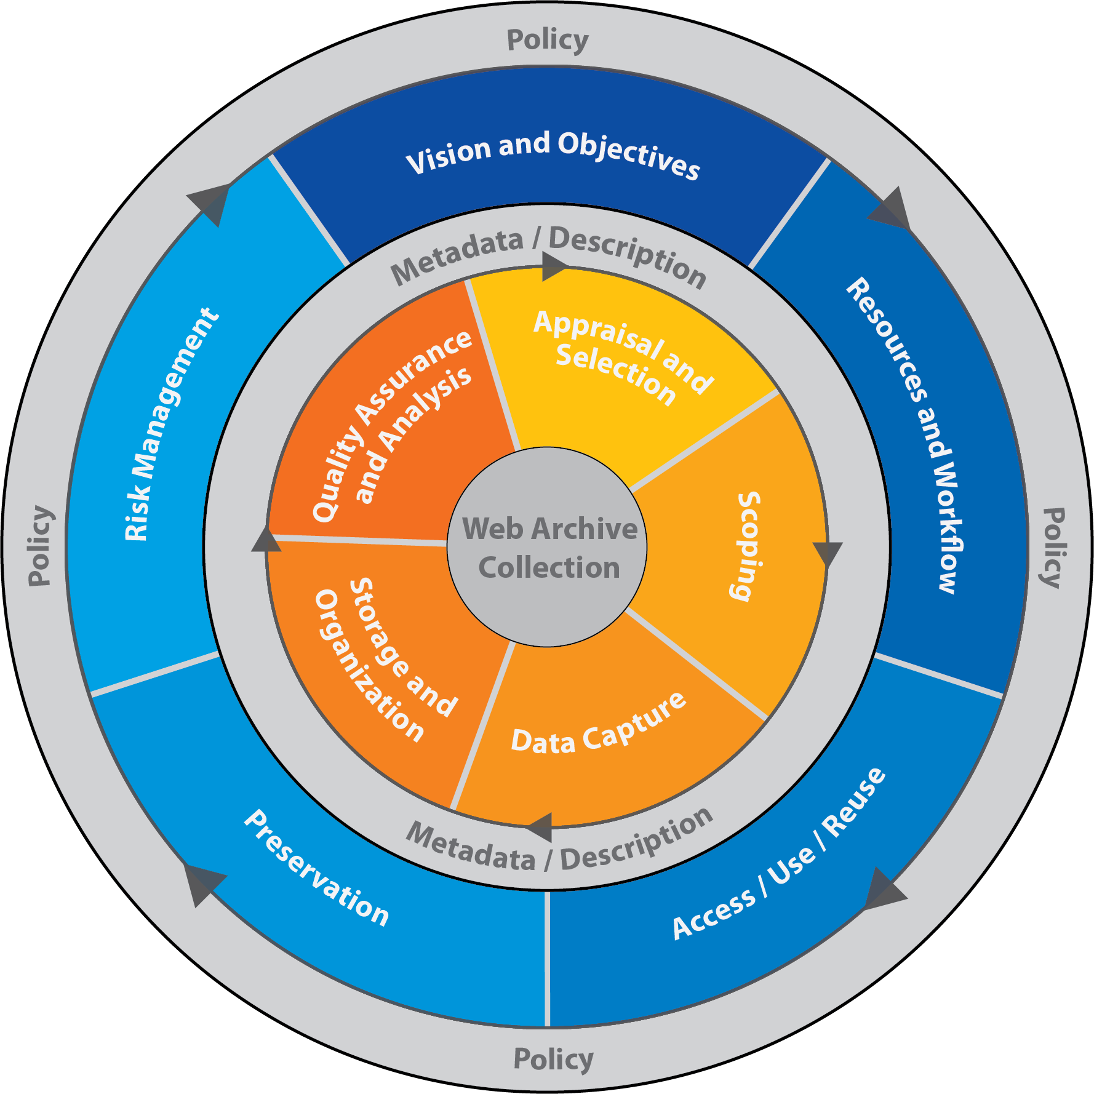
Notes:
--Goal: to represent the kinds of decisions / challenges and well as the steps (methodologies?) organizations take throughout the life cycle of their web archiving programs. Its not just setting up the program – its not just adding seeds or adding metadata– it’s the whole lifecycle of the program
-in other words, we did not set out to create a check list or a prescriptive management tool, but to represent the big ideas and the day-to-day activities organizations are involved in as they set up their program.
-the phases overlap-we made it a circle because we feel its important to show that the process is iterative and dynamic. As institutions get more experience with their program they go back and re-examine some of the decisions they have made previously. Or as the program grows they revisit and adapt their decisions as they move forward. -note the two circles – the offset and the arrows mean that one circle may revolve and repeat more often that the other.
-the collection it self is in the middle as that is the culmination of the process – the archived data.

Slide 6
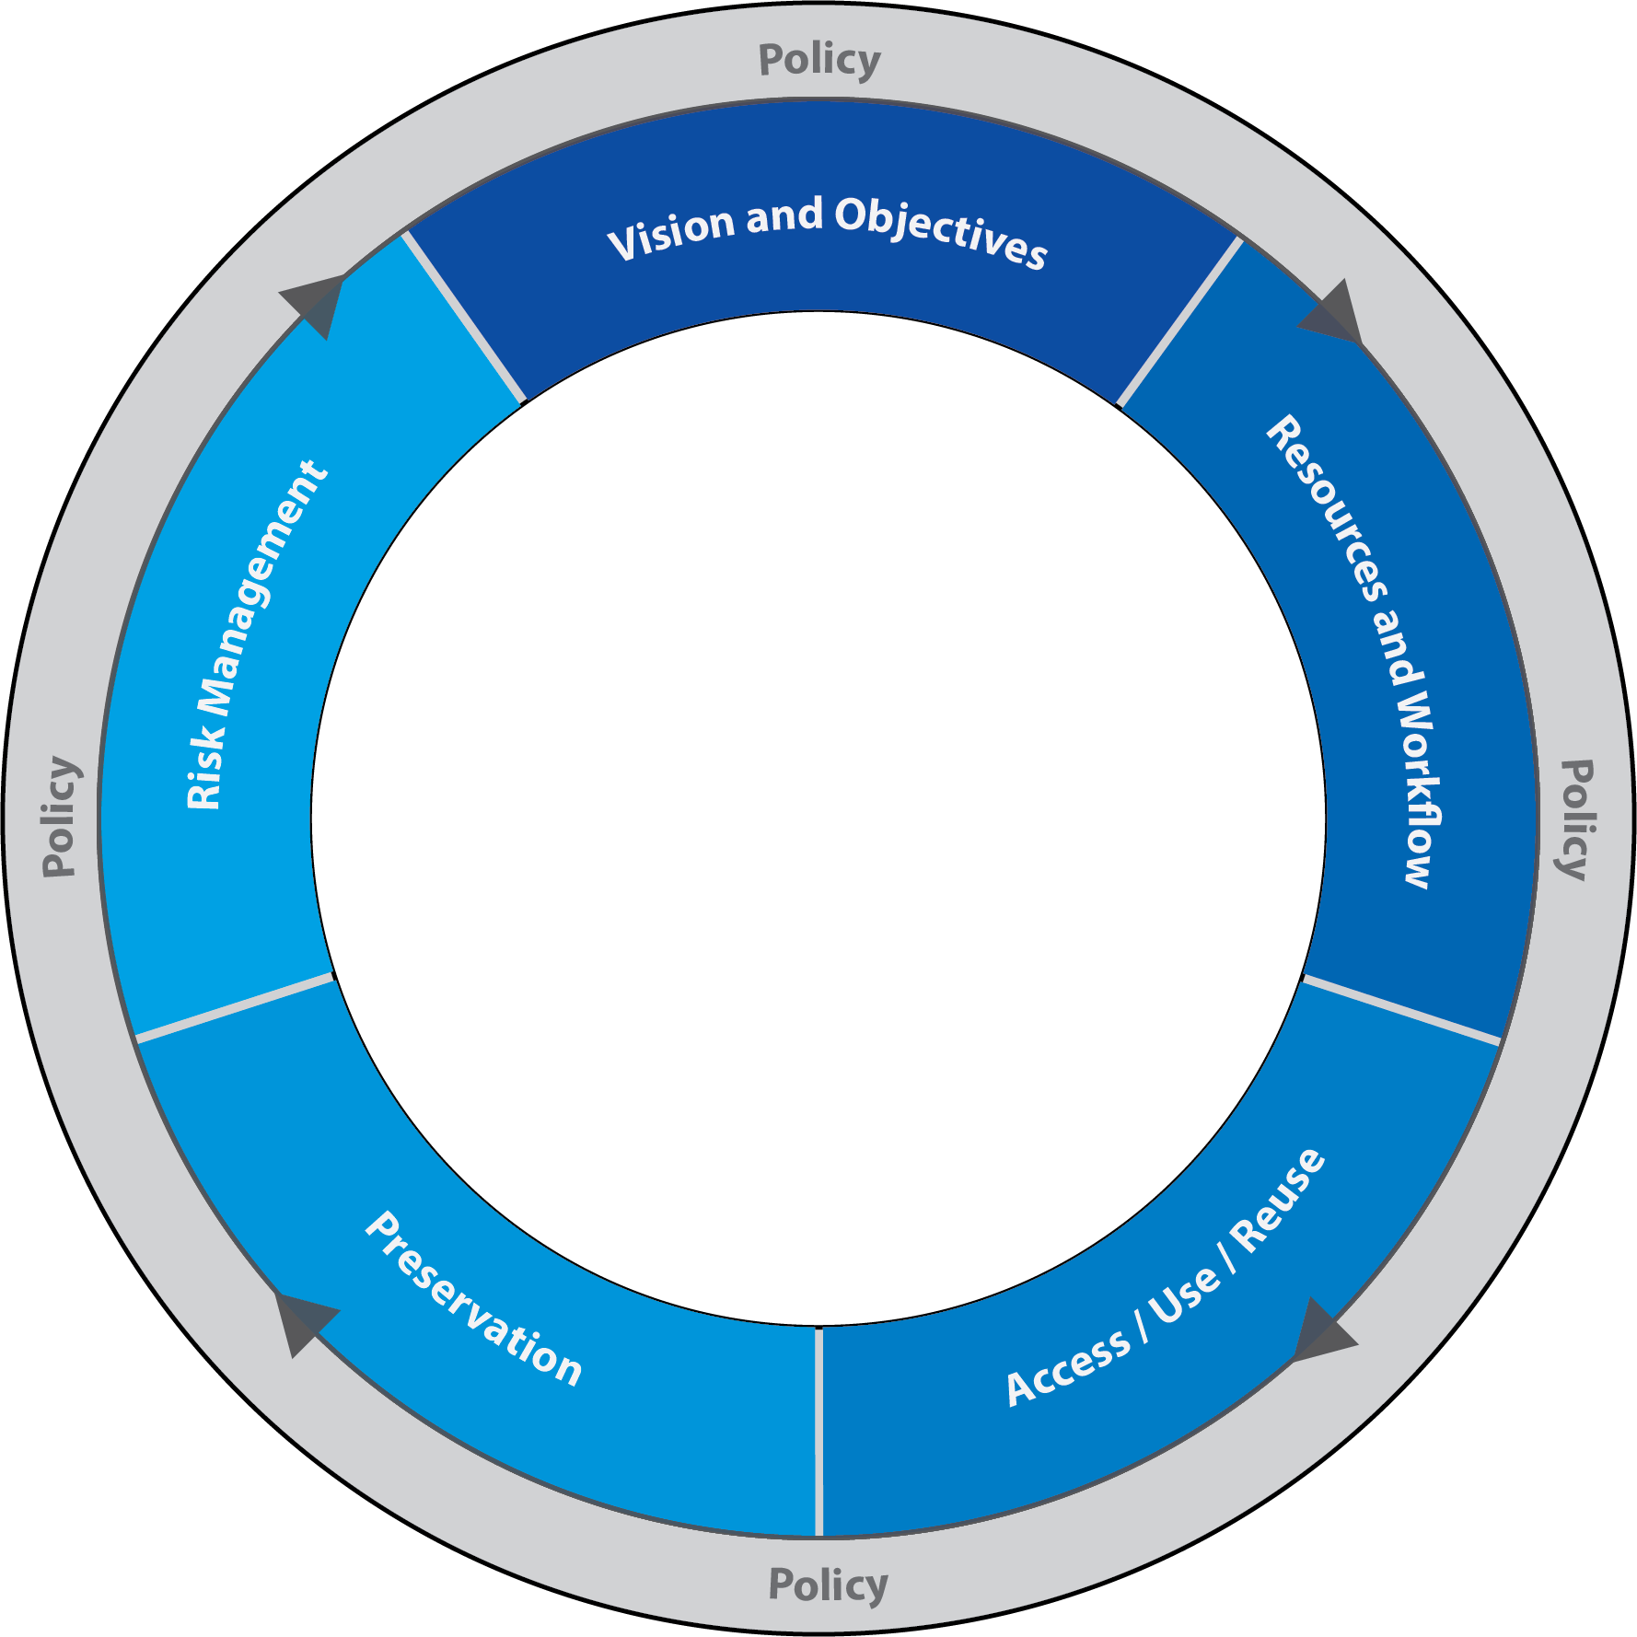
Notes:
The policy and the blue band represent some of the high level decisions that institutions make. Policy is a common theme here. There is policy in every phase of the lifecycle model, which is why it on the outside.
Phases To Highlight:
--POLICY
--VISION/OBJECTIVES
--RESOURCES AND WORKFLOW

Slide 7
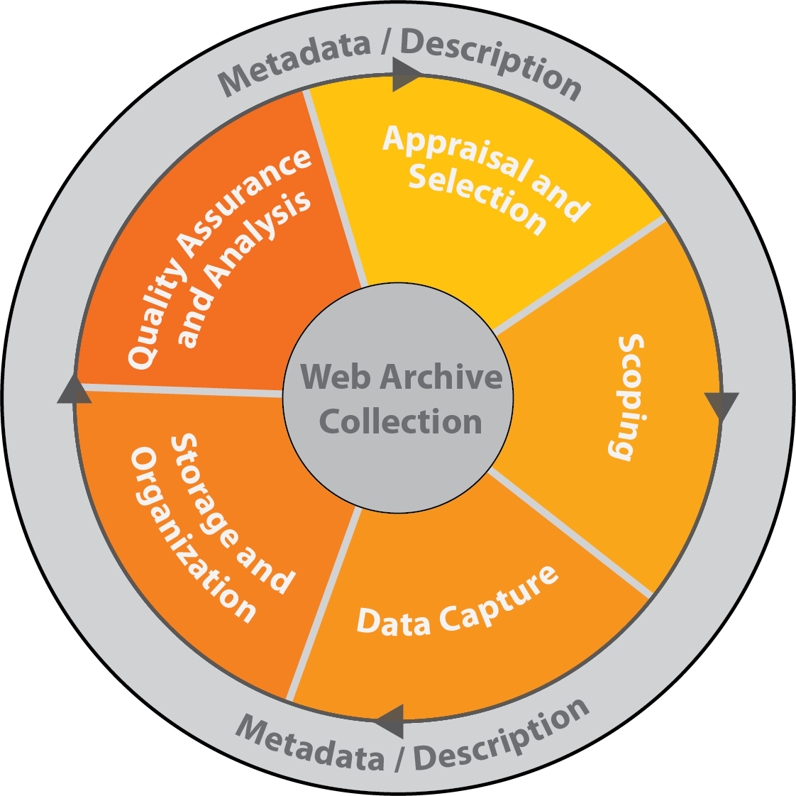
Notes:
The inner circle represents the more day to day management activities of the web archiving lifecycle – the nuts and bolts.
Phases to highlight:
-Appraisal and Selection
-Scoping / Data Capture:

Slide 8
Next Steps
The model will continue to evolve with your feedback and experiences
A white paper is coming in early 2013
Photo courtesy of SAN FRANCISCO HISTORY CENTER, SAN FRANCISCO PUBLIC LIBRARY.
Notes:
SHOULD I GIVE A MONTH FOR THE WHITE PAPER?
Photo courtesy of SAN FRANCISCO HISTORY CENTER, SAN FRANCISCO PUBLIC LIBRARY.
http://www.flickr.com/photos/sfplsanfranciscohistoricalphotographcollection/3494048745/

Slide 9
Thank You!
Questions and Feedback welcome!
http://support.archive-it.org/entries/21658298-web-archiving-life-cycle-model-draft
Send feedback to the Archive-It team.
Notes:
Is the model available online somewhere for everyone to refer to?
Image: http://www.lorschberke.com/services/team-building/thumbnail/

