Slide 1
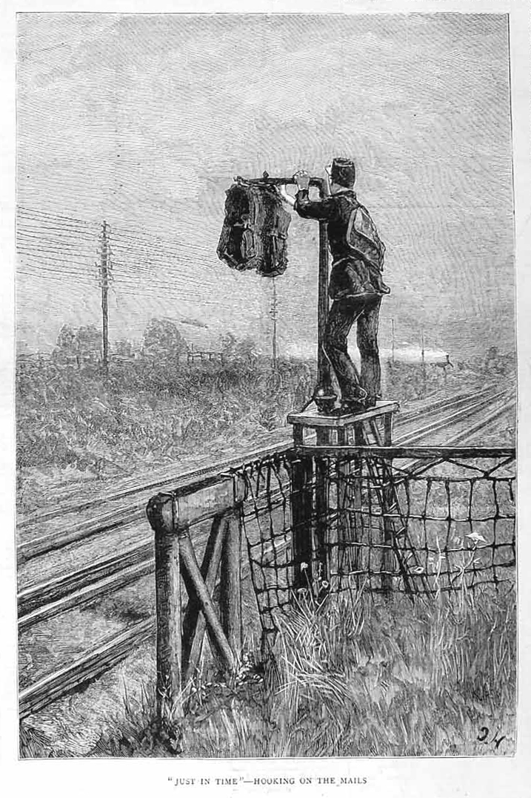
All Aboard! Archive-It and the OAI-PMH Metadata Railways

Slide 2
All Aboard!
Topics covered:
Overview of the OAI-PMH protocol
The “Metadata Route”: metadata records from Creation to Access
Record Harvesting
Field Mapping
Structure of the Archive-It OAI-PMH server
Sets
Moving Forward...

Slide 3
OAI-PMH Overview

Slide 4
OAI-PMH Overview
the Open Archives Initiative: “...develops and promotes interoperability standards that aim to facilitate the efficient dissemination of content.”
OAI-PMH (Open Archives Initiative – Protocol for Metadata Harvesting): “...defines a mechanism for harvesting records containing metadata from repositories.”

Slide 5
OAI-PMH Overview
the Open Archives Initiative: “...develops and promotes interoperability standards that aim to facilitate the efficient dissemination of content.”
OAI-PMH (Open Archives Initiative – Protocol for Metadata Harvesting): “...defines a mechanism for harvesting records containing metadata from repositories.”

Slide 6
OAI-PMH Overview
the Open Archives Initiative: “...develops and promotes interoperability standards that aim to facilitate the efficient dissemination of content.”
OAI-PMH (Open Archives Initiative – Protocol for Metadata Harvesting): “...defines a mechanism for harvesting records containing metadata from repositories.”

Slide 7
OAI-PMH Overview
Data Providers: “...maintains one or more repositories (web servers) that support the OAI-PMH as a means of exposing metadata.”
Archive-IT, Libraries, Data Repositories
Service Providers: “...issues OAI-PMH requests to data providers and uses the metadata as a basis for building value-added services.”
think OCLC’s WorldCat catalog ...

Slide 8
The OAI-PMH Metadata Route
Notes:
Add arrows around EVERYTHING.

Slide 9
Metadata Route: Creation

Slide 10
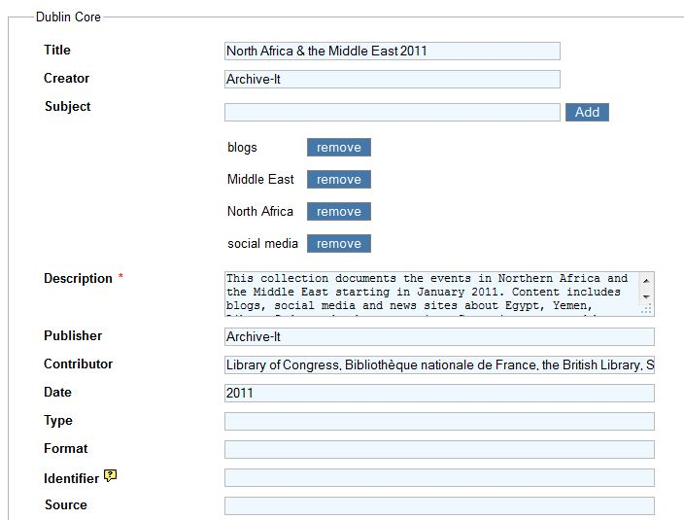
Metadata Route: Creation Archive-It Web App
Metadata is entered into the standard 15+ Dublin Core fields within the Archive-It web app

Slide 11
Metadata Route: Creation “Opt-In” to OAI-PMH feed
To be visible on the OAI-PMH feed, this box must be checked

Slide 12
Metadata Route: Dissemination
Metadata Record Harvest

Slide 13
Metadata Route: Dissemination OAI-PMH XML Feed
(Example GetRecord request: http://archive-it.org/oai?verb=GetRecord&metadataPrefix=oai_dc&identifier=http://archive-it.org/collections/2349)

Slide 14
Metadata Route: Discovery

Slide 15
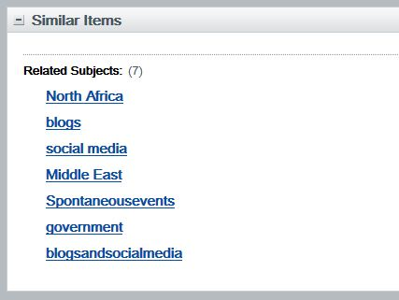
Metadata Route: Discovery WorldCat Catalog
http://www.worldcat.org/title/north-africa-the-middle-east-2011/oclc/756767371

Slide 16
Metadata Route: Discovery WorldCat Catalog
The link back to the Archive-It collection
http://www.worldcat.org/title/north-africa-the-middle-east-2011/oclc/756767371

Slide 17
Metadata Route: Access

Slide 18
Metadata Route: Access And back to Archive-It!
http://archive-it.org/public/collection.html?id=2349

Slide 19
Record Harvesting

Slide 20
Record Harvesting
OAI-PMH is based on the HTTP and XML protocols
Uses 6 main request types:
Identify ListMetadataFormats ListSets ListIdentifiers ListRecords GetRecord
More detailed explanation of each in online documentation
These request types are appended to a base URL:
Archive-It: http://archive-it.org/oai

Slide 21
Record Harvesting
Example “GetRecord” request: http://archive-it.org/oai?verb=GetRecord&metadataPrefix=oai_dc&identifier=http://archive-it.org/collections/2349
archive-it.org/oai
The Base URL
verb=GetRecord
...return a single record
metadataPrefix=oai_dc
...in the oai_dc (Dublin Core) format
identifier=http://archive-it.org/collections/2349
...with the identifier “http://archive-it.org/collections/2349”
this is also conveniently the URL to the collection public page

Slide 22
Record Harvesting
(Example GetRecord request: http://archive-it.org/oai?verb=GetRecord&metadataPrefix=oai_dc&identifier=http://archive-it.org/collections/2349)

Slide 23
Collection
Metadata

Slide 24
Field Mapping (or, How did that get there?)

Slide 25
Field Mapping
Archive-It Metadata Entry screen
Archive-It OAI-PMH XML feed
OCLC WorldCat Catalog

Slide 26
Field Mapping: WorldCat Catalog
Archive-It/OAI-PMH Dublin Core fields | WorldCat Catalog Fields
<title> | Title
<creator> | Author
<subject> | Subject Fields (on right & bottom)
<description> | Summary
<publisher> | Publisher
<contributor> | Contributor(s)
<date> | Date (located after Publisher)
<type> | Pre-populated as “Archival Material”
<format> | ...
<identifier> | Archive-It URL --> “view online” link
<source> | ...
<relation> | ...
<coverage> | Notes
<rights> | ...

Slide 27
Field Mapping: <identifier>
We utilize the “Identifier” field, from the collection level Dublin Core metadata, to append the unique URL of your collection to the OAI-PMH metadata record
Providing a URL back to the original record (in our case, the Archive-It web collection) is central to the philosophy and functionality of OAI-PMH

Slide 28
Field Mapping: Moral of the Story
While creating collection level metadata, think ahead to how these fields will be “mapped” to a record display in aggregators like the WorldCat catalog
Consult Best Practices in metadata creation:
Great OCLC article about creating “shareable” metadata:
www.oclc.org/gateway/support/best_practices.pdf
breakdown of Dublin Core elements:
http://dublincore.org/documents/usageguide/elements.shtml

Slide 29
OAI-PMH Server Structure

Slide 30
A Solr based approach

Slide 31
Benefits of a SOLR based OAI-PMH server
Dynamically updated? It is the database index!
Update collection level metadata, reflected in OAI-PMH fee immediately
Solr central to the Archive-It platform
No stand-alone, 3rd party software requiring maintenance or updates
the XSLT stylesheets and servlet wrapper developed in-house
And it’s FAST.

Slide 32
Sets

Slide 33
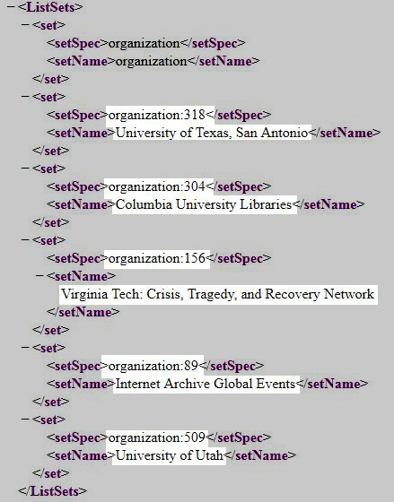
Sets

Slide 34
Sets
currently, sets are automatically generated only at the partner / organization level
ability to export all collection level metadata
coupled with the ability to “crosswalk” from one metadata schema to another –MARCXML for example - this would facilitate adding collection records to local catalogs
records can belong to multiple sets

Slide 35
MARCXML / MARC21 example
http://archive-it.org/oai?verb=GetRecord&metadataPrefix=oai_marc21&identifier=http://archive-it.org/collections/2349
Change the Metadata Prefix from “oai_dc” --> “oai_marc21”
Working to add more metadata formats: MODS, EAD, METS...

Slide 36
Moving Forward...

Slide 37
OCLC WorldCat Update Frequency
The default update schedule has been set to monthly
“opted-in” collections will appear, “opted-out” will be removed, and changes will be reflected
a “sync-now” option is available
but can only be performed by Archive-It partner specialists
is repository wide

Slide 38
Seed Level Metadata
Partners have expressed interest in Seed level metadata being exposed to the OAI-PMH feed and the WorldCat catalog
currently looking into this possibility
Would the metadata record point back to the seed URL in the Wayback Machine? or public collection page?

Slide 39
Thank you!
-the Archive-It team, Graham Hukill, 2011

