Slide 1
The Open Folklore Project
Collection Development…
—but not as your father knew it…

Slide 2
www.openfolklore.org

Slide 3
Open Folklore is a manifestation of the open access movement in the discipline of folklore studies (folkloristics).

Slide 4
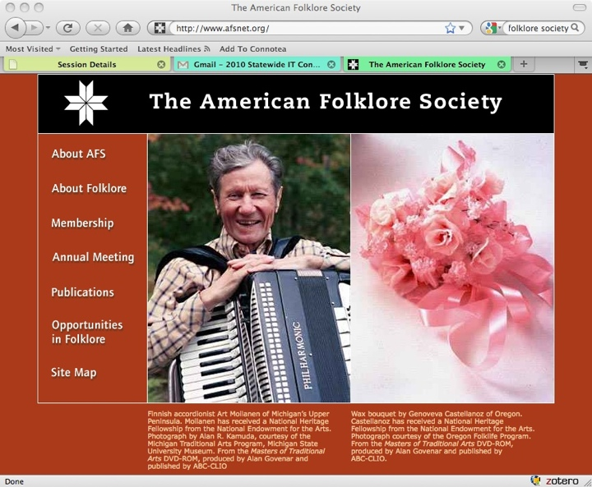
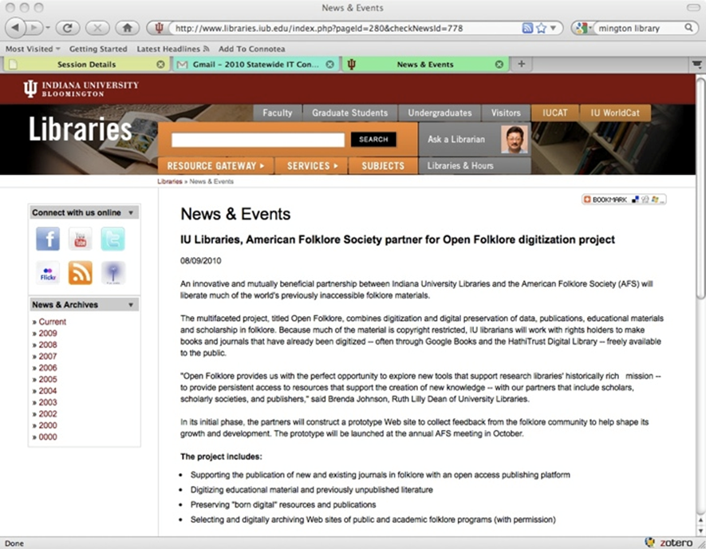
Partnership
Notes:
Open Folklore is a partnership of the American Folklore Society, the Indiana University Bloomington Libraries and the IU Digital Library Program.

Slide 5
Award Winning
Open Folklore received the 2011 Outstanding Collaboration Award from ALCTS

Slide 6
Open Folklore is many things
A Vision
Open access to scholarship in the field of folklore studies
A Collaboration
New connections between scholars, a scholarly society, university librarians and technologists
A Project
Leverage developments in digital resources for folklore scholars
A Website
Bringing it all together

Slide 7
Our mission: to promote open access to reliable scholarly resources in folklore studies.
Notes:
What Open Folklore IS (at least so far):
A collaboration: between Indiana University and American Folklore Society
A “Portal”: a context which explains and makes sense of multiple links to pots of good digital stuff
A Search: spans multiple repositories and services
An educational tool
A preservation tool
Perhaps most importantly, Open Folklore is
A Movement:
To organize and support rights holders in liberating their content
To build and nurture community, sparking deep collaborations
To act on shared values and goals
To highlight and celebrate the achievements and successes of folklorists
Why do this?
What Open Folklore is NOT
A repository
A formal organization
A new technology

Slide 8
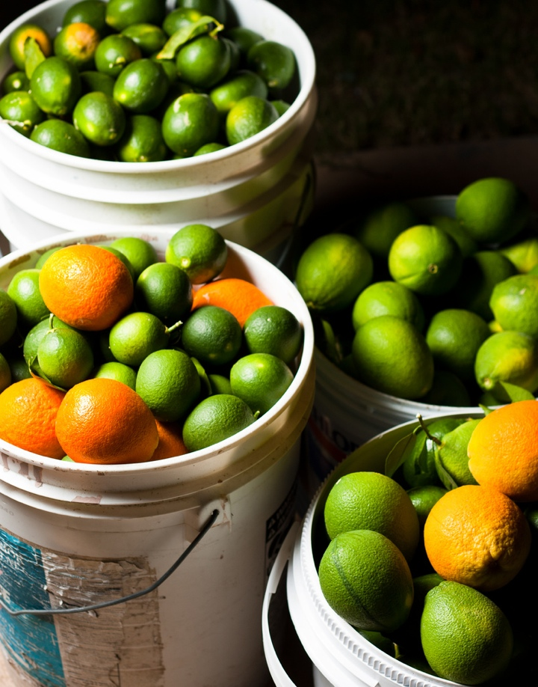
Leveraging the power of
multiple buckets
Buckets and Buckets by Josh Kenser CC BY-NC-SA 2.0 Generic http://www.flickr.com/photos/shoot-art/4895909799/
Notes:
Audiences: folklorists of all kinds; but also the communities that folklorists work with (i.e. "the folk")
Leveraging the power of multiple buckets:
A lot of good folklore material is freely available online, but it is not all in one place. OF will bring together and facilitate access to some of these:

Slide 9
IU Folklore Collection, Digitized
Notes:
57,000 titles, including 800 + serials

Slide 10
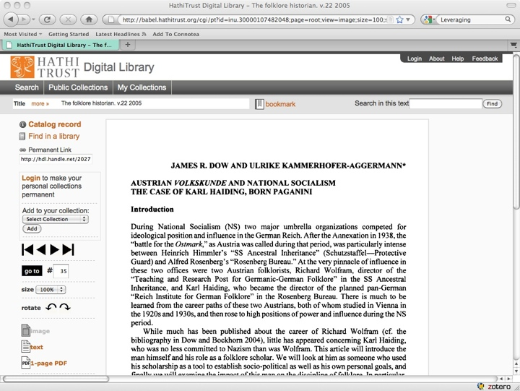
Hathi Trust
Notes:
The Journal Liberation Project: The Folklore Historian

Slide 11
Preserving works
in our IR

Slide 12
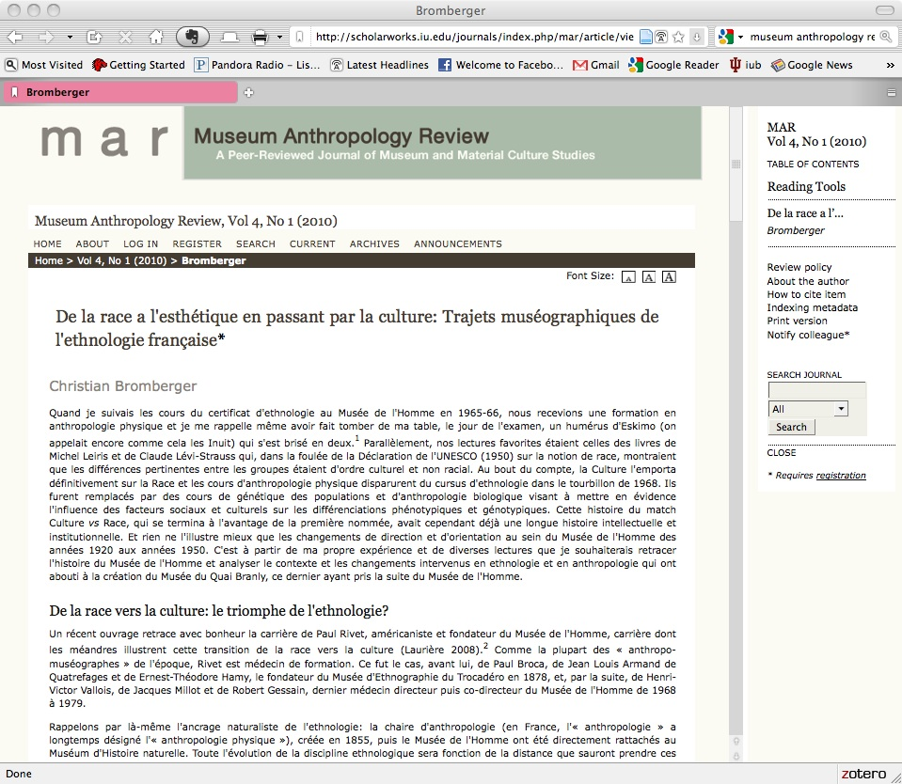
Publishing open-
access journals

Slide 13
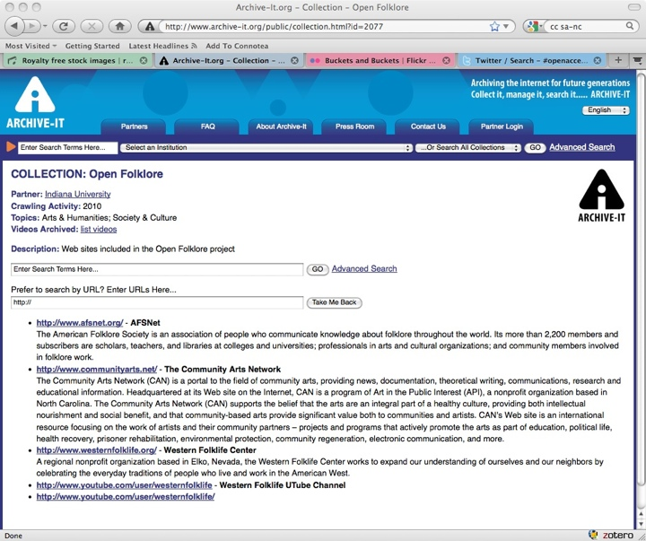
OF in
Archive-It
Notes:
OF enables you to consult and search full text of permanently archived versions of selected websites important for folklore studies. The first three are those of the American Folklore Society, the Western Folklife Center, and The Community Arts Network.
Preservation of ephemeral medium
Selection
Full-text search

Slide 14
Open Folklore
Books and Journals
Search
Websites
Archive-It
Special Projects
Ethnographic Thesaurus
Education
Podcasts
Website
Partners
National Folklore Archives Initiative
IUScholarWorks
HathiTrust
Liberating Journals
Syllabi

Slide 15
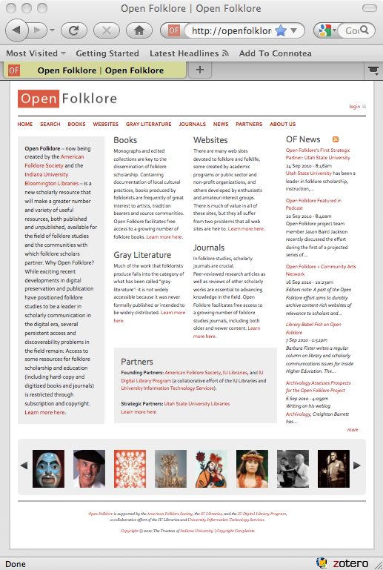
www.openfolklore.org
Notes:
Launched October 13, 2010

Slide 16
Archive-It: Open Folklore Collection
Searchable full text

Slide 17
Hungarian Cowboys
Western Folklife Center in Archive-It’s WayBack Machine

Slide 18
Problem: The Fringe
Notes:
Note the pop-up ads!
See also: fairy lore (The Mystic Voodoo)

Slide 19
Problem: the Ephemeral Web
http://www.communityarts.net/canabout.php
Notes:
Community Arts Network

Slide 20
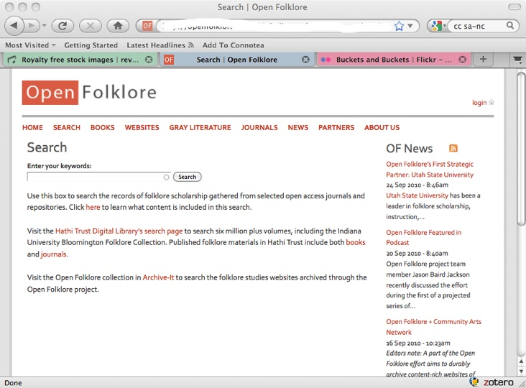
OF Search

Slide 21
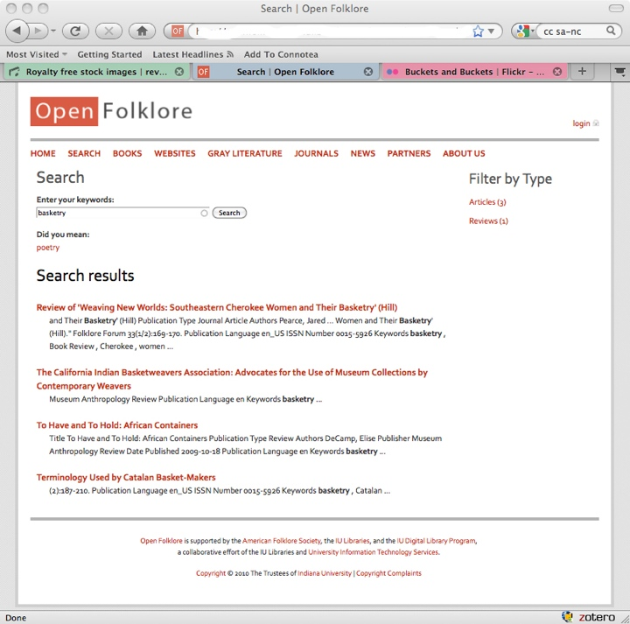
OF
Search
Results

Slide 22
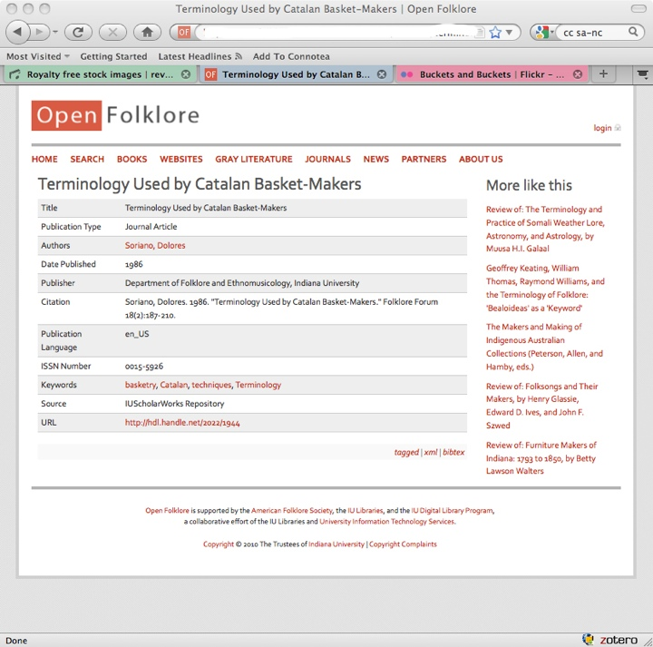
OF
Search
Record

Slide 23
Ethnographic Thesaurus

Slide 24
Open Folklore Mission
Educate
Advocate
Partnership / movement / force of nature
Notes:
Open Folklore is an experiment in reimagining the work of scholarly publishing, scholarly societies, and academic libraries.

Slide 25
Thank you!

