Slide 1
Web Archiving at the Innsbruck Newspaper Archive
Innsbrucker Zeitungsarchiv / IZA
Presentation by Renate Giacomuzzi, Elisabeth Sporer, Armin Schleicher
Web Archiving Meeting, Innsbruck 2013

Slide 2
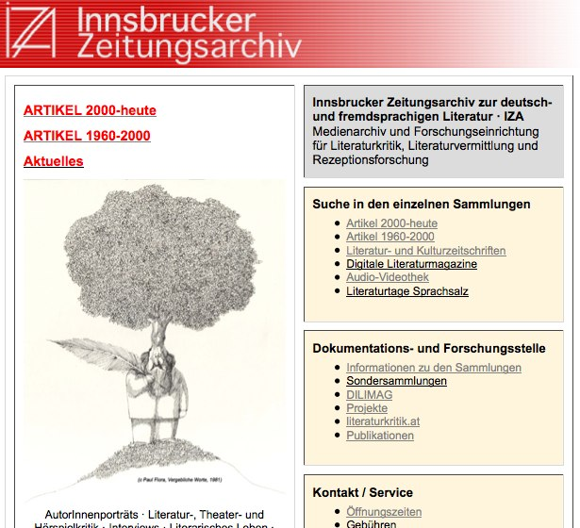
The Innsbruck Newspaper Archive and Research Center for Literary Criticism and Dissemination of Literature
Over one million digitized articles (book and theater reviews, interviews, portraits etc.).
URL: http://www.uibk.ac.at/iza/

Slide 3
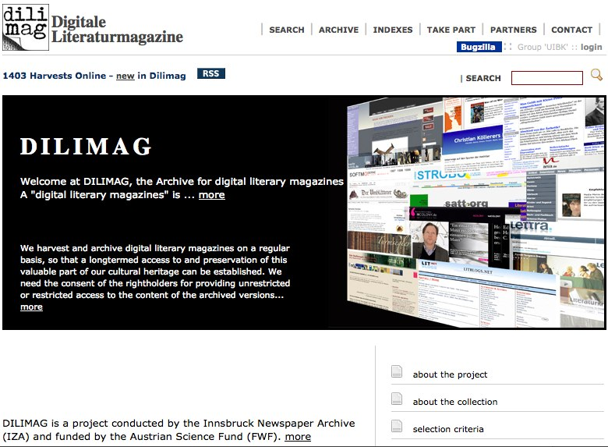
Getting started with Web Archiving: Pilot Project 2007-2010
URL: http://webapp.uibk.ac.at/dilimag/default.alo

Slide 4
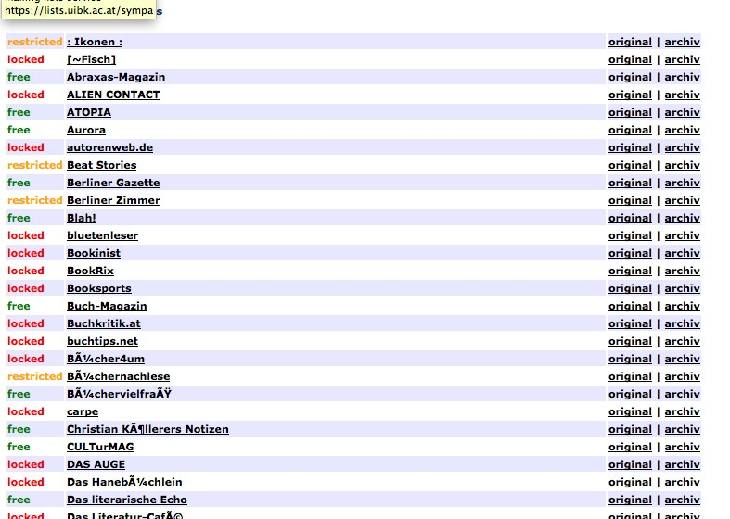
Database and archive for 147 literary magazines
70 permissions for open or restricted access
Technical tool: Web Curator

Slide 5
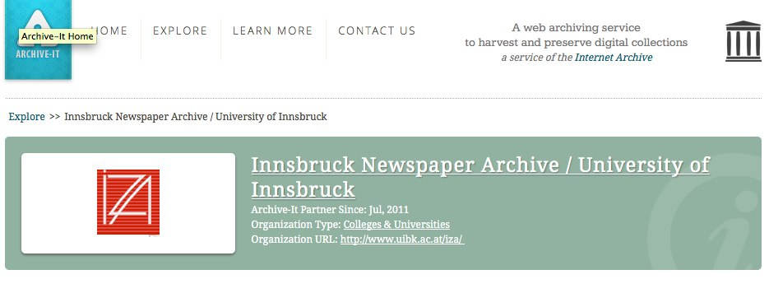
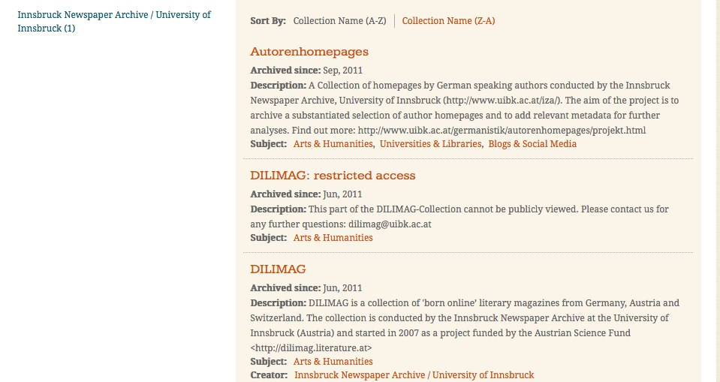
2011: A new collection and a new partner
http://www.archive-it.org/organizations/550

Slide 6
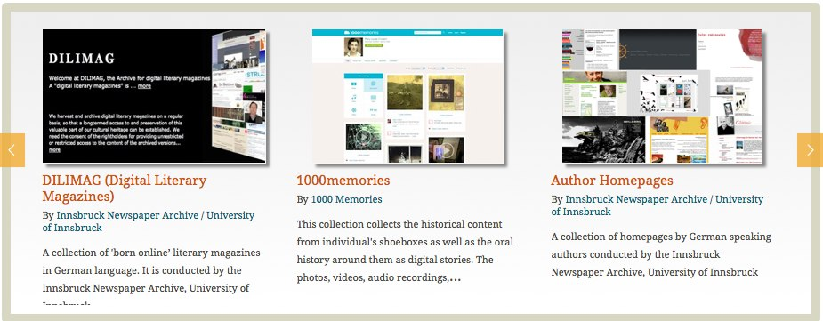
Our collections on the archive-it collection page
http://www.archive-it.org/collections/2697
http://www.archive-it.org/collections/2696
http://www.archive-it.org/collections/2844

Slide 7
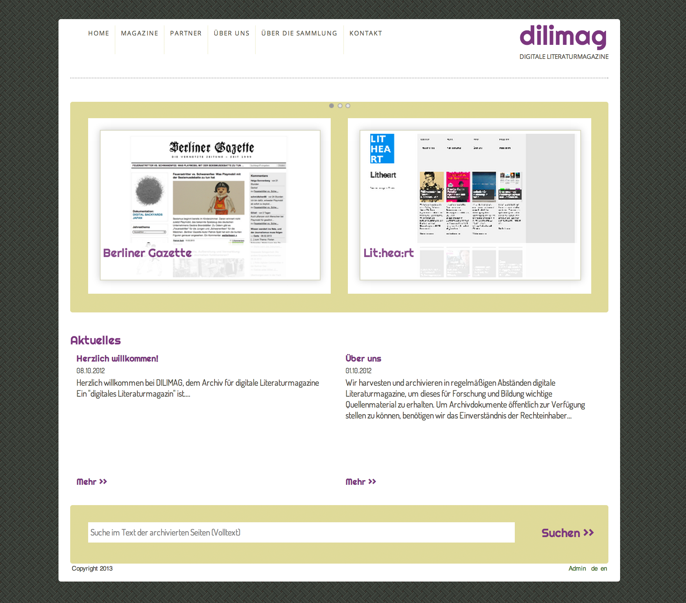
Our new homepage (coming soon)

Slide 8
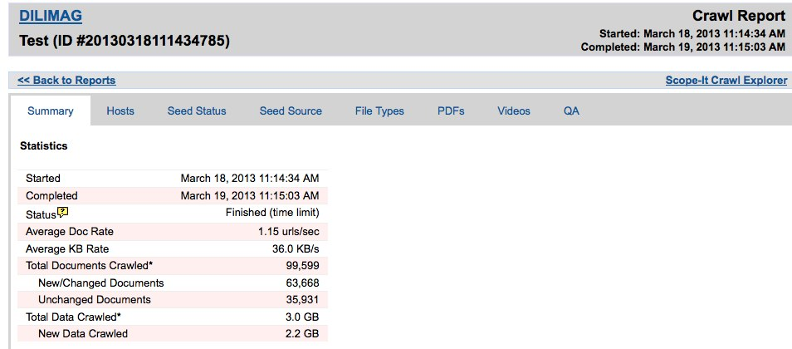
Problems arising from collecting literary magazines:
huge amount of documents

Slide 9
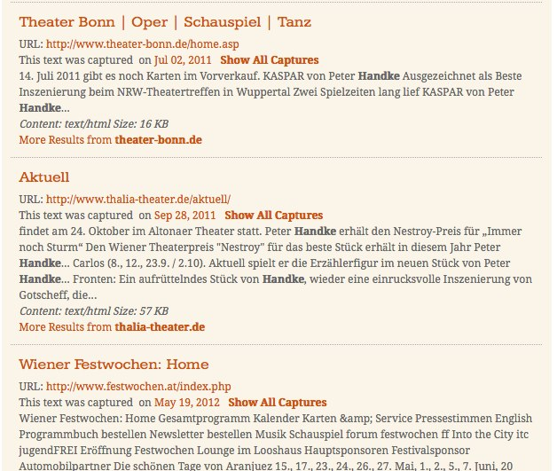
Keeping the material clean from external seeds
not allowed
example: http://www.archive-it.org/collections/2697?q=Handke&show=ArchivedPages&collectionIds=2697&page=2

Slide 10
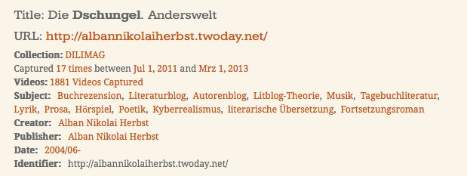
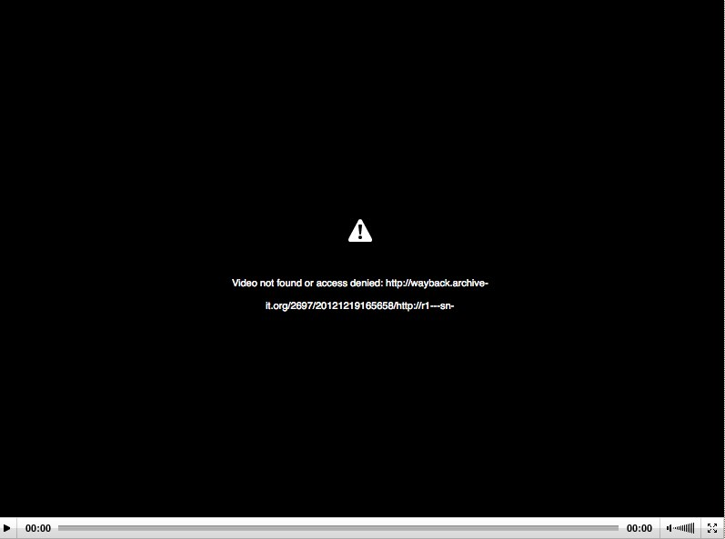
Blocked access to videos because of copyright problems

Slide 11
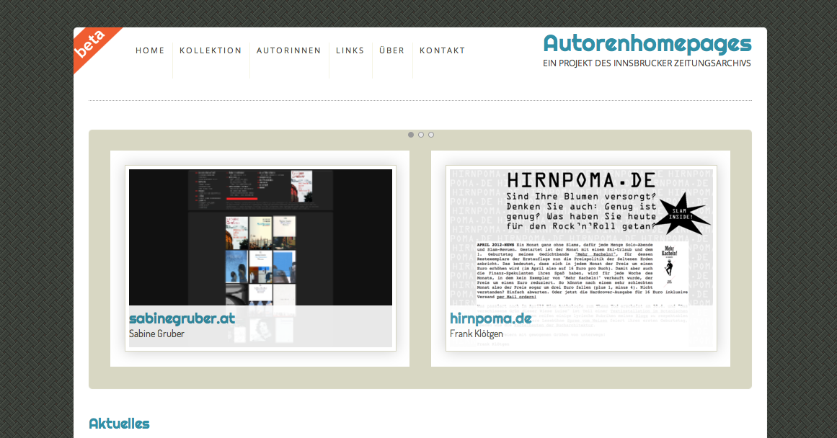
Our Archive-Website for the collection of Author homepages

Slide 12
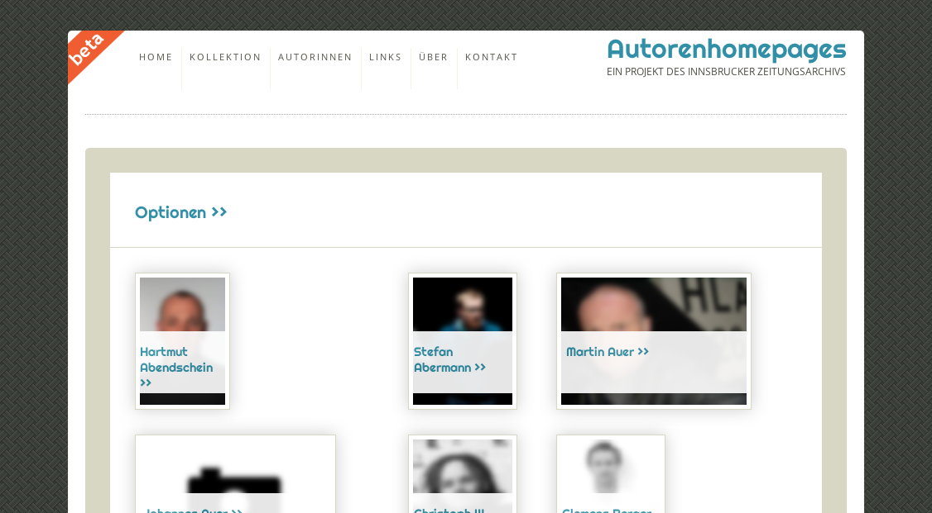
Author metadata

Slide 13
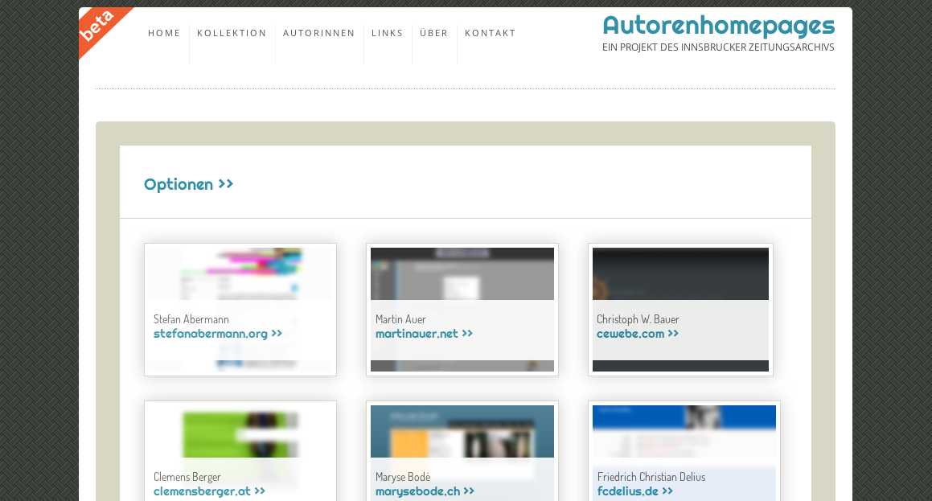
Website metadata

Slide 14
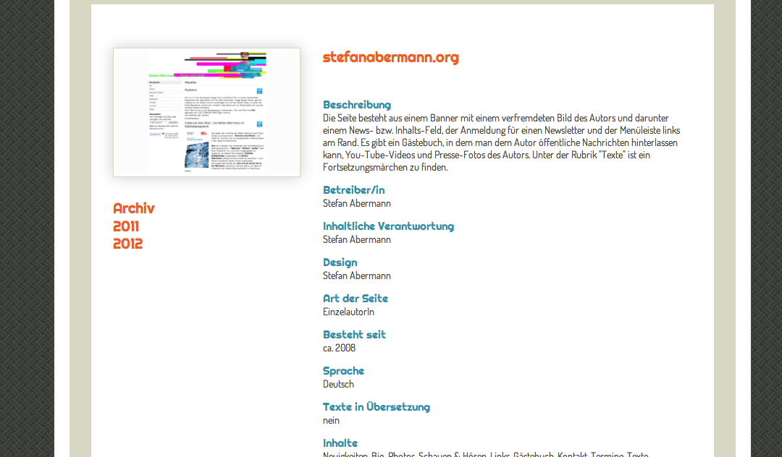
Metadata Detail

Slide 15
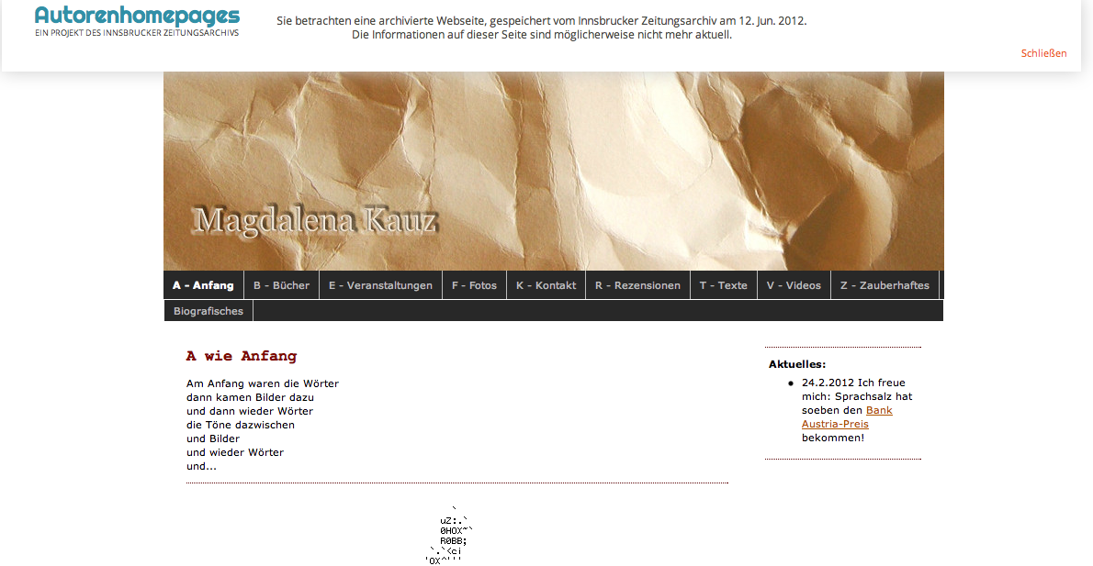
Archive View

Slide 16
Our Archiving Process
Harvesting
Processing
Presenting

Slide 17
Our Archiving Process
Harvesting
Currently done by Internet Archive
Managed using Archive It! Web application
Add seed
Configure
Run Test Crawl
Analyze Reports
OK?
Harvest

Slide 18
Our Archiving Process
Processing
Custom importer application written in pure Java
Highly configurable (filters for indexing etc.)
Controlled via archive webapp (in development)
Copy new files
Create index
Update DB
Update Wayback/ Solr

Slide 19
Our Archiving Process
Presentation
Webapplication built using JSF 2
Modular design for high upgradability
Integrating Open Source projects like IA Wayback and Apache Solr

Slide 20
Our Archiving Process
Presentation
Features:
Pagetext search (fulltext)
Metadata search (fulltext)
Metadata detail view/ chronologiocal view of harvests
Faceted Search
Role management
Admin section providing tight content control

Slide 21
Our Archiving Process
Current issues
Access control
Integration of multimedia content
Social media

Slide 22
Web Archiving at the Innsbruck Newspaper Archive
Innsbrucker Zeitungsarchiv / IZA
Presentation by Renate Giacomuzzi, Elisabeth Sporer, Armin Schleicher
Web Archiving Meeting, Innsbruck 2013

