Slide 1
Integrated Digital Event Web Archive and Library (IDEAL) and Aid for Curators Archive-It Partner Meeting Montgomery, Alabama
Mohamed Farag & Prashant Chandrasekar
mmagdy@vt.edu, peecee@vt.edu
DLRL, CS @ Virginia Tech
Nov. 18, 2014

Slide 2
Acknowledgments
IDEAL team also includes Fox, Kavanaugh, Sheetz, Shoemaker, Lee
Related Funding:
2007-2008: NSF IIS-0736055, DL-VT416: A Digital Library Testbed for Research Related to 4/16/2007 at Virginia Tech
2009-2013: NSF IIS-0916733, Crisis, Tragedy, and Recovery network (CTRnet)
2013-2016: NSF IIS-1319578, Integrated Digital Event Archive & Library (IDEAL)
2012-2014: Villanova University (NSF DUE-1141209): Computing in Context
2014: Mellon/Columbia, Archiving Transactions Towards Uninterruptible Web Service (UPS – building on Memento and SiteStory) – Prashant Chandrasekar
The Internet Archive (Kristine Hanna, co-PI):
Heritrix crawler and other tools and support
Hosting the crawls and resulting archives

Slide 3
Outline
Web Archiving
Events archiving (disasters, community, and government)
Automatic Seed URLs Generation
Social media
EFC
Extending Web Archives
Event Focused Crawler

Slide 4
Web Archiving
Crawling approach
Spontaneous disaster events archiving
High quality seed URLs (curation)
Crawling webpages
Frequency, Scope
Usually small number of seed URLs crawled frequently with many levels of scope
Human intervention (time, effort, expertise, and management)

Slide 5
Events archiving
Several types of webpages published online
Social media, news webpages, and formal (organization) webpages
Different characteristics of event-related published content
huge number of relevant webpages (low to high quality)
most seed URLs are of one-level scope (not hub pages)

Slide 6
Automatic Seed URLs Generation (1/3)
Tweet collections
Tweet URLs
Extraction & Expansion (unshortening)
URLs filtering (classification)
URLs archiving
One time crawl (or according to quality of URLs)
One level crawl (only crawl the given URL)

Slide 7
Automatic Seed URLs Generation (2/3)
Huge number of URLs extracted from tweets
Unshortening takes a lot of time
Following redirection
Infinite redirection loop
URL filtering using classification
Preparing training data
Evaluating quality of resulting archive (curation)

Slide 8
Automatic Seed URLs Generation (3/3)
Event
Keyword/Hashtag
Collect
Archive/Organize/Analyze
Access
Collect Tweets
Tweet Collection
Index
SOLR
Search
Extract URLs
Shortened URLs
Fetch
Webpages
Browse
Expand
Original URLs
Archive
WARC
Wayback

Slide 9
Crawling Approach (1/2)
Curator selects high quality seed URLs
Use Event Focused Crawler (EFC) to retrieve webpages that are highly similar to those with the seed URLs
Curator can configure EFC to adjust the number of webpages retrieved and the quality of retrieved webpages (similarity threshold)

Slide 10
Crawling Approach (2/2)
Event
Collect
Archive/Organize/Analyze
Access
Seed URLs
Index
SOLR
Search
Fetch
Webpages
Browse
Event Focused Crawler
Archive
WARC
Wayback
URLs

Slide 11
Extending Web Archives (1/2)
Similar to previous scenario
Archivists can use EFC to read WARC archives’ content and retrieve more webpages that are similar.

Slide 12
Extending Web Archives (2/2)
Extend
Archive/Organize/Analyze
Access
WARC files
Index
SOLR
Search
Fetch
Webpages
Browse
Event Focused Crawler
Archive
WARC
Wayback
URLs

Slide 13
Event Focused Crawler (1/2)
Modeling events
What happened, where, and when
Information retrieval
Helps find What part (VSM, LDA)
Natural language processing
Helps find Where and When parts (POS, NER)
Archive textual and linguistic analysis
Event model can help provide linguistic characteristics of archive content
Frequent and important words
Frequent entities
Important sentences

Slide 14
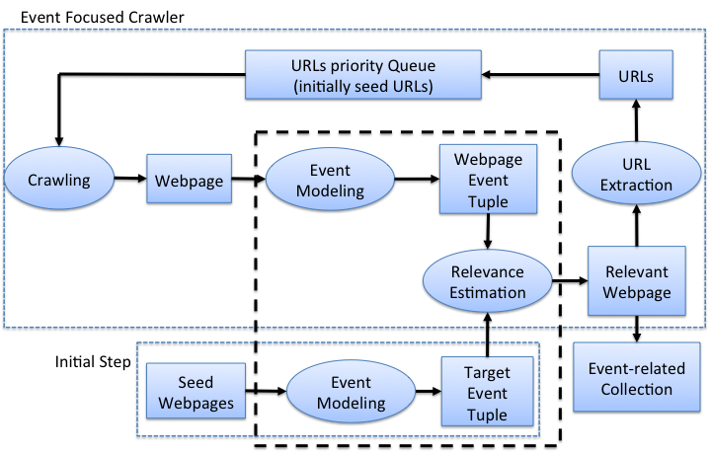
Event Focused Crawler (2/2)

Slide 15
Thank You
Questions?
Mohamed Farag & Prashant Chandrasekar
mmagdy@vt.edu, peecee@vt.edu

