Slide 1
MULTIPLE ACCESS POINTS
CREATING THE HUMAN RIGHTS WEB ARCHIVE PORTAL
AT COLUMBIA UNIVERSITY
ALEX THURMAN
Archive-It Partners Meeting
12/3/2012

Slide 2
background
In 2009 Columbia University Libraries got a grant from Andrew W. Mellon Foundation to implement a web resources collection program
Grant funded two 3-year Web Curators and one 2-year Programmer
Curators to build Human Rights Web Archive
Programmer to help build local access portal

Slide 3
multiple access points for web archives
www.archive-it.org collection page
Ability to search all web archive collections, browse by url with limited metadata (as of 2009)
MARC records in CLIO catalog for individual archived websites and for web archive collections
Local CUL portal for human rights collection
Branded, fuller integration of web archive into CUL website. Enhanced browsing, searching features

Slide 4
www.archive-it.org/collections/1068 (2009)

Slide 5
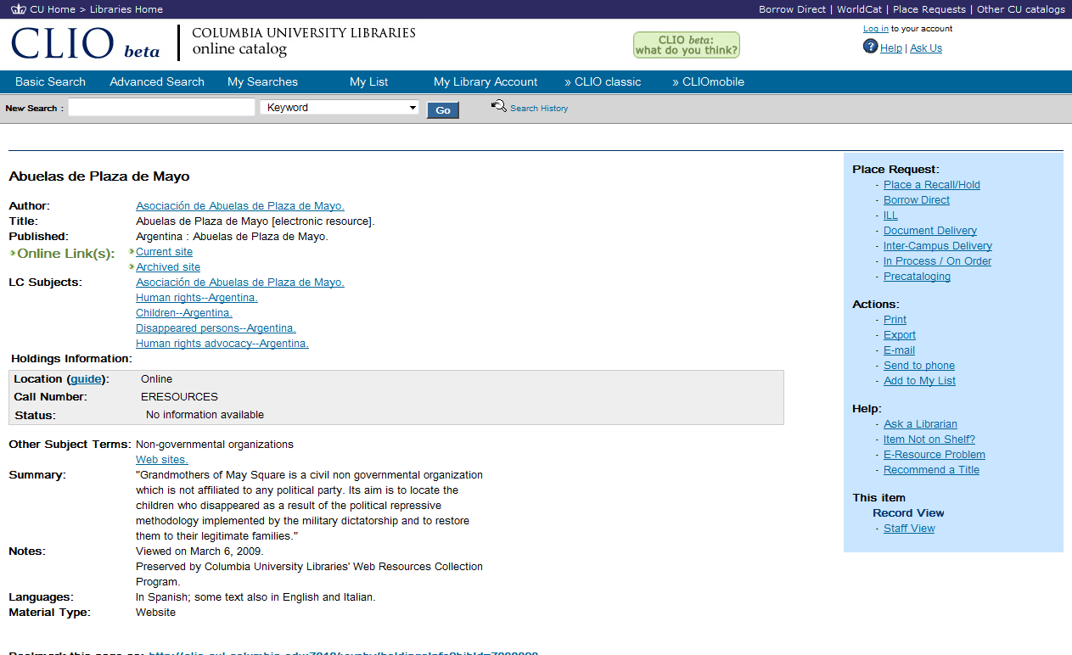
CLIO (Columbia University Libraries Online Catalog)

Slide 6
Portal Field MARC Tag
Title 245 Creator 1XX/7XX Organization Type 653 0 Organization Based In "Country" Geographic Focus 043 Subjects 650 Summary 520 Languages "Language" and 041 Seed URLs 856 40 Archived URLs 856 41
Nonpublic portal identifier “965hrportal”
mapping MARC data for portal use

Slide 7
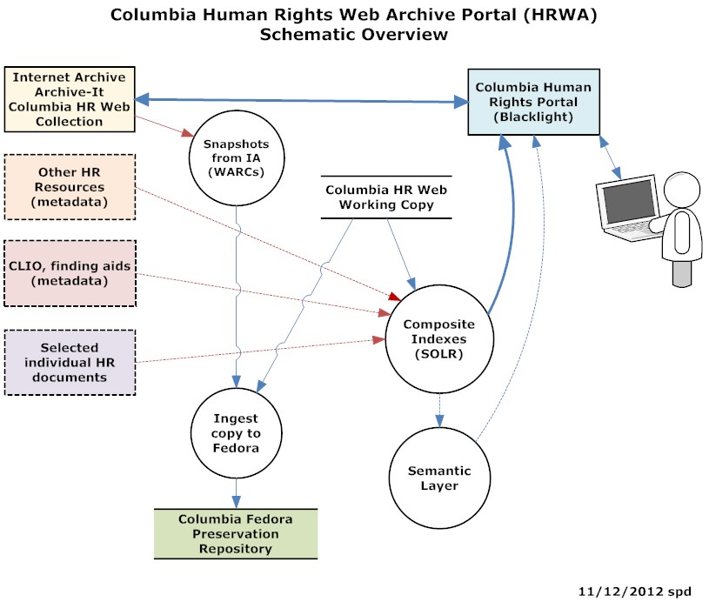

Slide 8
LDPD perspective on building local portal
Most challenging and innovative LDPD project to date.
Most data in single project (ca. 2 TB)
Largest indexes
Greatest number of servers for indexing / production
Most complex data (WARC / Web)
Most challenging end-user design requirements
Most uncharted in terms of users, possible uses, possible value added features, scoping, etc.
Most cutting edge, most unanswered tech questions

Slide 9
HRWA portal status
Beta release for internal testing, 9/12-
User testing, 1/13-
User groups to be tested include:
Human rights researchers (faculty, students)
Content providers (NGOs, activists)
Web archiving/library community

Slide 10
issues/ further development
Need to establish technical procedure for regular updating of portal CLIO metadata and WARC download from Archive-It
Determine if local indexing of data is sustainable
Improve quality of SOLR full-text search results for web archives
Determine if application of site-level metadata to individual documents is net benefit
Enhance full-test searching via Semantic web/Linked data layers?

Slide 11
hrwa.cul.columbia.edu

Slide 12
browse by title

Slide 13
browse by URL

Slide 14
browse by subject / alphabetical

Slide 15
browse by subject / number of sites

Slide 16
browse by geographic focus –number of sites

Slide 17
site details page

Slide 18
search options

Slide 19
website descriptions (metadata) search results

Slide 20
page full-text search results

Slide 21
site owner nomination form

Slide 22
Send any portal feedback or questions to me at
at2186@columbia.edu
Or use site Contact form
Thanks!

