Slide 1
Latin American and Human Rights Web Archiving as part of Research Library Special Collections
Archive-It Partner Meeting
December 3, 2012
Kent Norsworthy
LLILAS Benson Digital Curation Coordinator,
LLILAS & University of Texas Libraries
k.norsworthy@austin.utexas.edu
Notes:
Focus on 1) how we are using Web archiving as part of efforts to redefine the role and place of special collections in the research library, 2) how users are using our collections for research, justice, and activism.

Slide 2
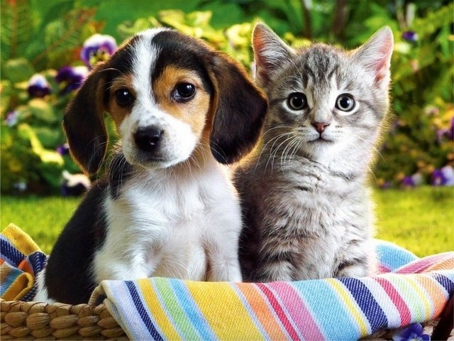
Lagda & Hrdi

Slide 3
Honduras before the coup
presidencia.gob.hn Before the Coup . . .
Notes:
LAGDA crawl of Zelaya administration’s website prior to the coup

Slide 4
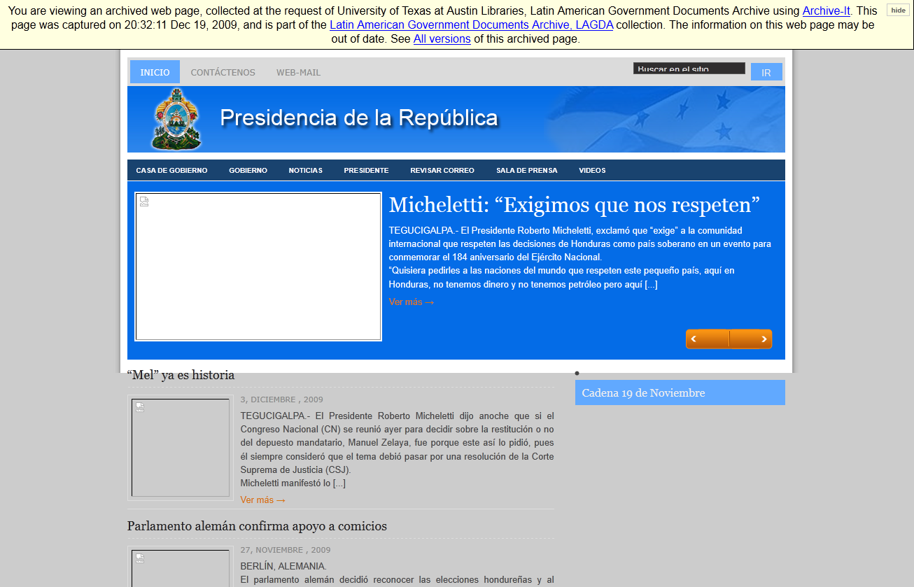
Honduras after the coup
presidencia.gob.hn . . . After the Coup
Notes:
Coup government’s website

Slide 5
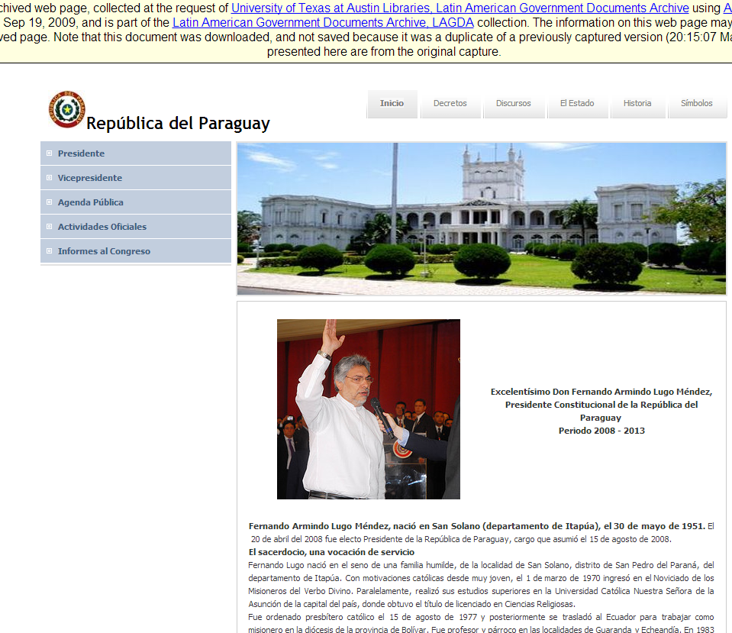
Paraguay before the coup
presidencia.gov.py . . . Before the Coup

Slide 6
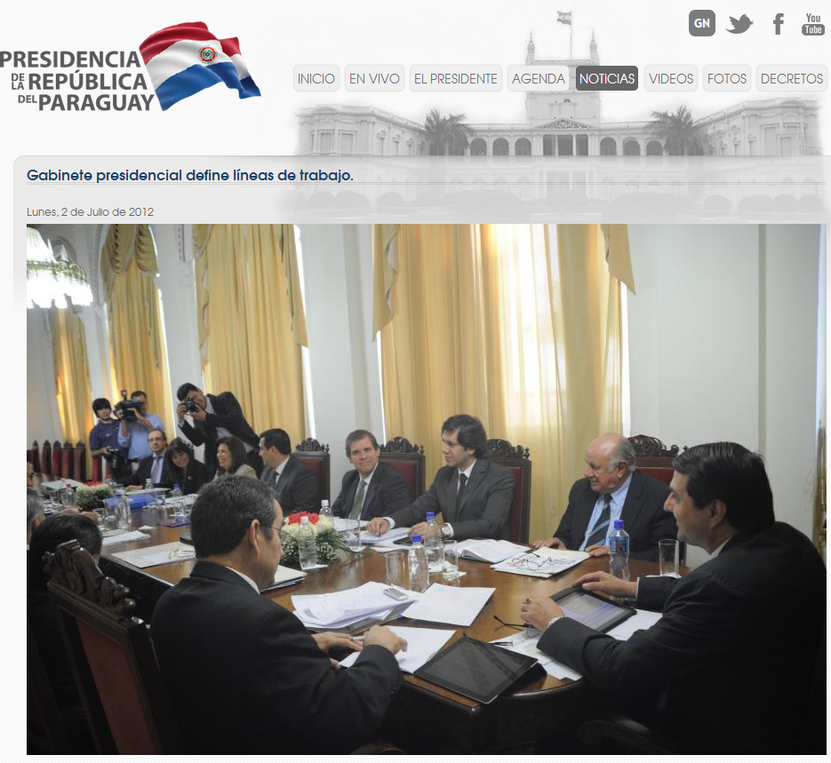
Paraguay after the coup
presidencia.gov.py . . . After the Coup

Slide 7
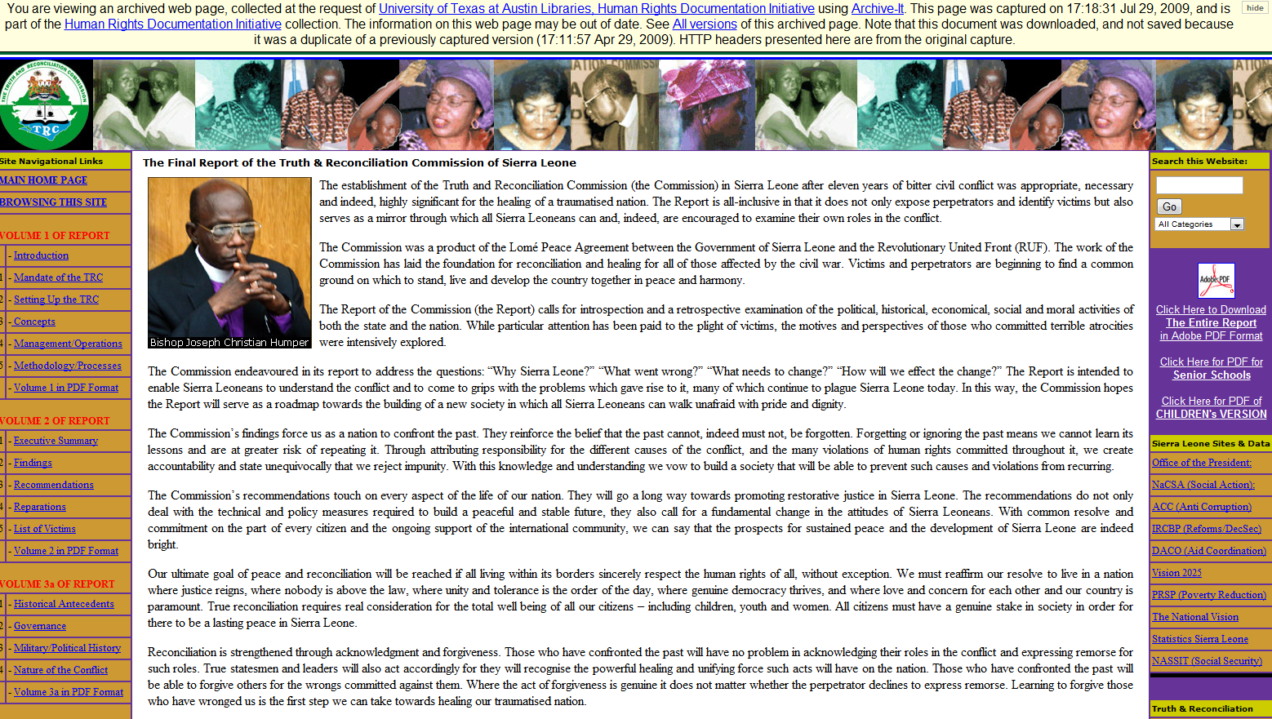
Sierra Leone Truth Commission
Sierra Leone Truth Commission
Notes:
While the Truth Commission Report itself can be found elsewhere, much of the auxiliary information published here only exists in HRDI’s Web archive.
7

Slide 8
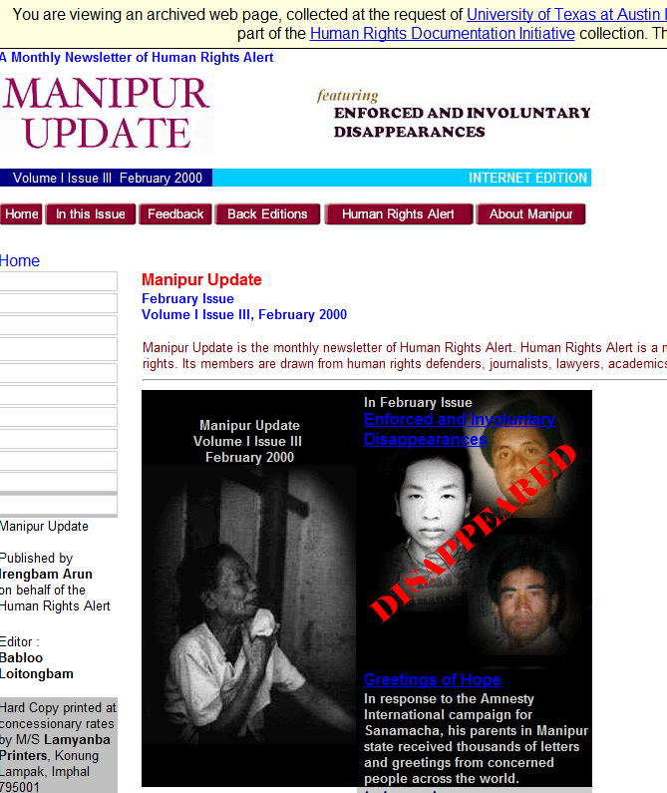
Human Rights Alert, Manipur
Human Rights Alert, Manipur
Notes:
HRDI seeks to develop digital infrastructure for the acquisition and preservation of the fragile born digital record of genocide and human rights conflicts.
8

Slide 9
LAGDA snapshot
LAGDA Snapshot
LAGDA = 280 seeds, about 15 gov ministries per each of 18 countries crawled quarterly since 2005
Files crawled and archived to date in LAGDA 75 million
Data archived 6.3TB
HTML pages archived per crawl 1.6 million
PDF documents archived per crawl 260,000
Monthly average pageviews on LAGDA 2,918
Notes:
LAGDA basic info

Slide 10
LAGDA local collaboration
LAGDA local collaboration
Area Studies: LLILAS = 140 UT Latinamericanist faculty
Benson Latin American Collection
UT Libraries: Preservation, Metadata, Systems
Texas Advanced Computing Center, TACC: Data Mining

Slide 11
LAGDA external collaboration
HRDI & LAGDA external collaboration
Internet Archive
Latin American Studies Association, LASA
Society of American Archivists, SAA
Center for Research Libraries, CRL
Seminar on the Acquisition of Latin American Library Materials, SALALM
Notes:
LAGDA has worked with and promoted the project through these groups
11

Slide 12
HRDI external partners
HRDI external partners
Genocide Archive of Rwanda
Free Burma Rangers
Museo de la Palabra y la Imagen, El Salvador
WITNESS
Texas After Violence Project
Notes:
12

Slide 13
Latin American government documents
What we capture
Speeches
Full text
Audio
Video
Reports
Regular Annual Reports
State of the Union
Sector Reports
Born Digital
(Social Media)
(Website as a digital object)
Official Statistics
Census
Surveys
Economic data
Notes:
13
“Website as a digital object”, based on researchers telling us what they need for their work: not just the documents themselves, but the context in which the documents were published, i.e., the “look and feel”, not just the bytes or the text content.

Slide 14
Ephemeral nature of target sites
Ephemeral nature of HRDI & LAGDA target sites
“Coups and earthquakes”
Ordinary governmental succession
Lack of preservation mandate or infrastructure
Ongoing changes in policy and ideology
HRDI: at-risk nature of the organizations themselves
HRDI: Government censorship and repression
Notes:
Content on the Latin American and Human Rights web is fragile and at risk by definition for many reasons. Important collecting imperative for research libraries, as nobody else has a mandate to gather and preserve this content.
14

Slide 15
LAGDA users and how they use it
LAGDA users and how they use it
Professors: research in political science
Students: classroom assignments & research projects
Comparative and cross-national research
Original owners/publishers of the content
Safeguarding national patrimony
Notes:
Patrimony: government ministries have no preservation mandate, national libraries either not tasked with preserving, or don’t have the resources, research libraries are in a position to play this key role.
15

Slide 16
HRDI users and how they use it
HRDI users and how they use it
Broadly: Memorialization, scholarship, & justice
Human rights activists & advocacy organizations
Legal community
University scholars and students
Survivors of human rights violations & family members
Safeguarding national patrimony
Notes:
16

Slide 17
Topic modeling
Topic modeling for improved search and discovery
When traditional search and browse isn’t enough
Enables users to interrogate the archive with new types of research questions
Can be applied to any type of large-scale collection of digital objects
Topic model construction combines machine learning and algorithms with validation by subject matter experts
Using tag clouds for now, but could move up to more advanced data visualization techniques
Notes:
17

Slide 18
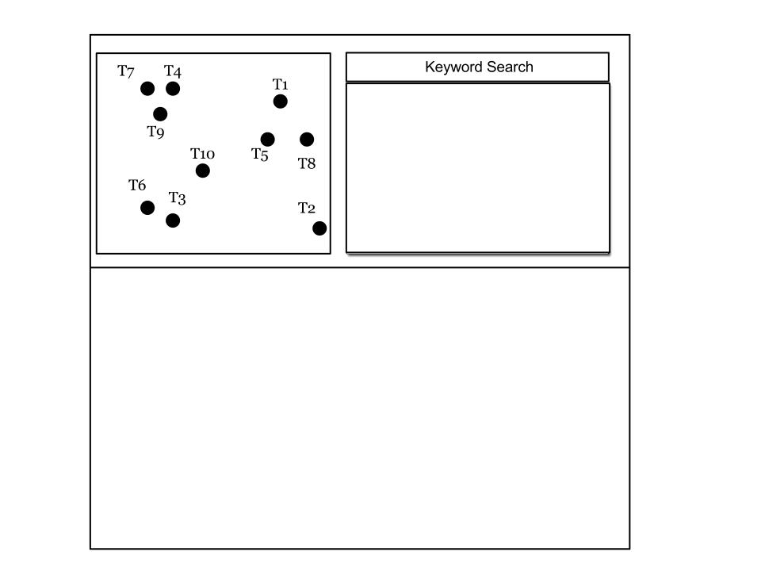
Topic modeling user interface step one

Slide 19
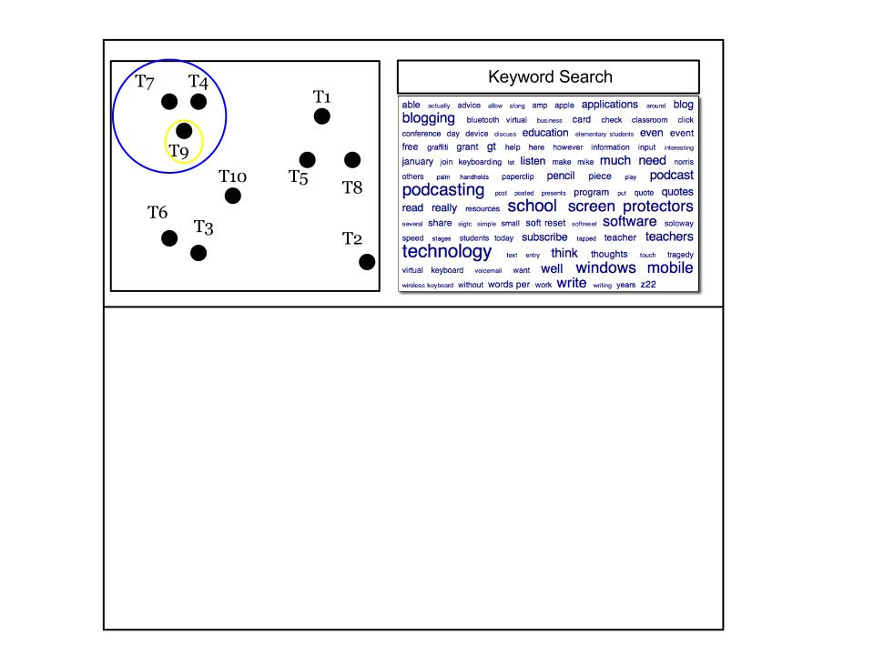
Topic modeling user interface step two

Slide 20
Topic modeling user interface step three

Slide 21
Mainstreaming special collections 1
Web archiving at UT Austin: Mainstreaming Special Collections
Transformation of special collections
Redefining the role and identity of the research library
More integrally connect the library to teaching, scholarship, and to 21st century learners
Explicit recognition of Human Rights and Latin American Studies as priorities
Notes:
Mainstreaming special collections; make the library more centrally connected to teaching, scholarship, and 21st century learners; LLILAS-Benson collaboration and recognition of LAS and Human Rights as priority areas (“can’t collect it all”).

Slide 22
Mainstreaming special collections 2
Web archiving at UT Austin: Mainstreaming Special Collections
Focus on born digital and non-custodial archiving
New forms of digital scholarship emerge as technology and content meet in special collections
Big data increasingly present in humanities/social sciences
Web archiving, non-custodial archiving, large text corpora
Web archives as primary source material
Notes:
22

Slide 23
Contact
Contact
Google: LAGDA Google: HRDI
Kent Norsworthy
k.norsworthy@austin.utexas.edu
Digital Curation Coordinator
T-Kay Sangwand
sangwand@austin.utexas.edu
Human Rights Archivist

