Slide 1
Visualizing Digital Collections at Archive-It
Michele C. Weigle, Michael L. Nelson
Web Sciences and Digital Libraries (WS-DL) Lab
Department of Computer Science
Old Dominion University
Norfolk, VA
Archive-It Partners Meeting
December 3, 2012

Slide 2
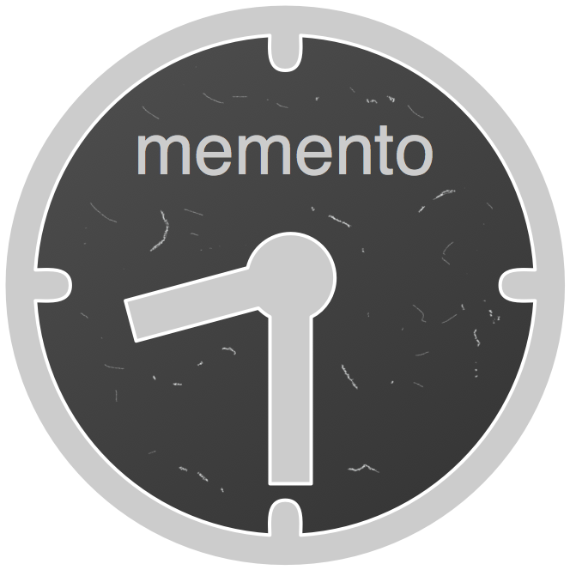
WS-DL at ODU
Memento protocol
MementoFox
ResourceSync
ArchiveFacebook
WARCreate

Slide 3
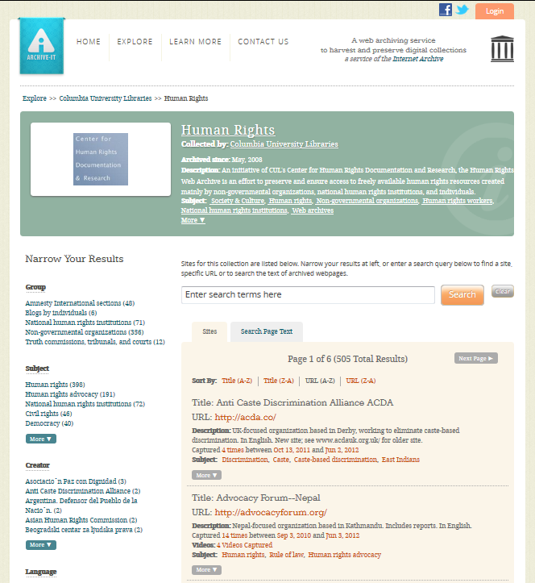
Exploring Archive-It Collections
http://archive-it.org/collections/1068

Slide 4
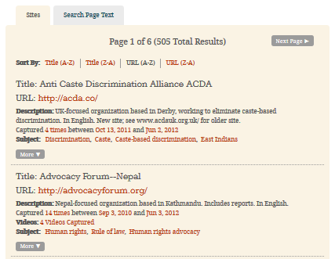
List of Web Pages
http://archive-it.org/collections/1068

Slide 5
Archived Versions of acda.co
http://wayback.archive-it.org/1068/*/http://acda.co/

Slide 6
Archive-It Collection Hierarchy
Collection Title
Category 1
Web Page 1
Web Page n
Category n
Root
Level 1
Level 2
Archived Version 1
Archived Version n
Level 3 (Leaf Nodes)

Slide 7
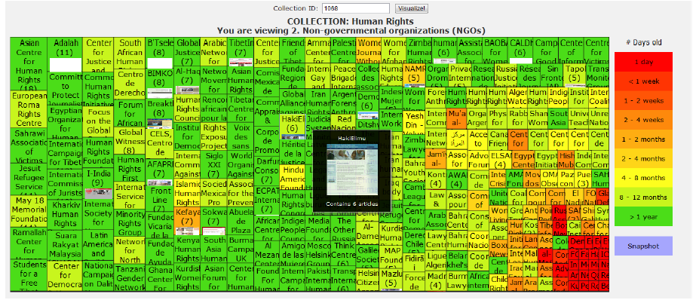
Prototype Visualizations
Treemap
K. Padia, Y. AlNoamany and M. C. Weigle, "Visualizing Digital Collections at Archive-It," In Proceedings of the ACM/IEEE Joint Conference on Digital Libraries (JCDL). June 2012.

Slide 8
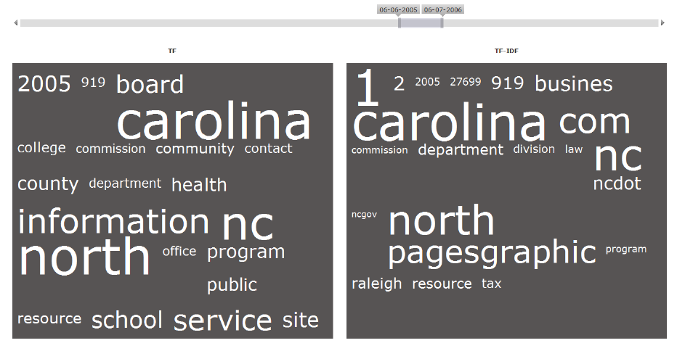
Prototype Visualizations
Treemap
Time cloud
K. Padia, Y. AlNoamany and M. C. Weigle, "Visualizing Digital Collections at Archive-It," In Proceedings of the ACM/IEEE Joint Conference on Digital Libraries (JCDL). June 2012.

Slide 9
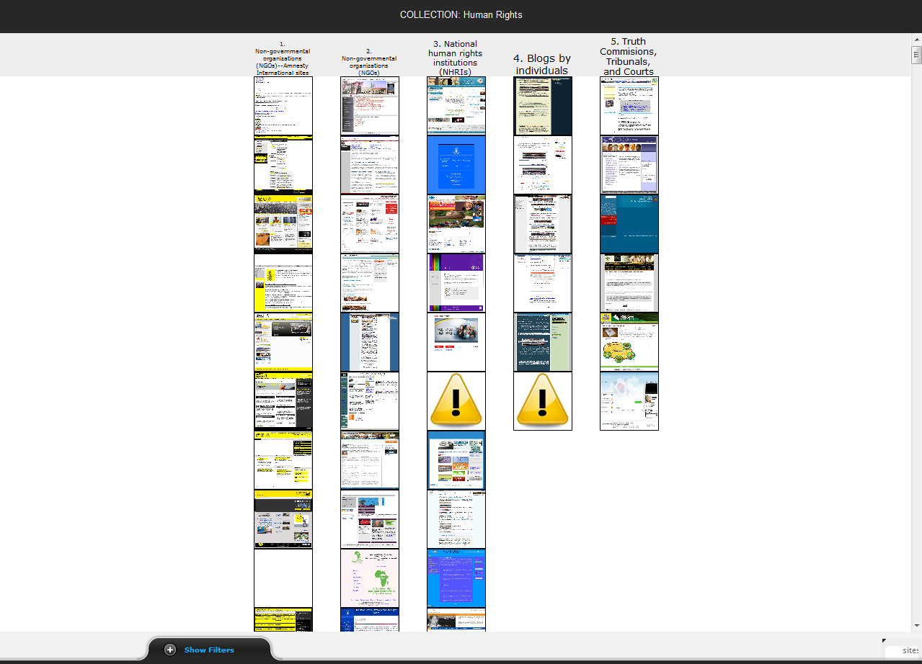
Prototype Visualizations
Treemap
Time cloud
Image plot
K. Padia, Y. AlNoamany and M. C. Weigle, "Visualizing Digital Collections at Archive-It," In Proceedings of the ACM/IEEE Joint Conference on Digital Libraries (JCDL). June 2012.

Slide 10
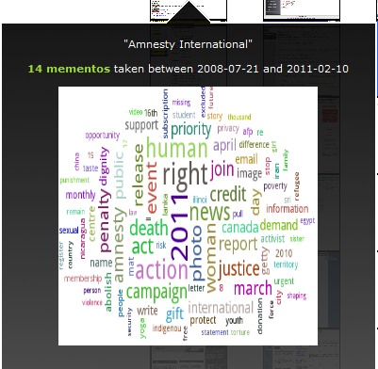
Prototype Visualizations
Treemap
Time cloud
Image plot
Wordle
K. Padia, Y. AlNoamany and M. C. Weigle, "Visualizing Digital Collections at Archive-It," In Proceedings of the ACM/IEEE Joint Conference on Digital Libraries (JCDL). June 2012.

Slide 11
Prototype Visualizations
Treemap
Time cloud
Image plot
Wordle
K. Padia, Y. AlNoamany and M. C. Weigle, "Visualizing Digital Collections at Archive-It," In Proceedings of the ACM/IEEE Joint Conference on Digital Libraries (JCDL). June 2012.

Slide 12
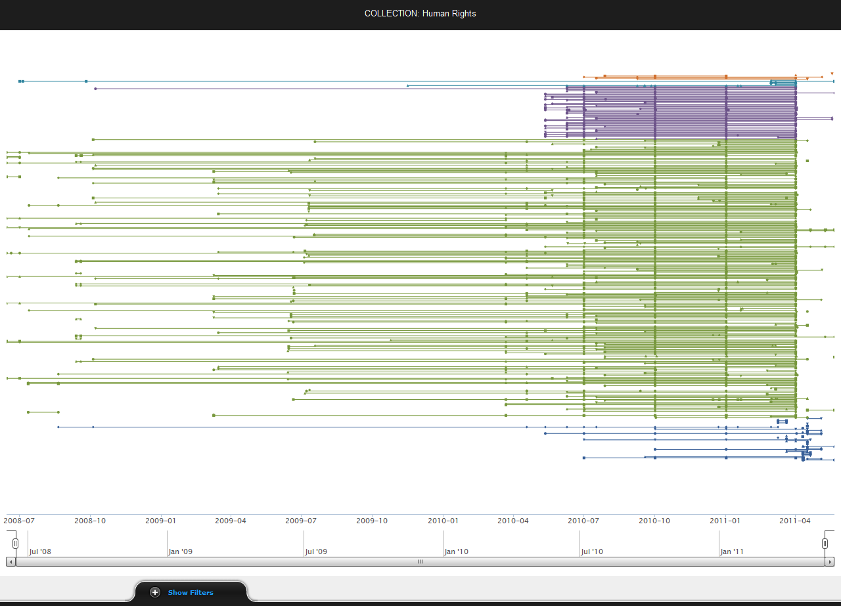
Visualizations
Treemap
Time cloud
Image plot
Wordle
Timeline
K. Padia, Y. AlNoamany and M. C. Weigle, "Visualizing Digital Collections at Archive-It," In Proceedings of the ACM/IEEE Joint Conference on Digital Libraries (JCDL). June 2012.

Slide 13
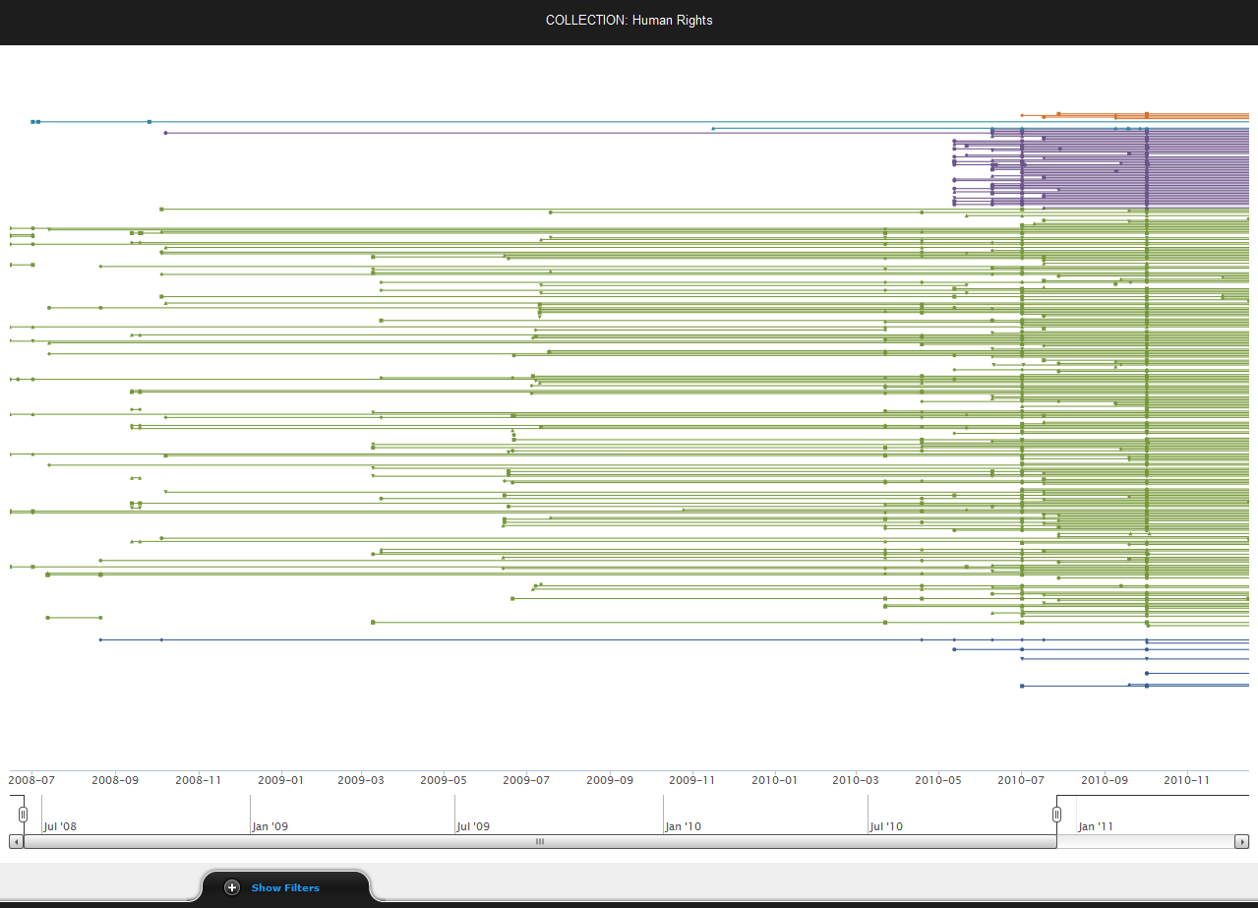
Collection Building and Growth

Slide 14
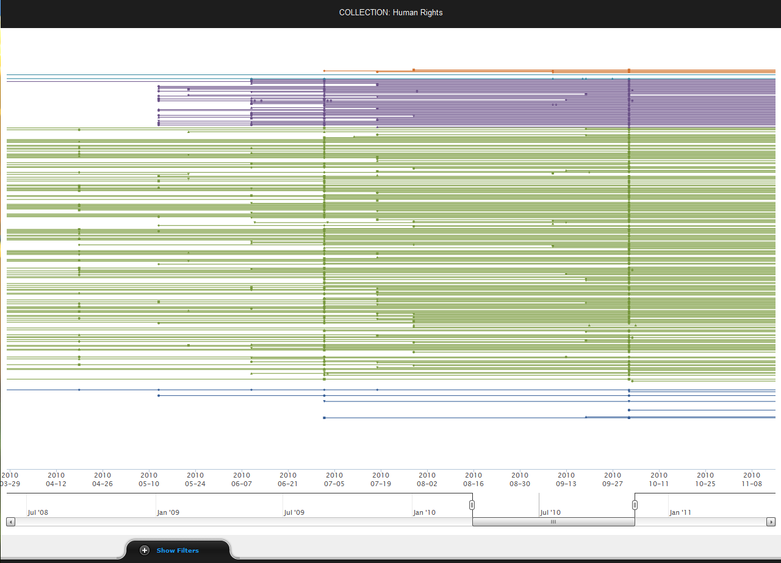
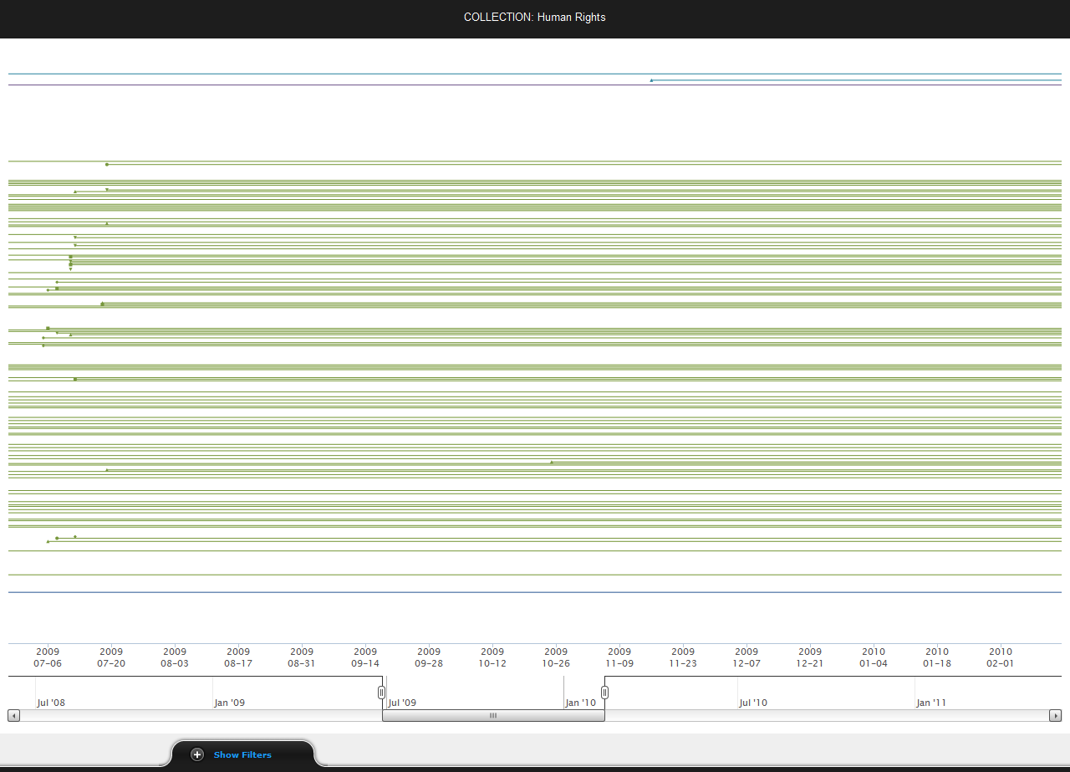
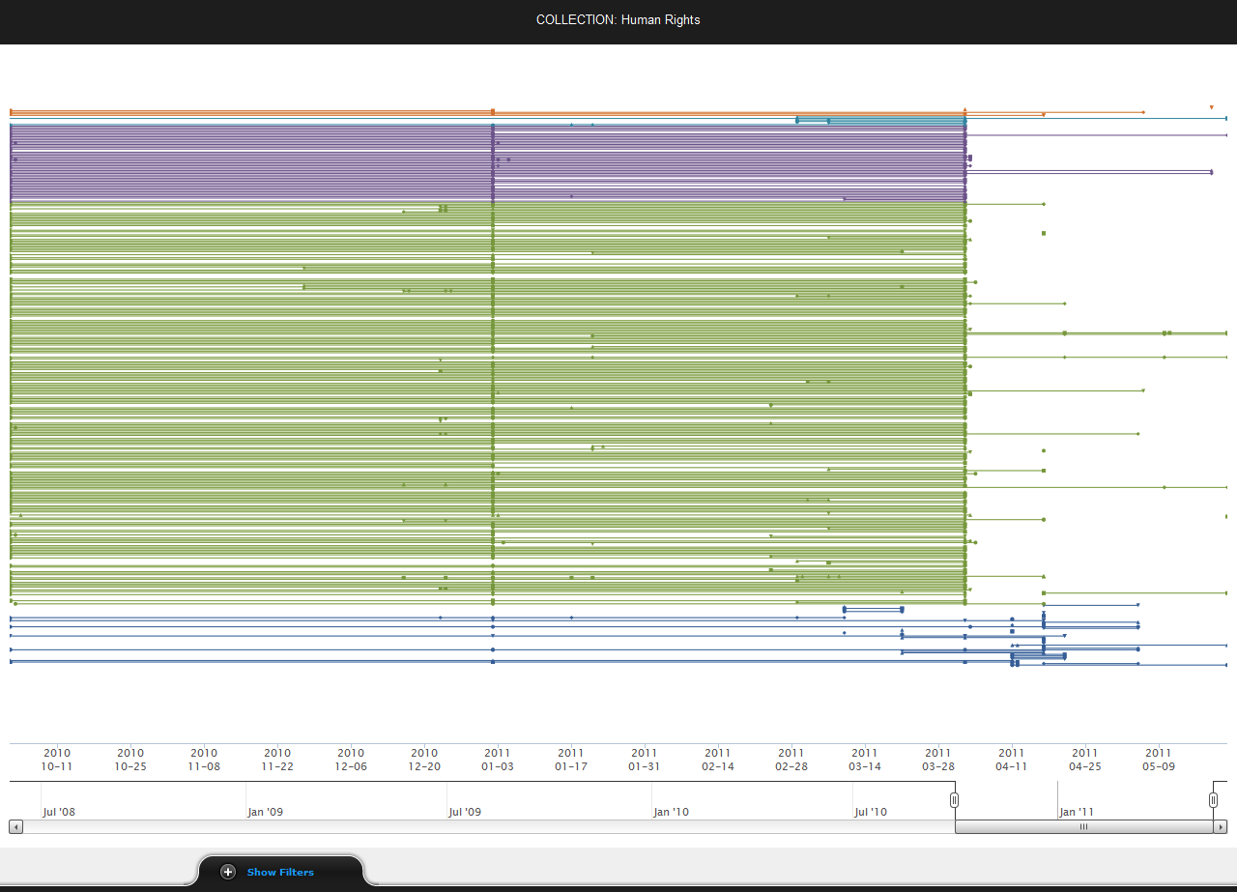
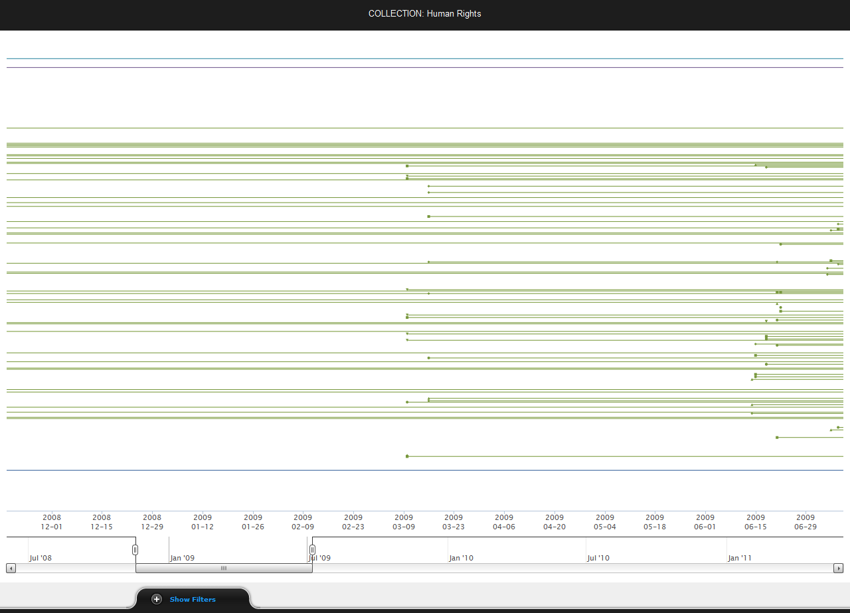
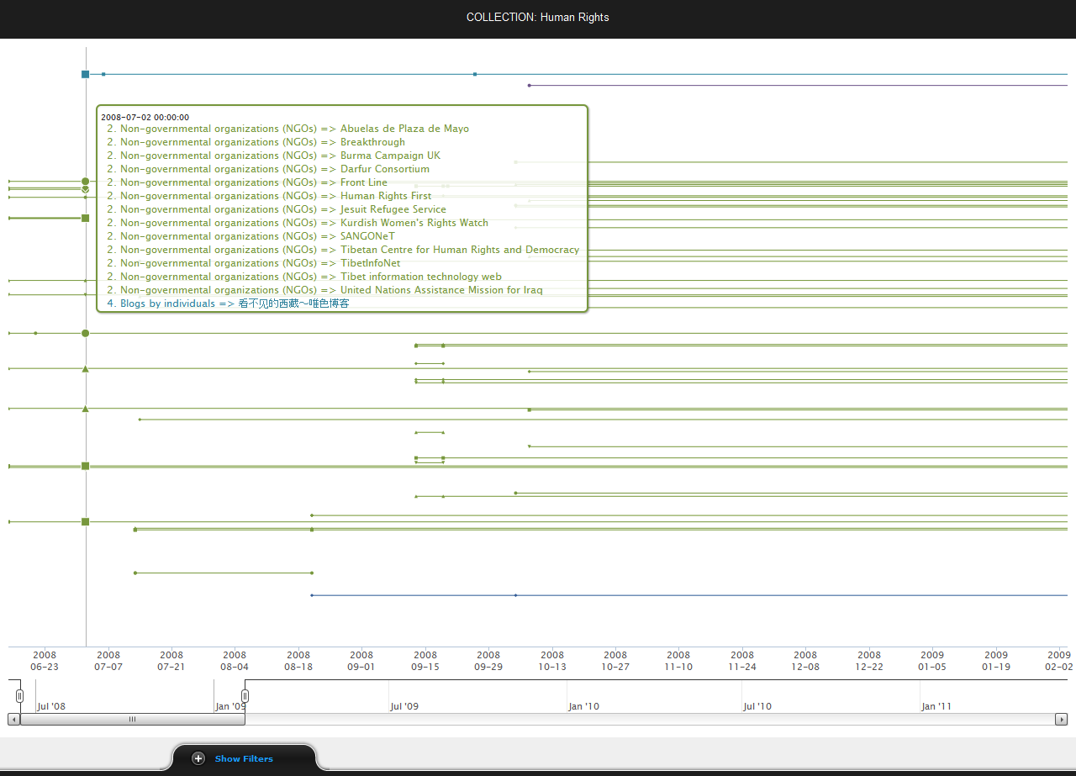
Collection Building and Growth

Slide 15
Collection Building and Growth

Slide 16
Some Collections Have Metadata
http://archive-it.org/collections/1068

Slide 17
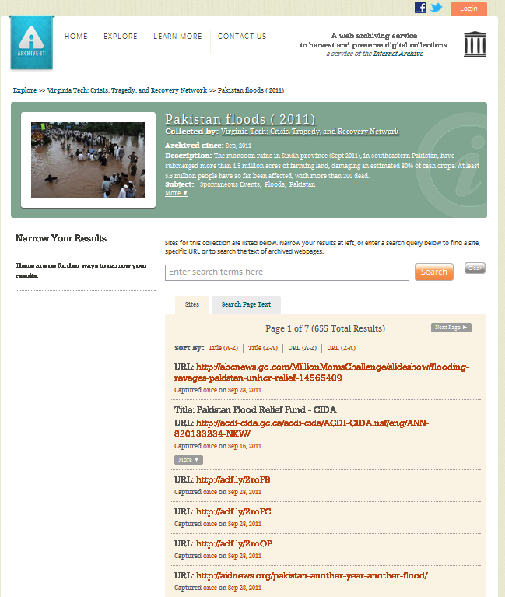
Some Collections Do Not
http://archive-it.org/collections/2836

Slide 18
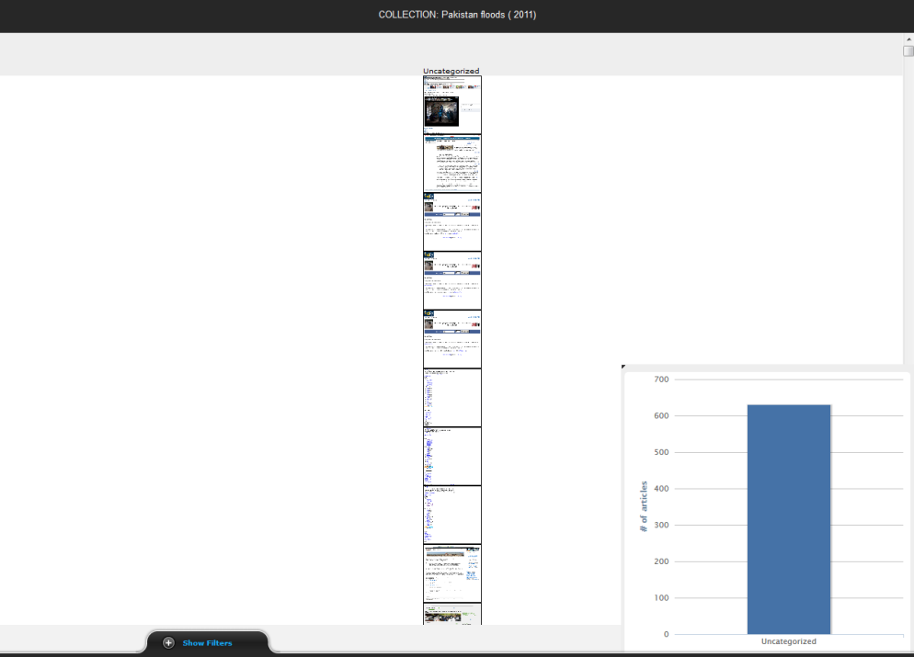
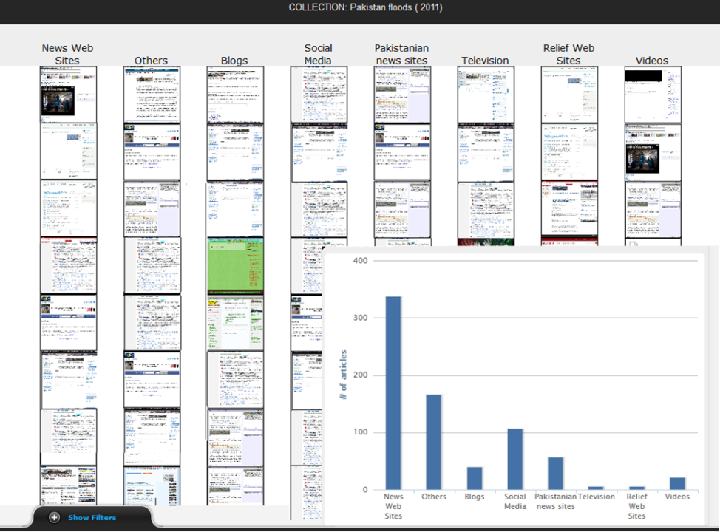
Prototype Re-Categorization
Pakistan Flood Collection
(no categorization)
After our rule-based categorization

Slide 19
Interested?
Michele Weigle
mweigle@cs.odu.edu
We're applying for a NEH Digital Humanities Implementation Grant
partnering with Archive-It
proposal due Jan 2013
Need participants from the humanities and Archive-It partner community
advisory board members - agree to serve as evaluators and provide us with feedback
write letters of support

