Slide 1
Alabama State Government & Politics , an Archive-It Example
Presented at the Archive-It Partner Meeting in Annapolis, Maryland,
December 03, 2012
by Mike Breedlove

Slide 2
ADAH - Early Beginnings
This talk is informal, pragmatic and details our experience
From the beginning we have felt there has been a real partnership between the ADAH and Archive-It, where we each have tried to be helpful, honest and forthcoming
The ADAH began experimenting as an Archive-It partner in September of 2005 under the direction of Tracey Berezansky

Slide 3
ADAH - Early Beginnings
Between 2005 and 2008 the ADAH experimented with crawling state agencies and educational institutions as part of an Archive-It pilot project. By December 2005 the ADAH had harvested 2,142,742 pages, and by December 2006 had harvested 4,140,341 pages

Slide 4
ADAH Collection Development
In 2008, when the ADAH committed to Archive-It as a long-term solution, I was asked to be the Archive-It person, primarily because of my responsibility as the state publications archivist and the fact that we knew we were missing the state publications published in electronic form.
We quickly decided that our primary focus would be on Alabama State Government, so we targeted all three branches of government, especially the constitutional officers.

Slide 5
ADAH Collection Development
The ADAH targeted content rich state agency sites that were well-organized, as the ADAH budget was 5 million documents per year then
In early 2008 the ADAH created the following collections:
Alabama Constitutional Offices, Legislature and Appellate Courts, 26 active seeds
Alabama State Agencies A-H, 65 active seeds
Alabama State Agencies I-Z, 52 active seeds

Slide 6
ADAH Collection Development
The ADAH added another collection that of seeds that we felt might not be captured:
Alabama Regional or Multi-County Agencies or Commissions, 15 active seeds, such as the North Central Alabama Regional Council of Governments and West Alabama Regional Council

Slide 7
ADAH Collection Development
In 2009 the ADAH added another area we believed we needed to document, Alabama Political BLOGs. That way the ADAH would get the “politics” as well as the “government” side
As the web archivist, for lack of a better term, the responsibility for crawling those BLOGs became mine

Slide 8
ADAH Collection Development
It should be mentioned here that the political BLOGs are the equivalent of private records collecting, and that the ADAH houses the Alabama History Museum, with over one million objects, and collects private records and special formats related to Alabama, amounting to well over 10,000 cubic ft. of materials

Slide 9
ADAH Collection Development
The ADAH also realized we needed to subdivide our web collections as crawls were ending due to time limitation before all the documents were captured
Subdividing requires one to deactivate seeds in one collection and activate them in another collection. The metadata must also be added to the seed in the new collection, and the seed shows up in both collections

Slide 10
ADAH Collection Development
The ADAH divided the constitutional officers into four collections, Alabama state agencies into nine collections, Alabama multi-county agencies into two collections and Alabama political BLOGs into four collections in 2009

Slide 11
ADAH Collection Development
It should also be noted that many agencies, though not all, changed their domain from state.al.us to alabama.gov at this time, necessitating a period of time of about two years when we collected both domains as separate seeds, creating redundancy

Slide 12
ADAH Collection Development
In 2010 the ADAH increased its budget from 5 million URLs to 8 million URLs per year
The period of redundant collecting from two different domains also largely ended
These two factors together allowed the ADAH to greatly expand the number of agency seeds crawled that year

Slide 13
ADAH Collection Development
This meant that the ADAH became comprehensive in capturing Alabama agencies, boards, commissions and departments twice a year in 2009
In addition, the ADAH began actively collecting social media sites of state agencies, boards, commissions and departments, specifically Facebook and Twitter posts

Slide 14
ADAH Collection Development
In 2009 the ADAH also added related sites to its seeds collected such the Alabama League of Municipalities, the County Commissioners of Alabama websites, and the Business Council of Alabama to help document local government and economic development, at least indirectly

Slide 15
ADAH Collection Development
The expanded budget allowed the ADAH to add seeds in which Alabama participates in multi-state organizations, such as the Southern States Energy Board and Southern Growth Policies Board
The ADAH also began collecting YouTube channels for state agencies, boards, commissions and departments

Slide 16
ADAH Collection Development
At this point the ADAH has twenty active collections with over 250 seeds
Now we can look at scoping
Notes:
Since the ADAH joined Archive-It, 33,129,143 documents have been placed in Archive-It, amounting to 2,015.8 GB of data.

Slide 17
Scoping
We can start with a bit of basic info from the Documentation in Archive-It: Crawl Scope is how much or how little of a website will be archived, or rules for where a crawler can go
The seed urls added to a collection determine how much of those sites will be archived
Embedded content (images, stylesheets, javascript, etc) on seed pages will be archived (whether or not they are hosted on the same site as the seed)
Websites that are not part of seed urls will not be crawled

Slide 18
Scoping
It is often (but not always) a good idea to end your seed URL with an ending slash, and when adding seeds the Archive-It interface may suggest you add one.
Do NOT use an ending slash if you want all sub-domains of your seed url to be in scope
Sub-domains of seed urls are NOT included in the scope of your crawl by default:

Slide 19
Scoping
In some cases the ADAH adds the slash at the end, and in some cases the ADAH does not
For example, to be comprehensive with state agencies the ADAH does NOT add the slash at the end because we want to capture the subdomains.
In large agencies there are often subdomains composed of divisions.

Slide 20
Scoping
One example is Public Health
The ADAH uses http://www.adph.org to insure the subdomains such as news http://www.adph.org/news/, county health departments http://www.adph.org/administration/Default.asp?id=505 and webcasts http://adph.org/rss/alphtnwebcasts.xml are included

Slide 21
Scoping
The ADAH leaves off the ending slash for one political BLOG as well
Doc’s Political Parlor and Home of Lawn Mower Repair, http://www.politicalparlor.net has several sub-domains
One of those in particular is audio from the Alabama Legislature, http://www.politicalparlor.net/doc/audio-archives/

Slide 22
Scoping
Audio from the Alabama Legislature
2011 Regular Session
2010 Special Session
2010 Regular Session
2009 Special Session
2009 Regular Session
[Hopefully the 2012 audio will be released soon]

Slide 23
Social Media and Ignoring robots.txt
The Alabama State Records Commission approved a standard permanent retention for all social media sites at its October 2012 meeting
The ADAH uses the ignoring robots.txt option for state agency social media sites, specifically those hosted by Facebook and Twitter
These sites are created by state government agencies and represent state government activity and transactions

Slide 24
Scoping
Capturing social media sites are always interesting. The ADAH has tried to get agencies to make their Facebook pages completely open, with some success
Trying to wade through the various Facebook settings, which change often, is a challenge in and of itself

Slide 25
Scoping
The technical folks at Archive-It have really allowed us to know what is happening on social media sites and to make adjustments
This has not been as much of a problem with Twitter, though challenges have occurred there as well

Slide 26
Scoping
The ADAH captures social media sites, specifically one Facebook collection, with 40 seeds, two Twitter collections with 21 seeds, and one news and RSS feeds collection, with 21 seeds, every two months, for both the political and state government seeds
We capture YouTube state agency seeds, with 24 seeds, twice a year
These crawls usually only take a few hours to run

Slide 27
Making Archive-It Accessible
Screen capture of digital page on ADAH web site
http://digital.archives.alabama.gov/

Slide 28
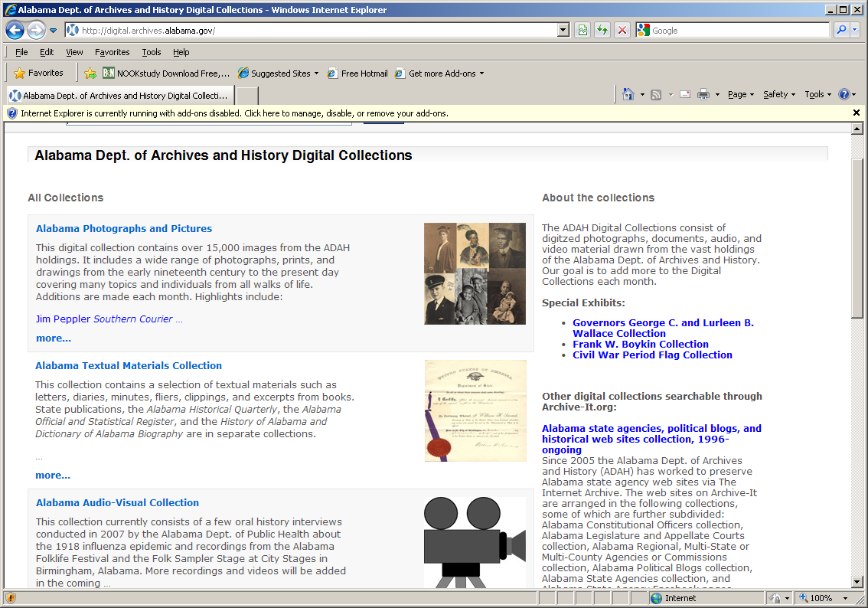
Making Archive-It Accessible

Slide 29
Making Archive-It Accessible
Screen capture of ADAHCAT catalog record
http://216.226.187.53:81/vwebv/search?searchArg=blogs&searchCode=GKEY%5E*&limitTo=none&recCount=10&searchType=1&page.search.search.button=Search

Slide 30
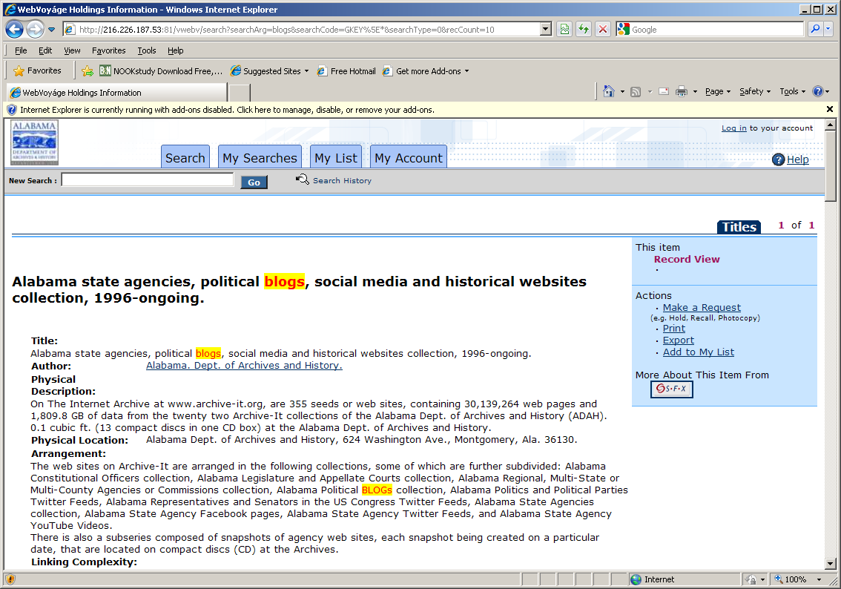
Making Archive-It Accessible

Slide 31
Making Archive-It Accessible
Screen Capture of Agency History Page with Archive-It link

Slide 32
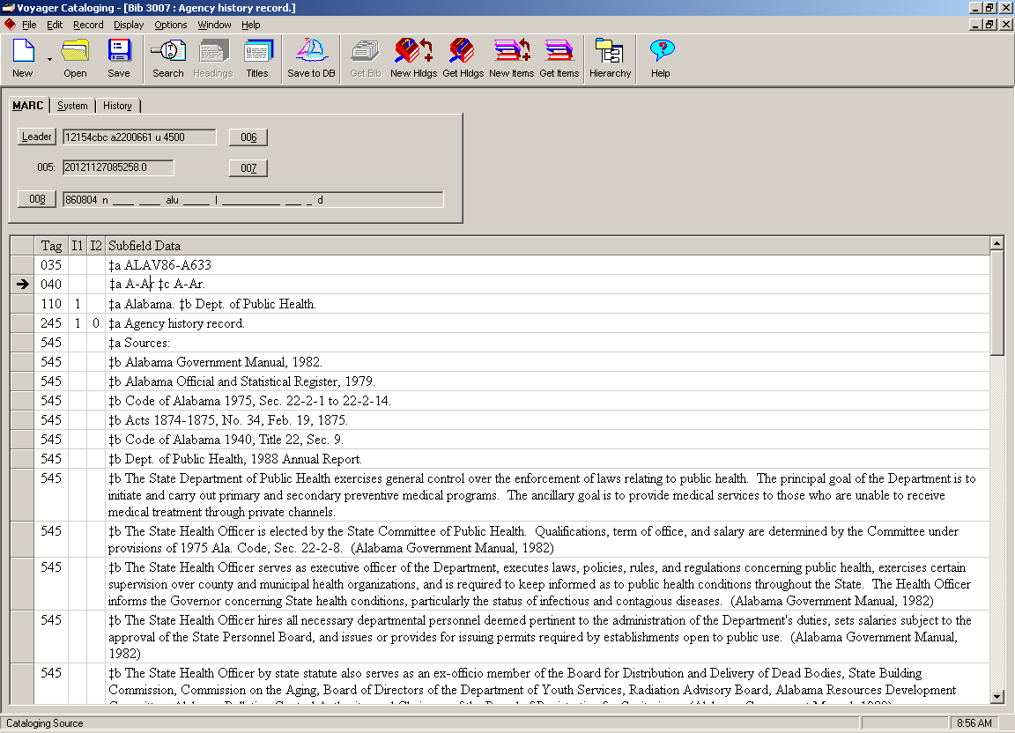
Top of the Catalog Record
Notes:
v3007 in ADAHCAT

Slide 33
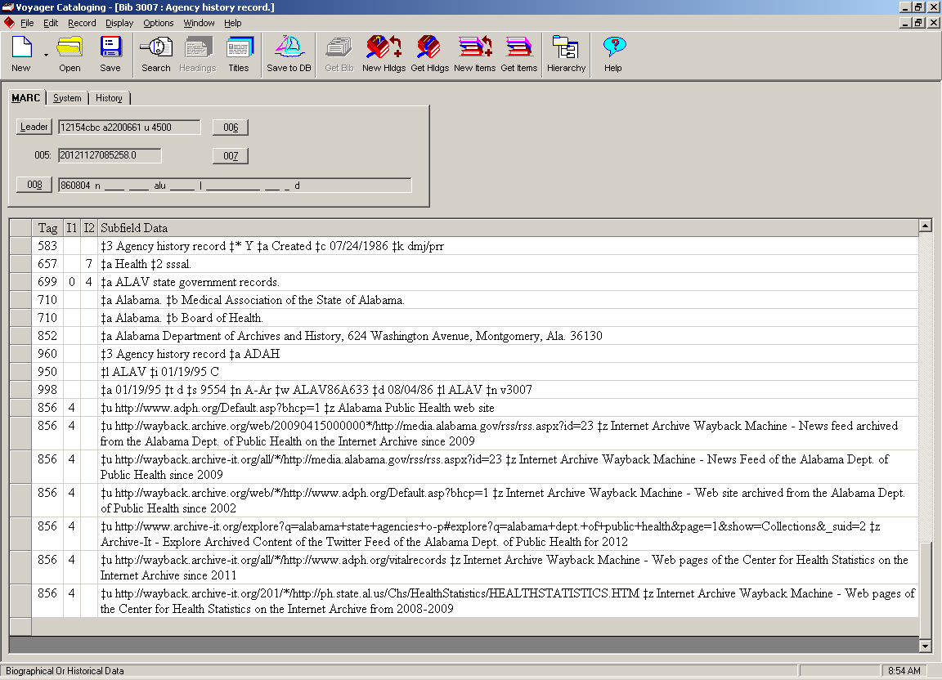
Bottom of the Catalog Record

Slide 34
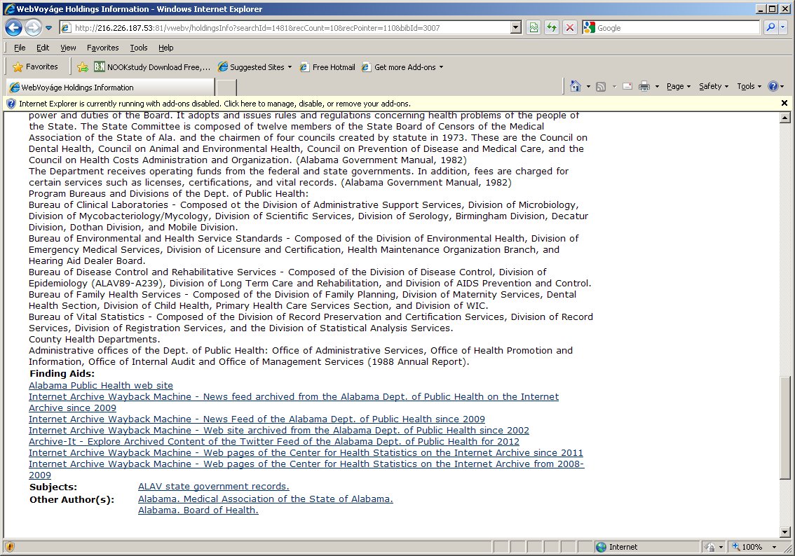
Bottom of Screen the Public Sees

Slide 35
Making Archive-It Accessible
Screen Capture of State Publications Page with Archive-It link

Slide 36
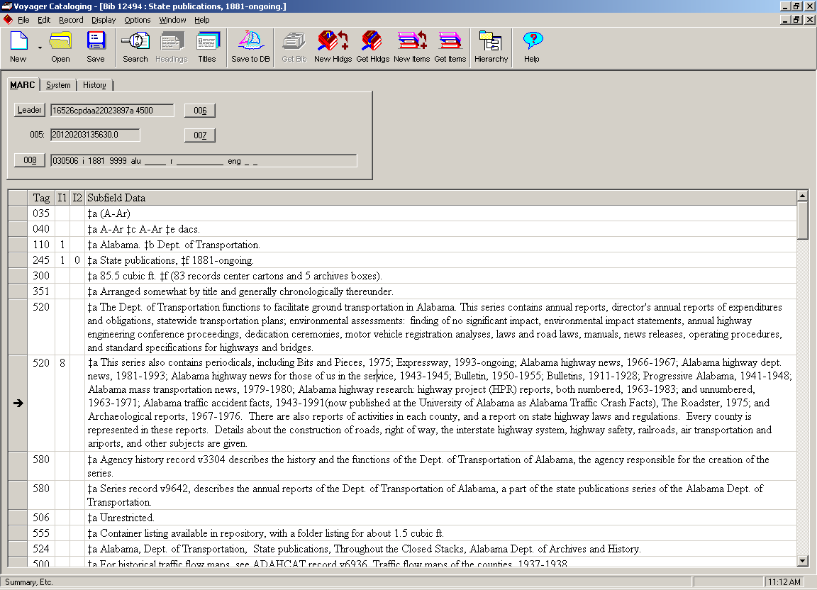
Top of the Catalog Record
Notes:
v12494

Slide 37
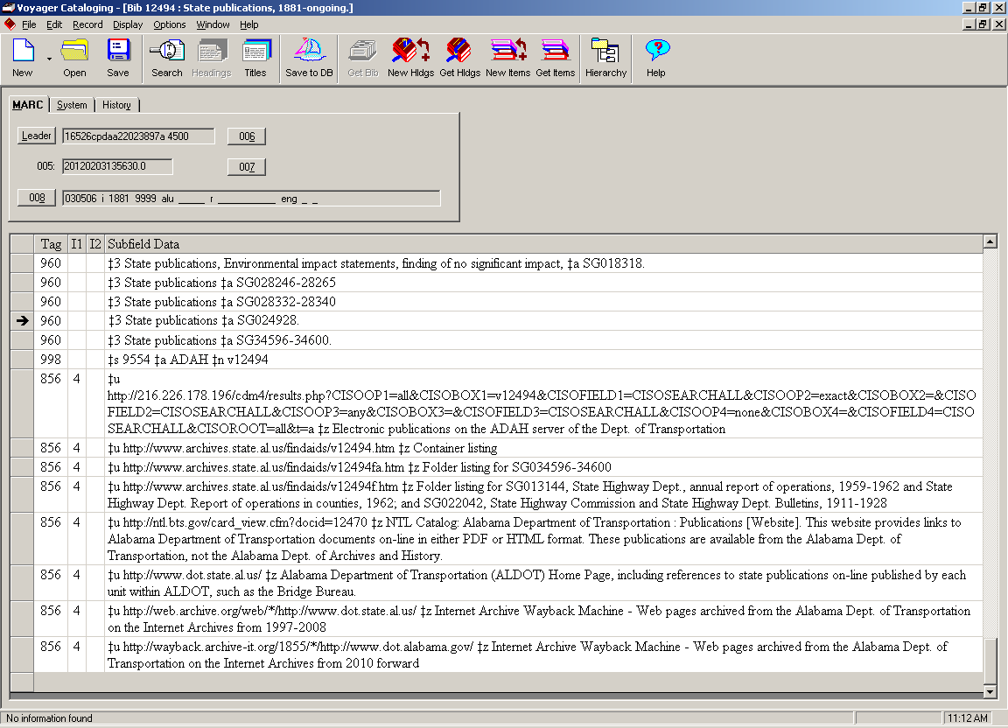
Bottom of the Catalog Record
Notes:
V12494 in ADAHCAT

Slide 38
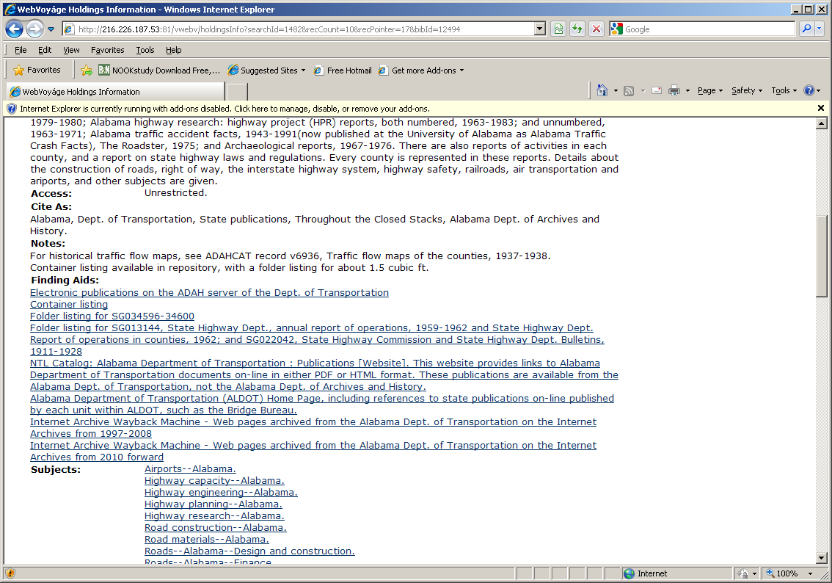
Bottom of Screen the Public Sees

Slide 39
ADAH Collection Development and Scoping
This has been a lightning tour
Questions or comments?

