Slide 1
ACCESS TO OUR ARCHIVED WEBSITE COLLECTIONS
Can we be doing more?
Beth Tillinghast
University of Hawaii at Manoa
October 19, 2011
Archive-It Partner Meeting

Slide 2
Access Points
ACCESS POINTS - METADATA
What is the best practice?
What guidelines do you use?
What is your practice?
Seed-level metadata
Collection-level metadata
Do you have a metadata policy in place as part of your Collection Development Plan?

Slide 3
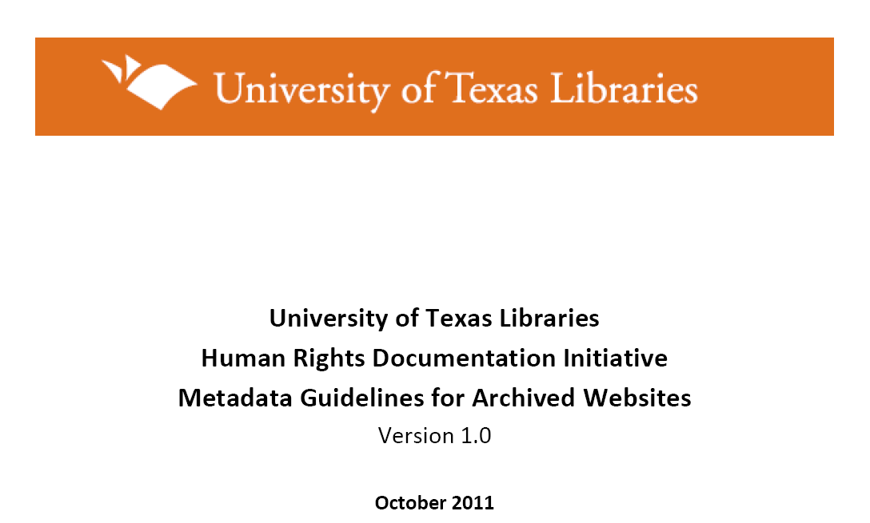
Access Points
ACCESS POINTS - METADATA
Just released ….
…from the University of Texas Libraries

Slide 4
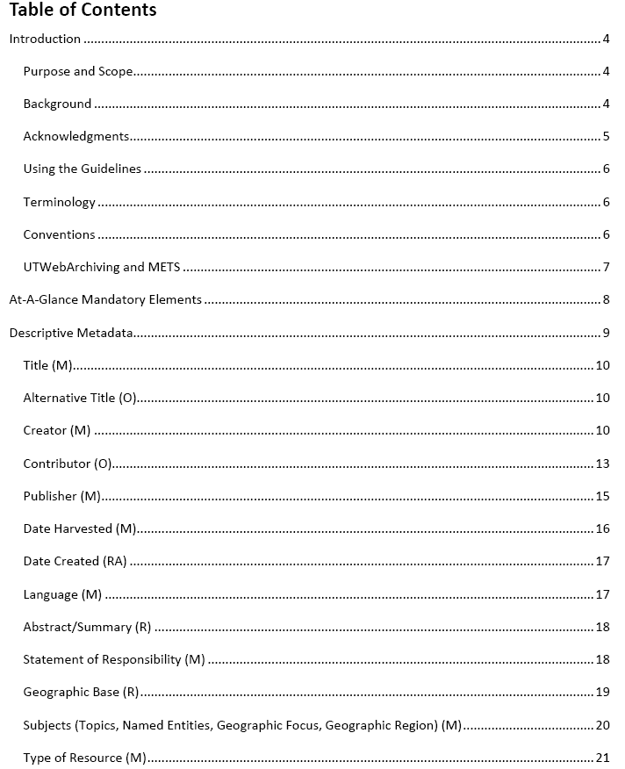

Slide 5

Access Points
ACCESS POINTS - METADATA
Document URL
http://dl.dropbox.com/u/7100804/Archived_Websites_Metadata_Guidelines_v1.pdf
Contact - Amy Rushing @
a.rushing@austin.utexas.edu

Slide 6
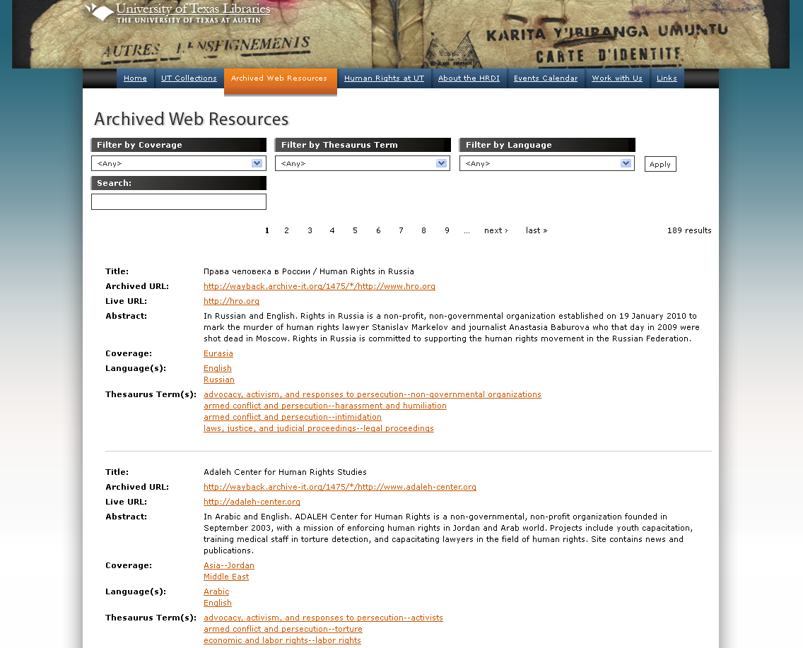
Access Points
Through an institution’s website

Slide 7
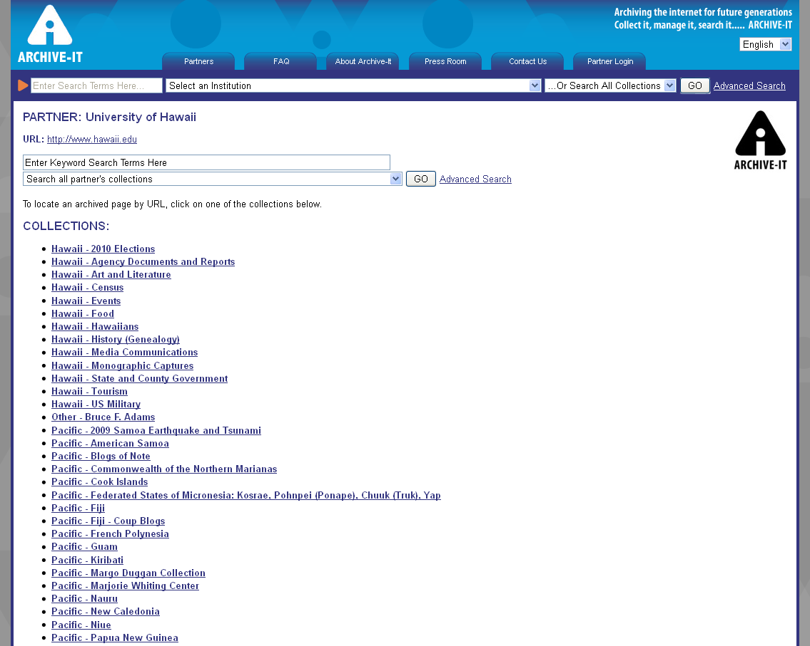
Access Points
Through the Archive-It Partner Page

Slide 8
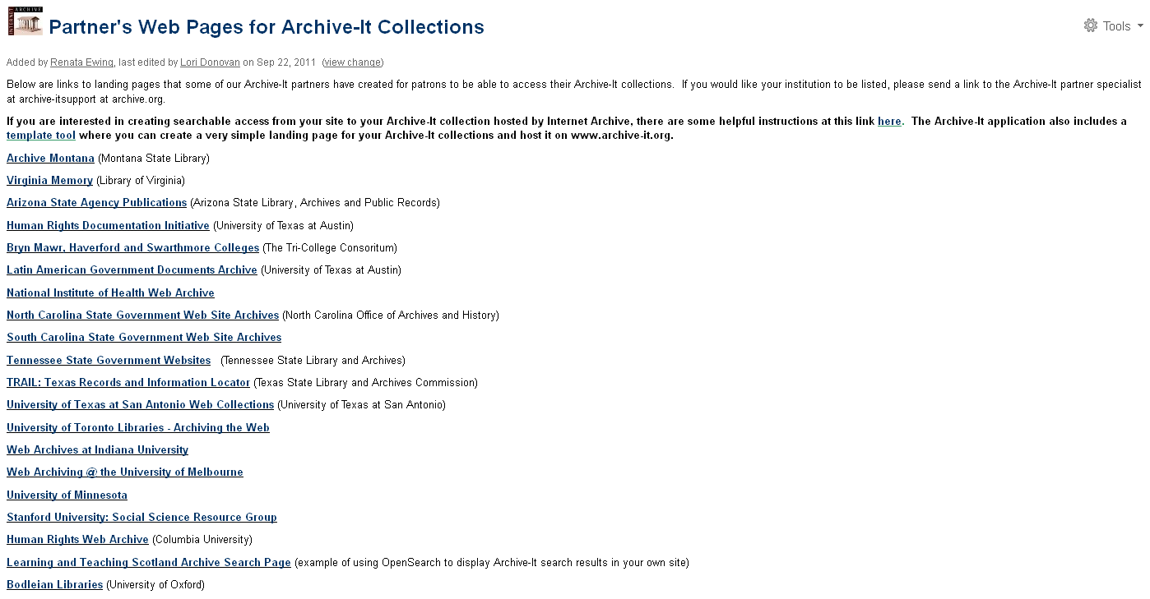
Access Points
Partner‘s Web Pages for Archive-It Collections

Slide 9
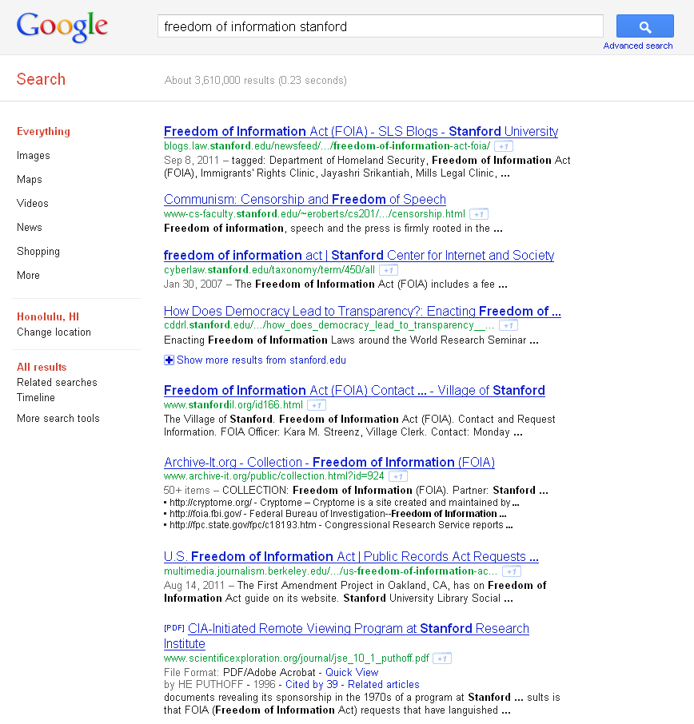
Access Points
General Web Search

Slide 10
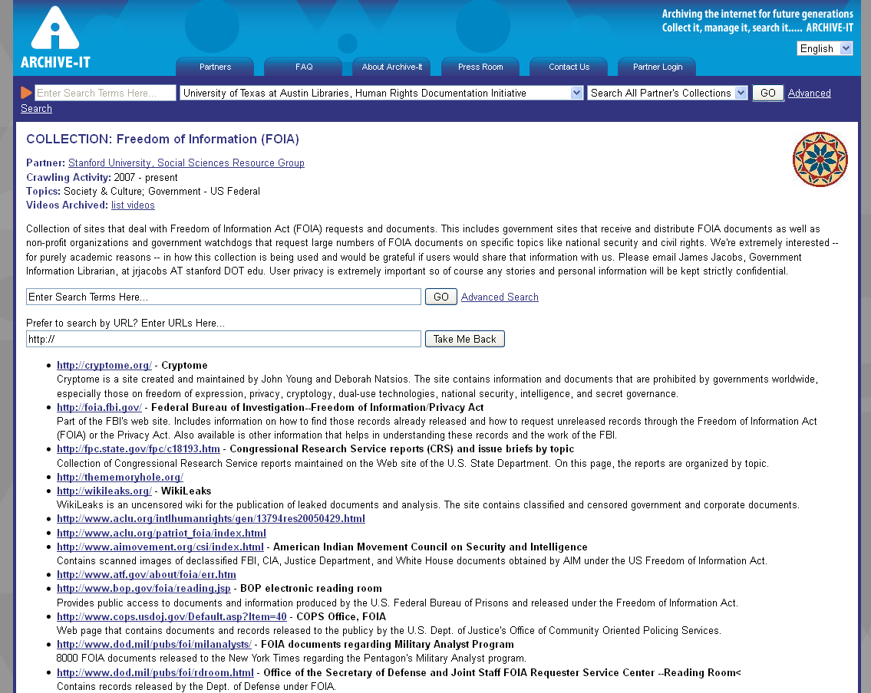
Access Points
General Web Search

Slide 11
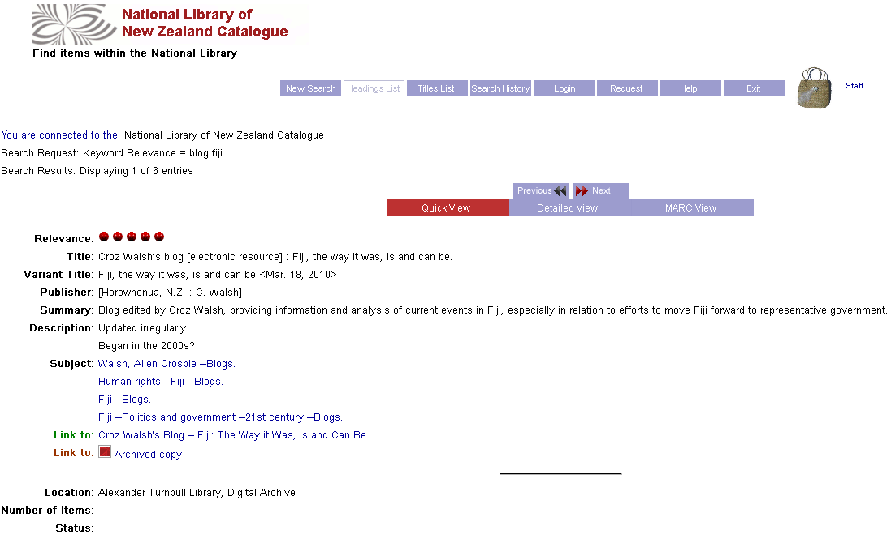
Access Points
Through an Institution’s Online Catalog

Slide 12
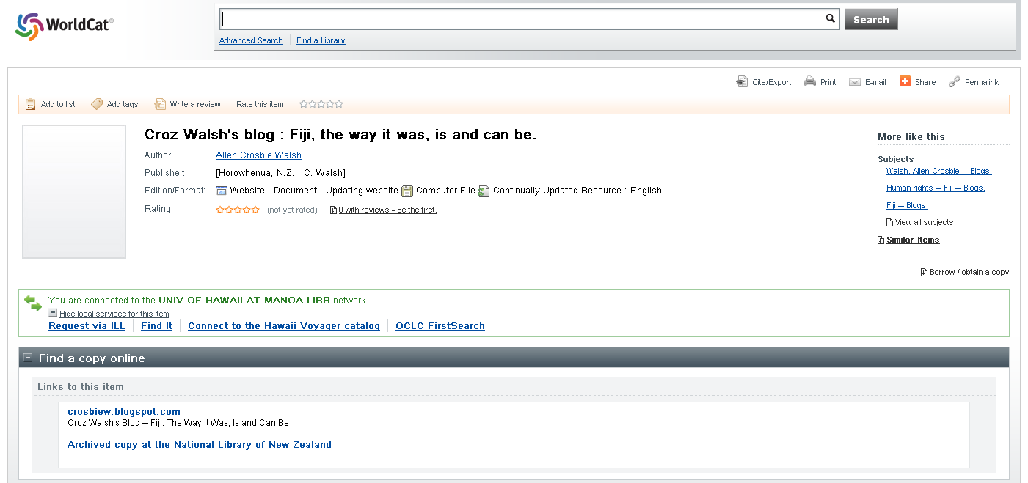
Access Points
Through WorldCat Via a Library Catalog

Slide 13
Access Points
WorldCat Digital Collection Gateway
Free tool providing ability for uploading the metadata of your unique digital content to WorldCat
http://www.oclc.org/gateway/

Slide 14
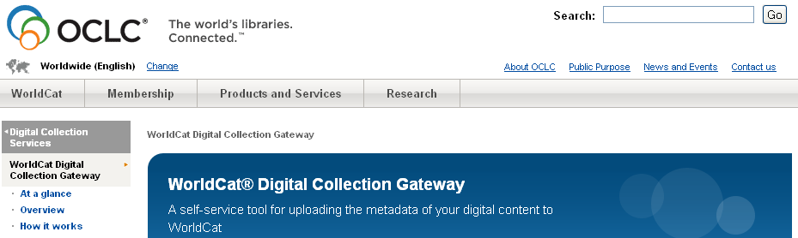
Access Points
Harvesting Archive-It records directly into WorldCat via the Digital Collection Gateway

Slide 15
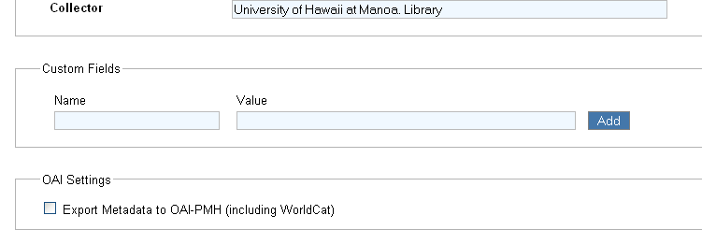
ACCESS POINTS
Exporting Metadata to WorldCat for collections

Slide 16
Other Thoughts ??
Are there Archive-It plans to allow document-level metadata harvesting?
What other ways can we provide better access to our archived websites?
Do the Archive-It Partners want to work together to develop an appropriate Best Practices?

Slide 17
Thank You!

