Slide 1
Metadata practices among Archive-it partner institutions: the lay of the land
Michelle Sweetser
19 October 2011
Notes:
We found that the staff at Archive-It were incredibly helpful in helping us set up our account and in trouble-shooting and refining crawls so that we had better success, but we were not exactly sure about decision-making in a number of areas that surrounded metadata, ways of making users aware of content, linking content, and the like. We wanted to know more about what our peers were doing, but felt we had not seen much within the professional literature on the this topic. This prompted my fellow librarian, Lynn Whittenberger, and I to undertake a survey to gain a better understanding of the landscape of Archive-It users. Unfortunately, due to a number of personal issues, Lynn’s participation in data analysis has been curtailed. I very much want to acknowledge her assistance in designing the survey itself.

Slide 2
Demographic information about respondents
Notes:
We sent an email inviting participation to the Archive-It member listserv on March 21, 2011. At that time, the list had 282 members; but if you de-dupe the list based on domain alone, it reduces the organizations represented to a maximum of 137, as some organizations – including my own – have more than one employee on the list. By the time the survey closed on April 6, we received 37 responses, a response rate of 13% of the full list or 27% of the de-duped list.

Slide 3
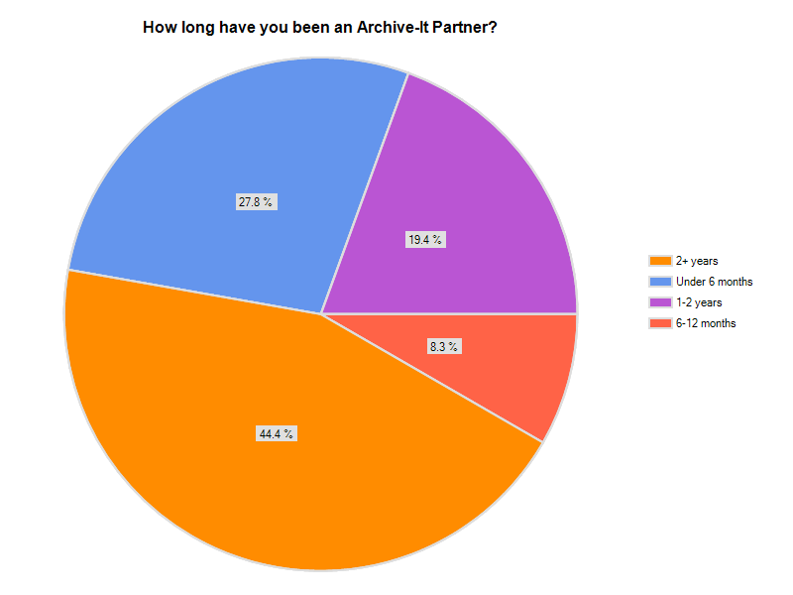
Notes:
We began by asking participants about the length of time they had been with Archive-It.
As you can see, 44% have been partners for over two years, but the next largest group of respondents are Archive-It newbies, using the service for under 6 months. My own organization fell into that category at the time. Depending on frequency of crawl schedules, some respondents may have experienced only one harvest, or perhaps two at the time they completed the survey.

Slide 4
Notes:
Nearly half of respondents were affiliated with a college or university archive or library; the second largest group of respondents identify with state archives or libraries, and the numbers drop off from there.

Slide 5
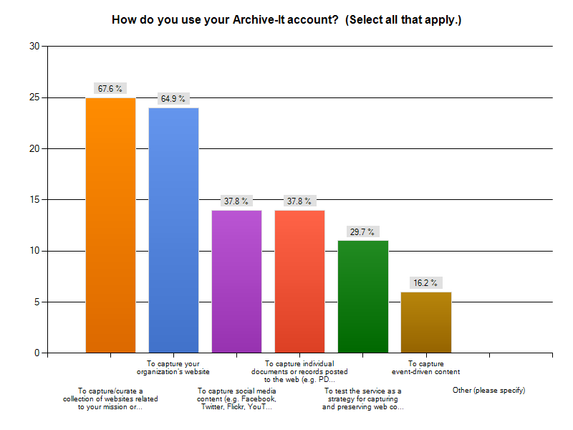
Notes:
We asked respondents how they use their Archive-It accounts; for this question they could select all answers that apply, so the percentages add up to more than 100.
The top uses of the Archive-It software, quite predictably, are to capture/curate collections of websites related to the mission of the organization (67.6%) and to capture their own organization’s website (64.9%).
A second tier of priorities cluster around 38% - with capturing social media content and capturing individual documents or records posted to the web. Nearly 30% of respondents report they are using Archive-It in some sort of “testing” capacity to see how it might work for capturing and preserving web content.
Only 16% report using their accounts to capture event-driven content.

Slide 6
Notes:
One-third of responding organizations have two or more individuals involved with Archive-It efforts at their institutions, and over ¼ have four or more individuals involved.

Slide 7
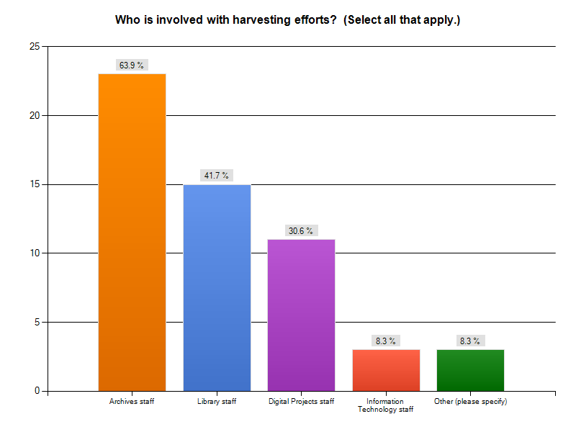
Notes:
We also wanted to know who is involved in harvesting efforts; respondents could select all options that apply, so percentages add up to more than 100.
Archives staff, quite naturally, seem to be most closely involved with harvesting efforts with nearly 64% or organizations reporting that that department was involved in some way.
Library staff in general are involved in the efforts at 42% of organizations, and just over 30% report involvement by digital projects staff.
It is interesting to see that information technology staff are involved at only 8% of the responding organizations.
Other responses here included students (mentioned by two respondents) and one responding institution that involves web teams in some way.
We also asked a question about the frequency of harvesting efforts, but the majority of respondents replied that they could not generally characterize the frequency, as it varied from collection to collection or that they were still trying to determine how frequently they should be harvesting.

Slide 8
Notes:
Half of all responding organizations devote less than 1 hour per week to their Archive-It efforts, and 44% spend 1-5 hours per week. This obviously is not an activity in which practitioners are currently spending a lot of time, perhaps in part by design.

Slide 9
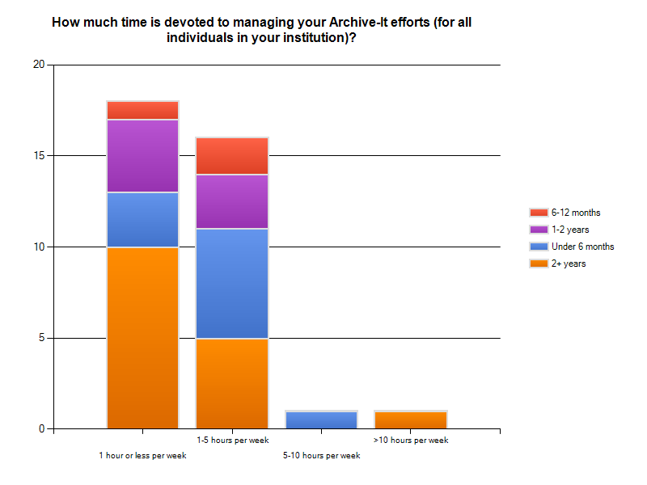
Notes:
If you cross-tab this question and look at responses based on the amount of time an institution has been an Archive-It partner, you will find that the partners who have been with Archive-It one year or more tend to fall more heavily into the 1 hour or less/week category (14 of 18 responses) and those who have been with Archive-It for up to one year tend to fall more heavily into the 1-5 hour per week category (8 of 16 responses). This seems to make logical sense as you consider the learning curve for a new software product, developing workflows, and the like.
The higher categories – with one respondent each – represent an organization with Archive-It for less than 6 months and spending 5-10 hours/week and an organization with Archive-It for over two years spending more than 10 hours a week.

Slide 10
respondents’ current metadata practices within archive-it
Notes:
As I mentioned earlier, one of the reasons we embarked on this research project was to learn more about what our colleagues were actually doing in terms of preparing metadata about resources collected in their Archive-It collections.
As you know, Archive-It allows us to prepare metadata at three levels: that of the collection, that of the seed, and that of the individual document or file. Are partner organizations preparing metadata within Archive-It?

Slide 11
Metadata practices within Archive-It
35% of respondents prepare metadata at the collection level beyond the required description field, 35% do not.
The majority of responding institutions (51%) do not prepare or scrape metadata for individual seeds for use on collection pages (22% always do).
Of the 17 responding institutions who do prepare or scrape metadata for individual seeds, 71% generate the metadata manually; 47% pull it automatically from the <title> tag.
81% of respondents do not prepare metadata for individual documents captured by Archive-It crawls.
75% of those who do prepare metadata for individual documents generate it manually.
Only one respondent (3%) reported creation of a customized metadata field.
44% of respondents prepare site groupings within Archive-It, 47% do not.
Notes:
Given that the majority of respondents spend less than 1 hour a week on their Archive-It efforts, responses in the area of metadata preparation are not particularly surprising.
Read points on the slide!
4. The customized metadata field was created to repeat an existing field.
5. Those who have been Archive-It partners for less than 6 months are slightly less likely to create site groupings than those who have been partners for longer periods. This could be the result of a number of factors, including the time they have had to experiment with the product, the possibility that they may harvest fewer seeds and have less need for site groupings to arrange their collection pages, or something else entirely.
Given that 44% of respondents have been using Archive-It for 6 months or less, it will be interesting to see if these responses change over time. Generally speaking, as the process of metadata creation becomes more granular – moving from the collection to seed to document level – it becomes an increasingly manual process, meaning it is also more time-consuming.

Slide 12
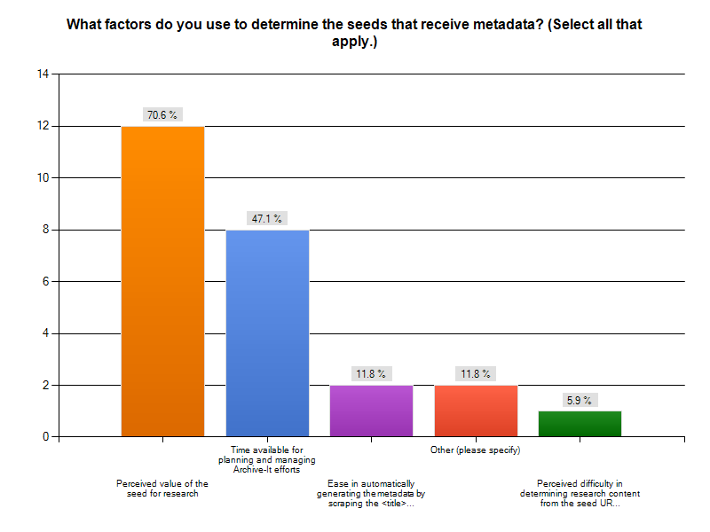
Notes:
Two main factors seem to play a role in decisions to create seed-level metadata in general: the perceived value of the seed for research and the time available for planning and managing Archive-It efforts. There are a few other factors that weigh into the equation, including the ease in automatically generating the metadata and the perceived difficulty in determining the content from the seed name itself.
The other category here: 1 institution noted in research mode; another noted that all or almost all seeds receive metadata, so the factors don’t really apply to their decision-making.

Slide 13
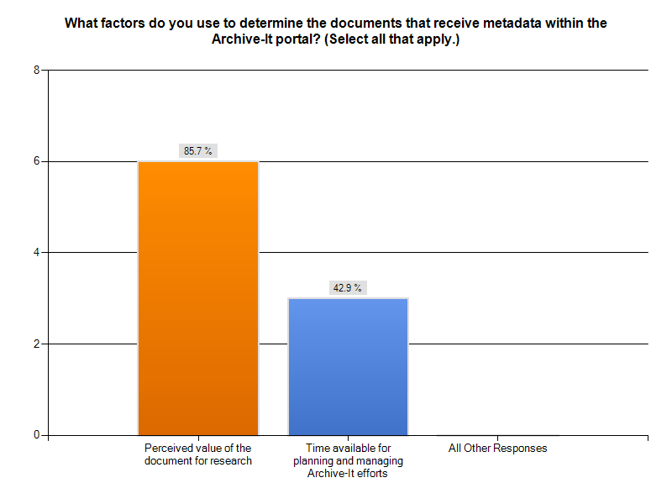
Notes:
When we asked about factors used to determine documents that receive metadata, responses fell into only two categories, the same as for the seed-level. Nearly 86% respondents base their decisions on the perceived value of the document and the number basing the decision on time available remained fairly stable at almost 43%.

Slide 14
Notes:
We also asked respondents about their usage of Dublin Core fields with regard to seeds and individual documents. The number of respondents who actually prepare metadata for individual documents is too low to generate meaningful discussion, but you can see here that in every case with the exception of the format field, respondents are more likely to use a field at the collection, as opposed to the seed level.
The most utilized fields, not surprisingly, are the description and title fields, with a flip-flopping in primary usage between the collection and seed levels.
For me, the biggest take-away in terms of respondents’ practices in generating metadata within Archive-It is that organizations are not, by-and-large, doing a whole lot. There are a number of possible reasons, including:
Organizations just haven’t yet gotten around to preparing metadata in Archive-It and are still in their infancy in terms of their web archiving efforts
Organizations do not believe that metadata is warranted or useful to be created
Organizations are focusing their metadata creation practices in areas outside the Archive-It platform
Of course, it could be something else entirely as well.

Slide 15
Creating awareness of content captured by archive-it
Notes:
Now that we know a little bit more about how organizations are applying and using metadata within the Archive-It portal and framework, we wanted to learn more about how organizations were directing users to this content and, in general, making them aware of its existence.
This content we are capturing with Archive-It is by and large in a silo, separated from related material in the archives due to the service employed to capture and present it. What are organizations doing to enable discovery of this content and to build linkages between Archive-It content and other content described and accessible via more traditional modes – for example, in finding aids and catalog records?

Slide 16
Notes:
One place librarians and archivists have traditionally described content is within a catalog record. You can see here that the majority of respondents do not catalog Archive-It content at any level within a catalog record, with responses from roughly 63% to 70% in the negative, depending on the granularity.
Of the 13 respondents who do create catalog records at some level, the highest percentage prepare records at the collection-level. 7 of those 13 (54%) also submit records to WorldCat.
Archivists also prepare finding aids describing their holdings at a more detailed level. Within university settings in particular, it seems quite likely that content captured by an Archive-It subscription would continue series already held by the organization in paper or other formats. We were curious as to how or if partners are building linkages between content in these different formats, stored and accessible in different ways.

Slide 17
Notes:
Only 23% of respondents are linking to Archive-It content from their finding aids! Again, I am not sure if this is due to lack of time devoted to this effort or something else. Within our organization, there are some people who are concerned about linking to content before we are able to show a history of crawls, and so this is a step we are delaying on for the short term.

Slide 18
Notes:
Another approach – and not one that we necessarily advocate – could be to create separate collections, record groups, or series to describe only the content collected via Archive-It. Few respondents – just over 17% have taken this approach.

Slide 19
Notes:
One other popular means of discovery is the Google-type search box that many of us deploy in some form on our institutional sites. Archive-It offers code for such a box to be deployed on organizational websites to search Archive-It content. Only 41% of respondents reported that they include an Archive-It search box on their organization’s website.
By and large, then, it appears that respondents are not employing tactics to build linkages between the content being captured by Archive-It and the content collected and described elsewhere.

Slide 20
Where do we go from here?
Notes:
As the final piece of our survey, we designed a series of questions that we hoped would get at whether organizations were happy with their efforts, or whether they saw their Archive-It efforts in their infancy and the direction in which they felt they might be going. We hypothesized that as many organizations were still relatively new to the service, they might report less incidence of some sorts of descriptive efforts we asked about due to the fact that they had yet had the opportunity to explore or implement them.

Slide 21
General Satisfaction
Respondents were split in terms of satisfaction with users’ ability to discover their publicly accessible Archive-It content (47% satisfied, 53% unsatisfied).
Vast majority (82%) indicated an intent to extend efforts to make users more aware of the availability of resources captured by Archive-It.
Notes:
Those who do not intend to make users more aware of resources in Archive-It tend to view it as a
low-priority project,
lack the resources to increase awareness (time, staff, etc.)
or have fears that the archived content might be mistaken for current content and so are, in some ways, trying to keep that content less discoverable.

Slide 22
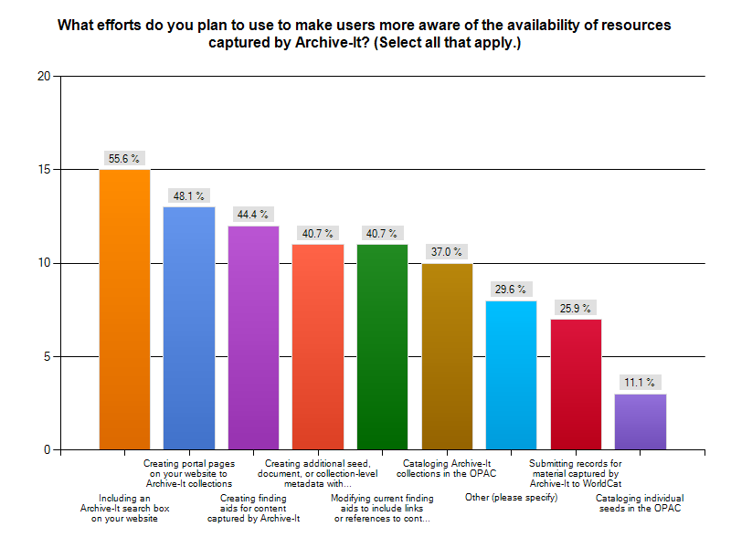
Notes:
We asked about the ways in which organizations planned to make users more aware of content in Archive-It.
The top areas tend to relate to activities creating those linkages between Archive-It content and organizational webpages or finding aids describing archival content, with 56% planning to include an Archive-It search box on their website and 48% planning to develop portal pages to Archive-It content.
Priorities are much lower focusing on the creation of metadata within Archive-It, and the fewest respondents plan to focus on metadata within the OPAC.
Answers provided by respondents in the other category (8) were a bit all over the map, though several respondents noted that they intended to conduct some sort of publicity/awareness campaign. Other responses included interest in
Adding a link to Archive-It on institutional 404 pages, and
adding Archive-It URLs for electronic versions of resources to catalog records for print versions, and
adding some of the harvested content to the organization’s main digital repository in topic-based collections and trying to refine the search capabilities for precision

Slide 23
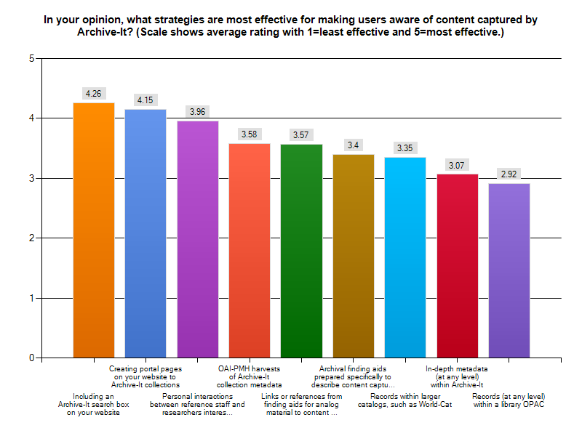
Notes:
Finally, we asked respondents which strategies they felt were most effective in increasing awareness of content, as we weren’t sure whether they would be entirely consistent with activities they planned to implement, though we suspected there would be a close alignment.
What you can see here indicates that respondents view their websites and personal interactions as being the strategies most effective for increasing awareness, where as metadata within Archive-It and catalog records as being the least effective of the suggested options. These responses are consistent with the activities they actually plan to engage in to increase awareness.

Slide 24
Concluding thoughts
Need quick and easy-to-implement ways to navigate both to and from Archive-It content
Use the relation field or a customized field in Archive-It to point to finding aids or the organization’s website
Work with website administrators to have the standard 404 error pages include a link to your Archive-It collections
Need for ongoing research and sharing of experiences
Notes:
Given that most repositories are devoting little time to their Archive-It efforts, it would seem we need quick and easy-to-implement ways to navigate both to and from Archive-It content.
Given that individual institutional websites and finding aids appear to be the locus for many plans to build awareness, I think it will be helpful for organizations that have some experience in this area to share their experiences.
Two seemingly low-hanging fruit with potentially big payoffs come to mind
Use the relation field or a customized field in Archive-It to point to finding aids or the organization’s website for related material or perhaps include basic text about where users can go to find additional archival holdings. It looks like these metadata fields are generally hidden when users view the archived content from Archive-It, but perhaps there could be an option to make that more visible or front-and-center.
Work with website administrators to have the standard 404 error pages include a link to your Archive-It collections. This places the archived web content in front of the user at a point when they are most likely to desire it.
Hard to say what best practices are at this point. I believe we need to conduct research with our users as to how they interact with our tools and interpret the systems. Can they get to our archived content? And what bearing did our practices have to due with that, if any? We believe certain efforts to be more effective, but do not know if they truly are. Just as our work with Archive-It is in its beginning stages, so is our understanding of how our users discover, understand, and interpret the resources we have preserved with the service. We need to engage in ongoing research and sharing of experiences as we are doing here today.

Slide 25
Michelle Sweetser michelle.sweetser@marquette.edu
Notes:
Again want to think my colleague, Lynn Whittenberger, as well as all of the organizations who participated in the survey. Will be making report of data available later this month.
Any questions?

