Slide 1
Notes:
MSC photo: It was taken some time in the late 1930s, but we don’t have an exact date. The college was known as MSC from 1925 until 1955 when we became MSU. That was also our centennial year. The entrance is unknown.

Slide 2
Implementing Archive-It @MSU: Lessons Learned
Ed Busch
October 19, 2011

Slide 3
Overview
What We Did
What We Learned
What Is Next

Slide 4
What We Did
Our Goal: To “preserve and make accessible” MSU web sites of enduring historical and research value
Almost every office and unit on campus has a web site with business information
Content that isn’t preserved anywhere else
Integral to mission of MSU
Notes:
This goal is what is driving our web archiving.
Many of our campus publications are only on the web now as pdfs or html

Slide 5
What We Did
Inventory of MSU related web sites
Top level domains = approx. 1,273 sites
e.g. 2020vision.msu.edu or broadmuseum.msu.edu
External domains = at least 183 sites
e.g. coachizzo.com or spartancash.com
Trial ran “snapshots” of msu.edu
Too many pages and associated media to capture absolutely all MSU associated sites
Example, there are over 3.6 million PDF files just within msu.edu
Notes:
Numbers from “host master” at ATS Network Management Services (Doug Nelson)
Probably more domains and pages now. Many units have started blogs using site such as wordpress.

Slide 6
What We Did
Surveyed MSU web masters - 67 respondents
Highlighted vocabulary differences between archivists and IT professionals
Many MSU affiliated sites outside msu.edu domain
Much of the content on web sites is new; not available in print or other media formats
Many sites have password protected content
Many sites have dynamic content and updated frequently
Notes:
Such as the word archiving.

Slide 7
What We Did
Limited crawls
Board of Trustees, Office of the President, University Archives
Topical (2011 Blizzard)
Looked at what other universities were doing
Began Using University of Waterloo model (Administration, Colleges, Students)
Used URL inventory to start picking seeds
Notes:
Always test crawls first
Also, captured some decommissioned MSU web sites.
Active: Admin has 131 seeds, Colleges has 120 seeds, Students has 94 seeds
Smaller collections: topical events, MSU news publications

Slide 8
What We Did
Updated Retention Schedule to include web sites
MSU Publications
Created Web Site Collection Plan
Added Metadata at collection level
Identified crawl schedule
Notes:
Our current retention schedule is online. A new retention schedule should be coming out in 2012
Draft of collection plan available online

Slide 9
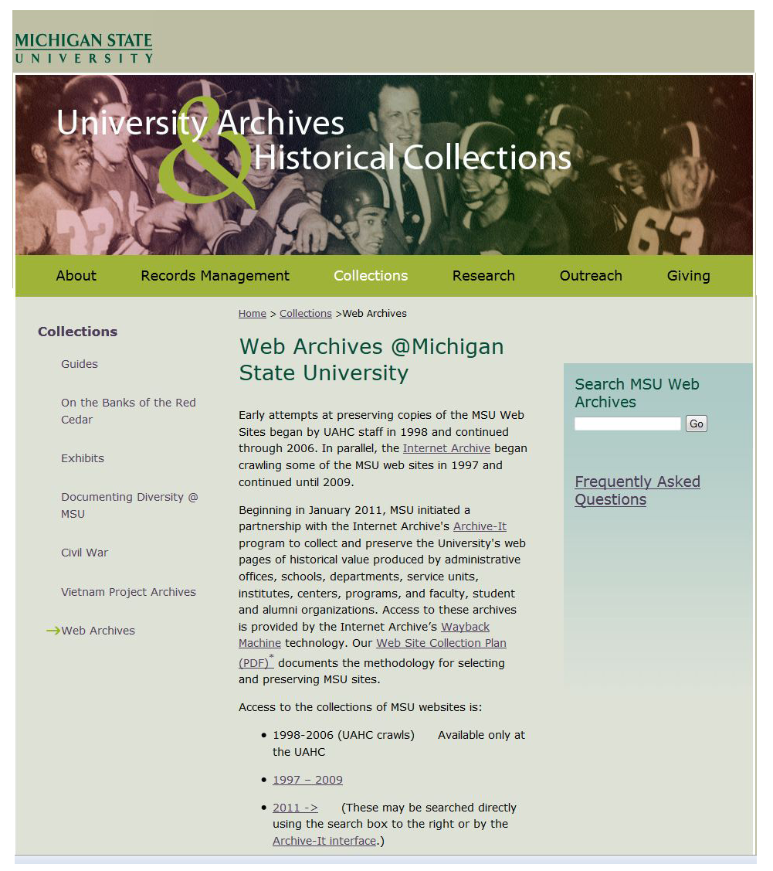
Notes:
Discuss web interface

Slide 10
What We Learned
Once you create a collection, you can’t get rid of or combine
What’s the best collection creation strategy- to lump or not
Some sites are just difficult to crawl – recursive issues
Using regular expressions and constraints
Lots of test runs – takes time
Creating useful metadata
What can be useful at the collection level?
When to do document level? (Can it be automated?)
Number of Seeds – too many at MSU to fit basic subscription
Either expand subscription or activate / deactivate collections
Web Archiving requires more staff time than expected

Slide 11
What Is Next
Refine our collections
Add more university seeds and deal with problem ones
Add Social Media
Quality check
When there is time
Add metadata (especially with new public interface)
Outreach to campus units
Notes:
Can an old dog learn regular expressions?
Add Facebook
Get help from units to point out problems

Slide 12
Contact
Ed Busch
Electronic Records Archivist
buschedw@msu.edu

Slide 13
Notes:
Surveying class photo: Taken in 1885, which was the beginning of the engineering course, the second major offered at the college. The students are all juniors or seniors. At this point in college history, there was no women’s course, so the women were taking the same courses as the men.

