Slide 1
University of Alberta Libraries: Bringing in the Harvest
Archive-It Partners Meeting .: October 2011 .: Geoff Harder

Slide 2
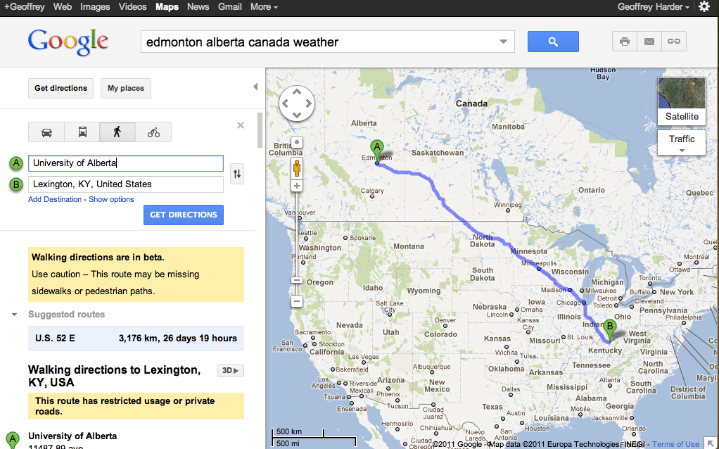

Slide 3
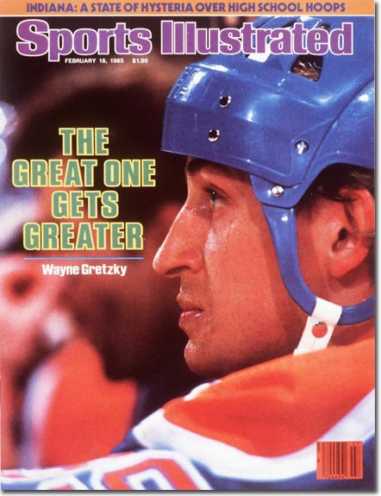

Slide 4
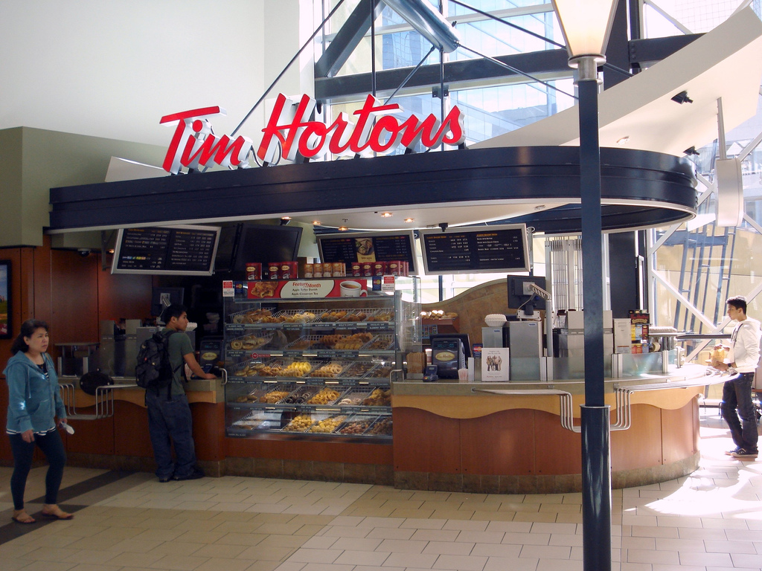
http://www.flickr.com/photos/markjms/1352382350

Slide 5
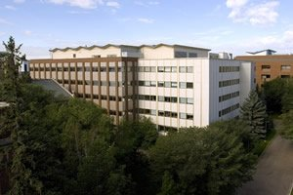
University of Alberta Libraries:
2nd largest academic and research collection in Canada
#12 in ARL rankings
Strong digital initiatives and digital collections program

Slide 6
Why web archiving?
Recognized the gap
Too much (western) Canadian online content disappearing.
Not enough attention being paid by libraries and other memory institutions to the born digital content originating from new publishing streams.
Historically important events happening all around us
Social media/citizen journalism in particular shines a spotlight on the temporary nature of today’s “news”
Strong digital collections and digital preservation program
Digitization, repositories, ejournals, research data, DP leader in Canada – why would we ignore web content?
Needed a catalyst for action…

Slide 7
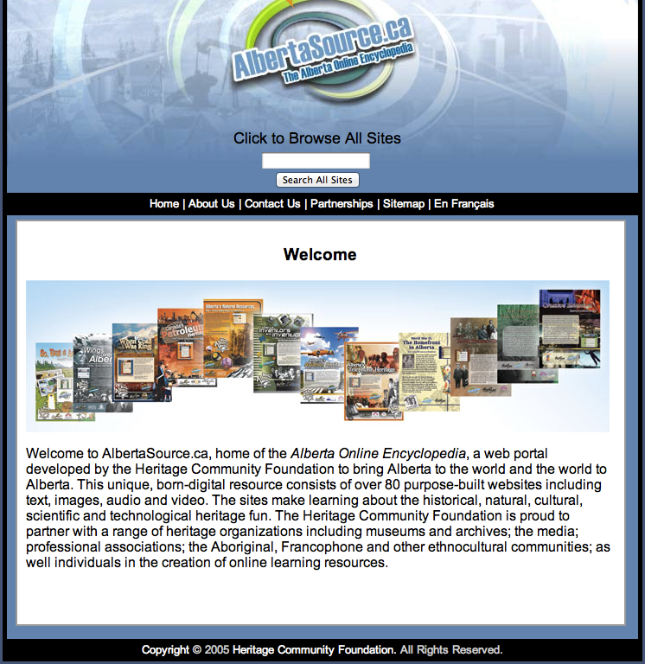
Collection Rescue
Non-profit foundation ceases to be
Created 80+ websites with research and informational value
Rescue operation required!
Multitude of technologies and file formats used over the course of a decade of construction

Slide 8
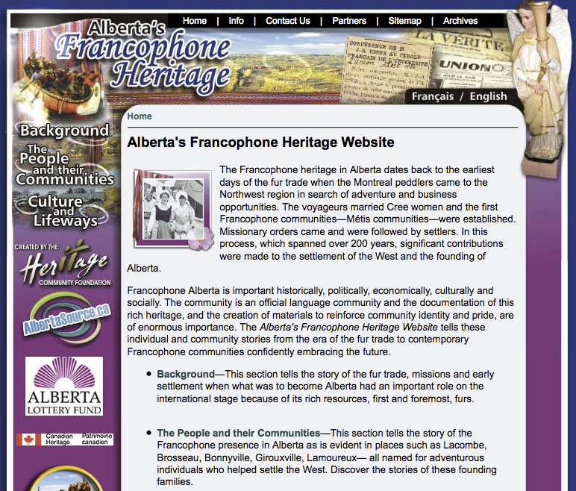

Slide 13
Rescue 911: The Alberta Encyclopedia
Projected to be an expensive, resource (i.e. time) intensive undertaking to stabilize websites, patch security holes, deal with hardware, etc.
Issues around having 80+ new puppy dogs that would need ongoing care and attention
Goal was to *preserve the material in the spirit it was created*
Decision to take a web archiving approach to the project as opposed to a web hosting approach made the most sense

Slide 14
Rescue 911: The Alberta Encyclopedia
Hired recently graduated SLIS student on short term contract to optimize the sites
Control over the content meant we could test the crawling and modify the content as required – learned what Archive-It can and can’t do
Addressed content hidden behind database searching by creating sitemaps and browsable indexes
Converted multimedia files for improved playability
Archive-It’s searching made up for loss of native search (in many cases resulting in improved searchability)
**Recognized the value of Archive-It as a lightweight, economical tool for saving orphaned and at risk web content where we know a time bomb is ticking
e.g. International Polar Year; grant funded research project home pages

Slide 15
Interesting sidebars:
Discoverability through Google and other search engines – how best to redirect traffic and rankings to popular materials?
- working with IA to expose HCF archived content to search engines
Managing expectations – materials can’t be edited
- This is not a “hosting” solution
- It is archiving -- extended archiving service to HCF partners looking to take, edit and grow *their* web material with another host

Slide 16
What else could we use Archive-It for?
End the printing of hard copies of born digital materials for our collection
Education curriculum collection
born digital material produced yearly by AB Learning, Provincial Gov’t – limited to no archiving
Required someone to monitor sites; print out materials which would then be catalogued for in-person use
Recognized opportunity to point and scope crawler to do regular harvesting – materials could still be catalogued (if warranted)
Captures curriculum, supplements, related information, and context of the materials and their creation, i.e. can navigate the materials within the historical context of their publication

Slide 17
What more can we do?
Preserve University of Alberta’s web presence
No brainer – important to the University; many of the websites hadn’t been crawled by IA’s Wayback Machine in many years due to robots.txt restrictions and other issues.
University Admin immediately interested in the project
University’s web presence rounds out a view of the University as documented in the University Archives (for many units and departments, digital record keeping is still a work in progress)

Slide 18
Collections and Liasion/Subject Librarians
Growing the collection
Begins with a collection policy and an expanded view of what constitutes a research collection
Collections of strength
Collections of interest
Library of Record
Format agnostic – base decisions around research value, not just around containers
Identify the materials a collection ought to have. Step two is to find the tools and the resources to make it happen. Step three is about priorities.

Slide 19
The UAlberta Experience
Growing interest from units and subject liaison librarians
Enthusiasm tempered only by lack of time to do this work
Emerging models:
Liaison(s) selector/curator of a collection
Other staff can assist in identifying materials, setting up the crawls, monitoring changes
Metadata and cataloguing support where appropriate
Interdisciplinary approach to current events – all hands on deck to help build time-sensitive collections
Possibility of partnering with the library school, or creating internship opportunities and so forth

Slide 20
Permissions and copyright
Rights and permissions
IP issues remain a fuzzy area
Public record – e.g. political party websites, vs. clearly copyrighted material
Federal and provincial government materials
Preserving context – not rebranding and repurposing content – finding that most people/organizations understand why we’re trying to do this work.
Approaching content creators to be partners – Recognize the value of their material as important to the historical record. “We’re doing something that helps you.”

Slide 21
Areas to explore
Metrics and discovery
Need a discovery strategy that works for web archives
Archive gateway?
Catalogue?
Primo or other discovery layers?
Are there other ways to integrate/indicate the archived versions of web content?
Better metrics would help us understand how the archived materials are being used and discovered

Slide 22
Title image credit: http://www.flickr.com/photos/28931095@N03/3932513534/sizes/l/in/photostream/
Geoff Harder
Digital Initiatives Coordinator, U of A Libraries
geoffrey.harder@ualberta.ca

